Slide 1

ČGM mikrorezonatora uzpumpēšanas par frekvenču ķemmi modelēšana
ERAF Projekts Nr. 1.1.1.1/18/A/155
Kristians Draguns
12.02.2021

Slide 2
Saturs
Aktualitāte
Čukstošās galerijas modas (ČGM)
Dispersijas analīze
Frekvenču ķemmes modelēšana
  Lugiato-Lefevēra vienādojums
  Brīvā koda progammatūra pyLLE
Secinājumi

Slide 3
Aktualitāte
Stipra gaismas un vielas mijiedarbība
Pielietojumi telekomunikācijās
Pielietojumi optiskajos atompulksteņos, astronomijā, augstas izšķirtspējas spektroskopijā

Slide 4
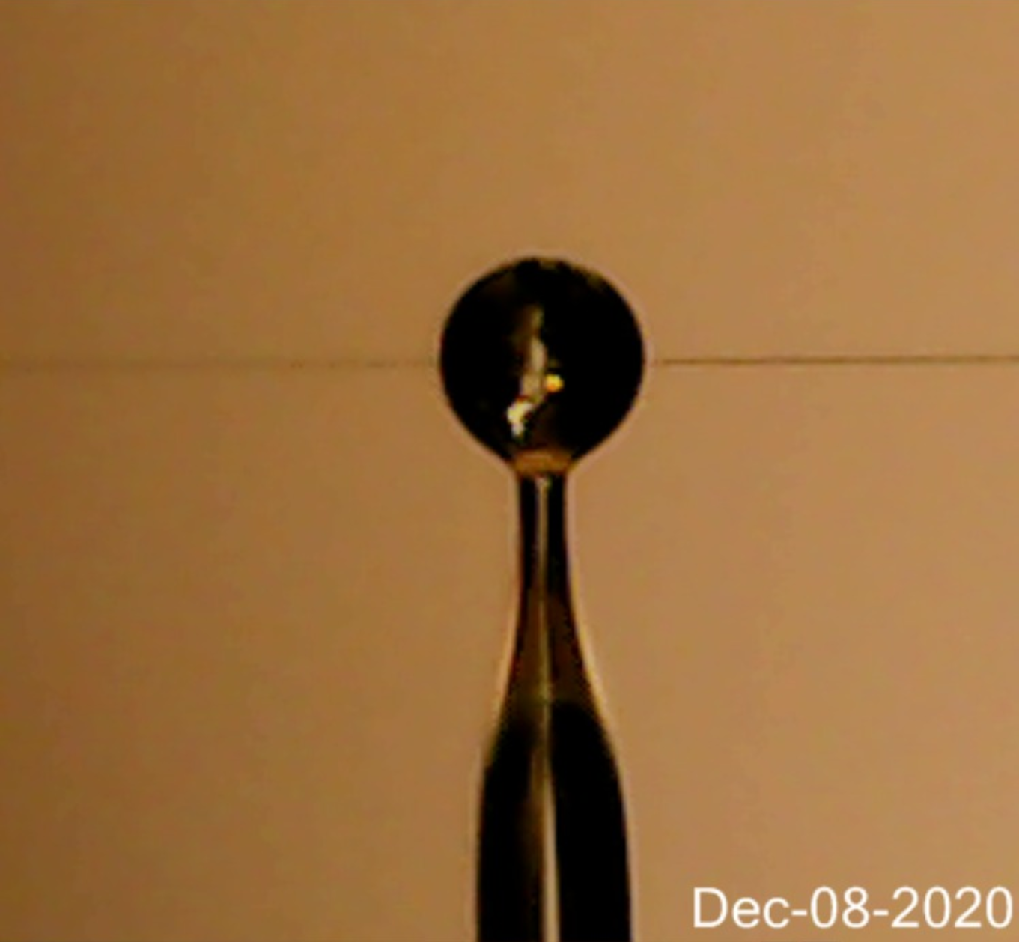
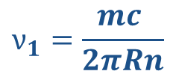

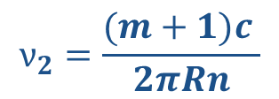

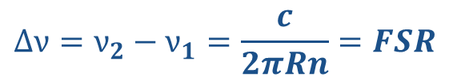
Čukstošās galerijas modas (ČGM)
$$2πRn=mλ$$
$$ν_{1}=\frac{mc }{2πRn}$$
$$ν_{2}=\frac{(m+1)c }{2πRn}$$
$$R$$
$$∆ν=ν_{2}−ν_{1}=\frac{c}{2πRn}=FSR$$

Slide 5
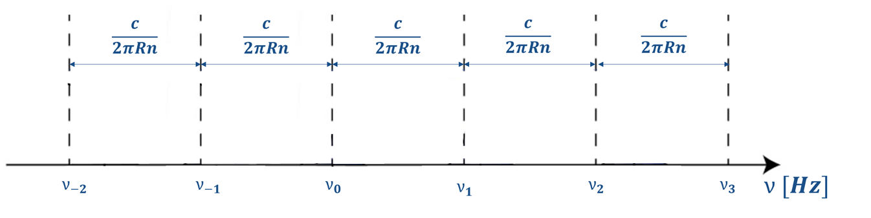
Brīvais spektrālais apgabals (FSR)

Slide 6
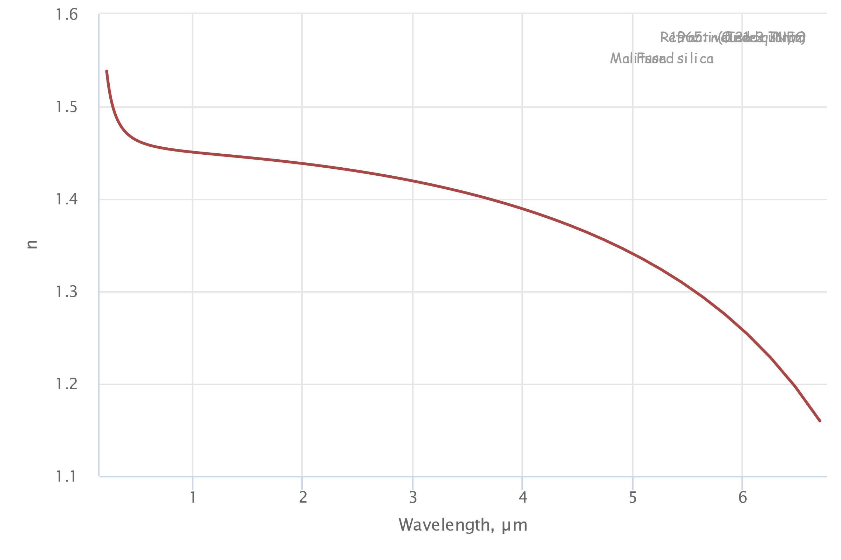

Materiālā dispersija
$$2πR\underline{n}=mλ$$
[https://refractiveindex.info/?shelf=glass&book=fused_silica&page=Malitson]

Slide 7
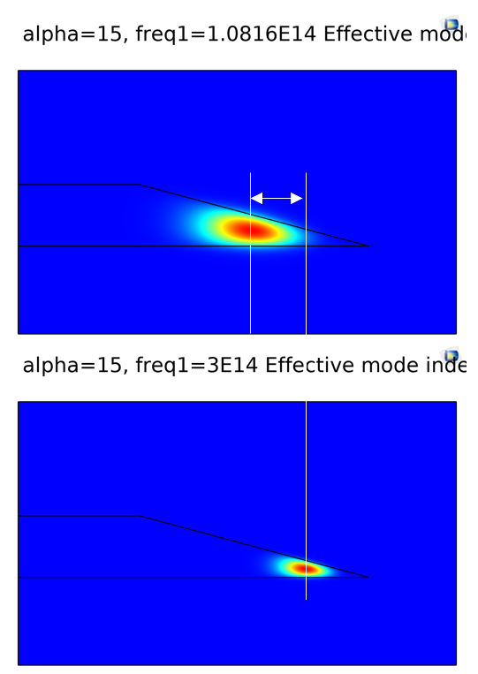

Ģeometriskā dispersija
$$2π\underline{R}n=mλ$$

Slide 8
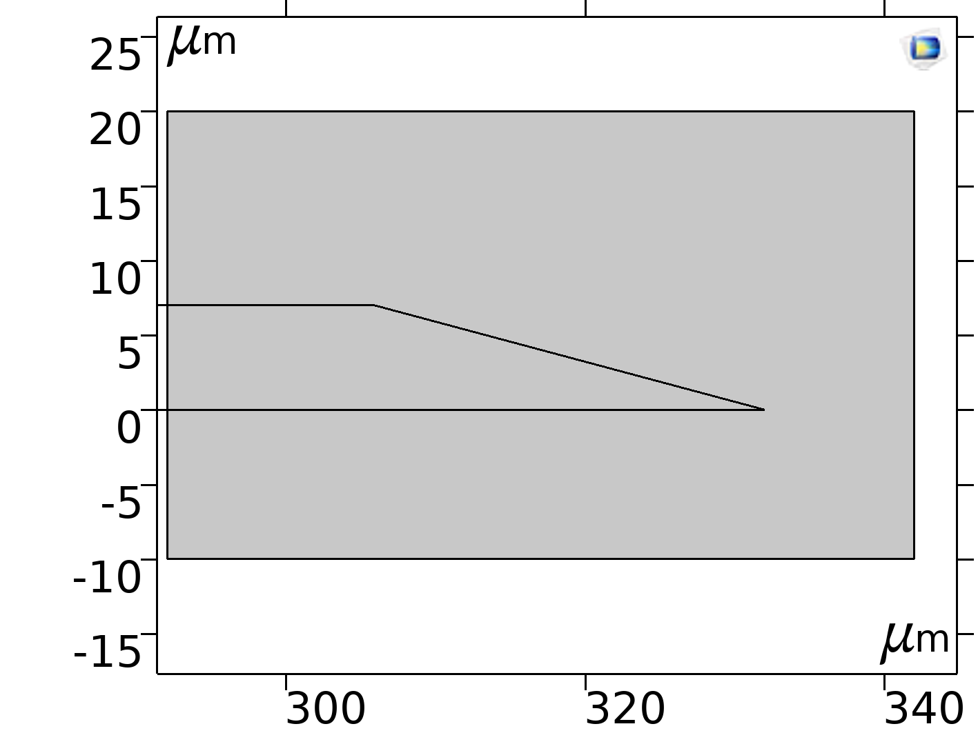
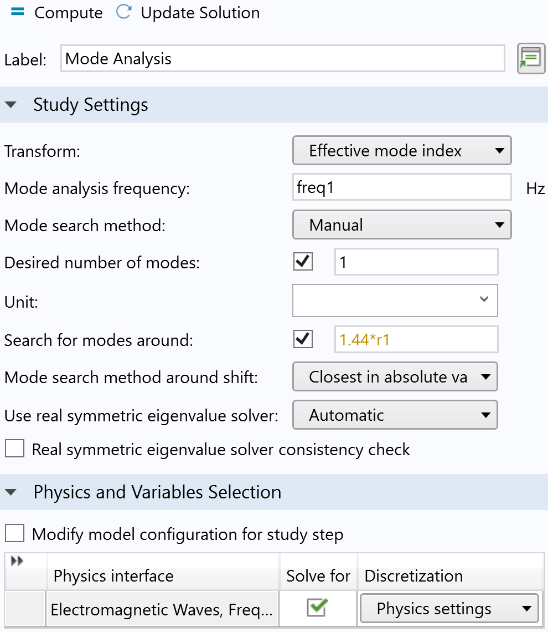
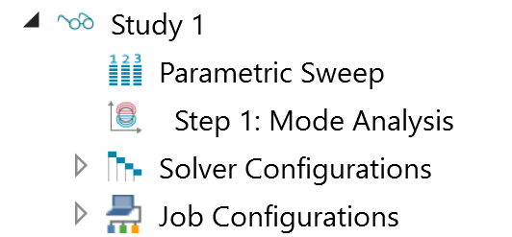
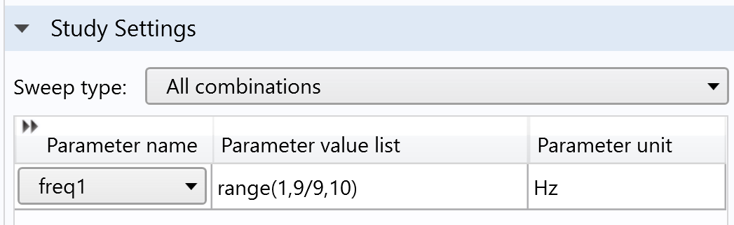
COMSOL Multiphysics Dispersijas aprēķiniem

Slide 9
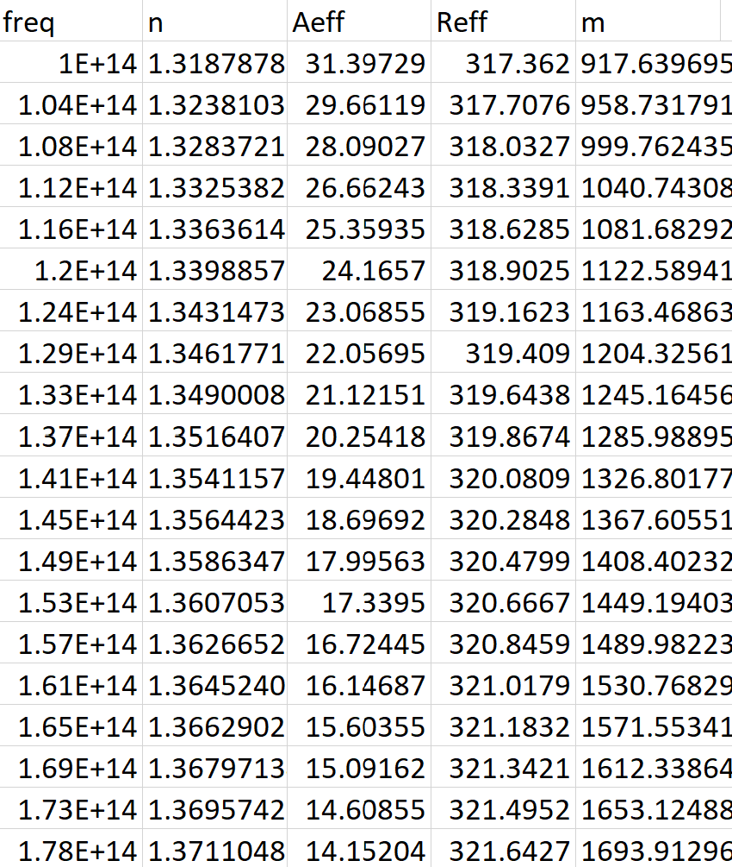
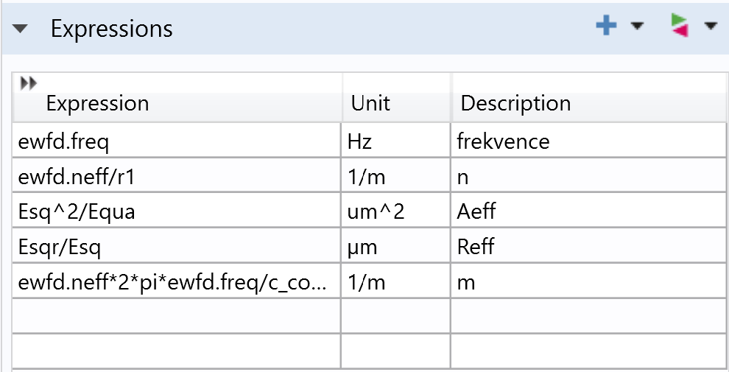
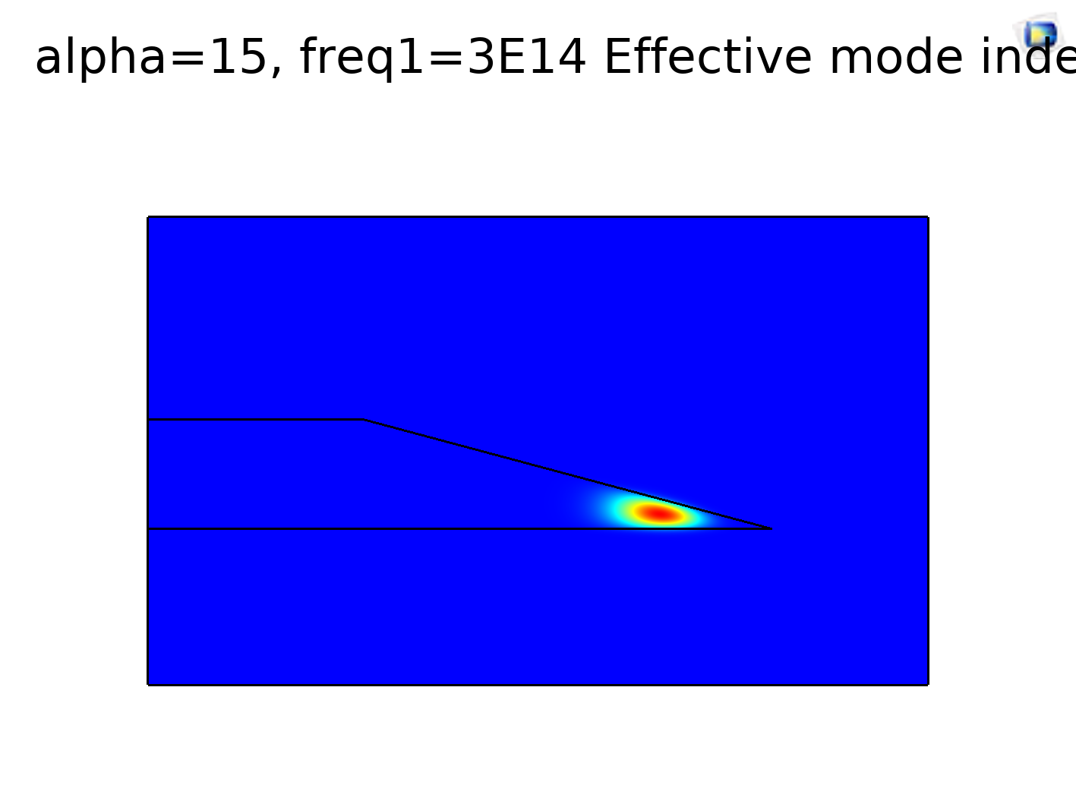

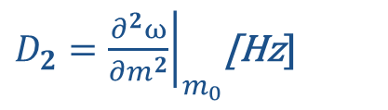
COMSOL Multiphysics Dispersijas aprēķiniem
${FSR=D}_{1}={\left.\frac{∂ω}{∂m}\right|}_{m_{0}}$[Hz]
$D_{2}={\left.\frac{∂^{2}ω}{∂m^{2}}\right|}_{m_{0}}$[Hz]

Slide 10
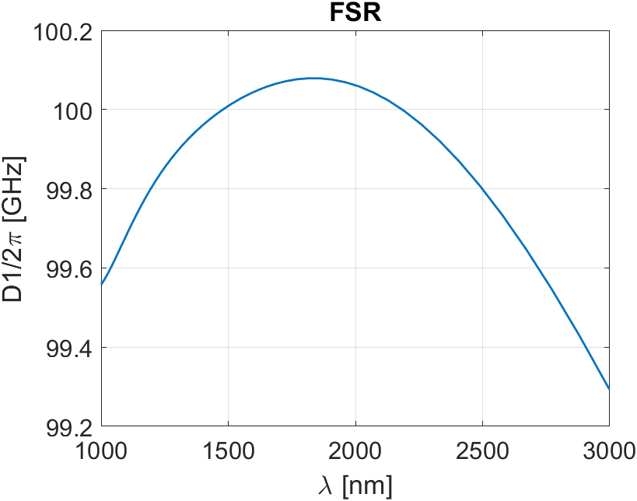
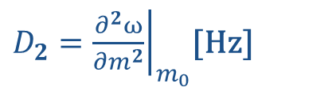


COMSOL Multiphysics Dispersijas aprēķiniem
$$ω=ω(m)$$
${FSR=D}_{1}={\left.\frac{∂ω}{∂m}\right|}_{m_{0}}$[Hz]
$D_{2}={\left.\frac{∂^{2}ω}{∂m^{2}}\right|}_{m_{0}}$[Hz]

Slide 11
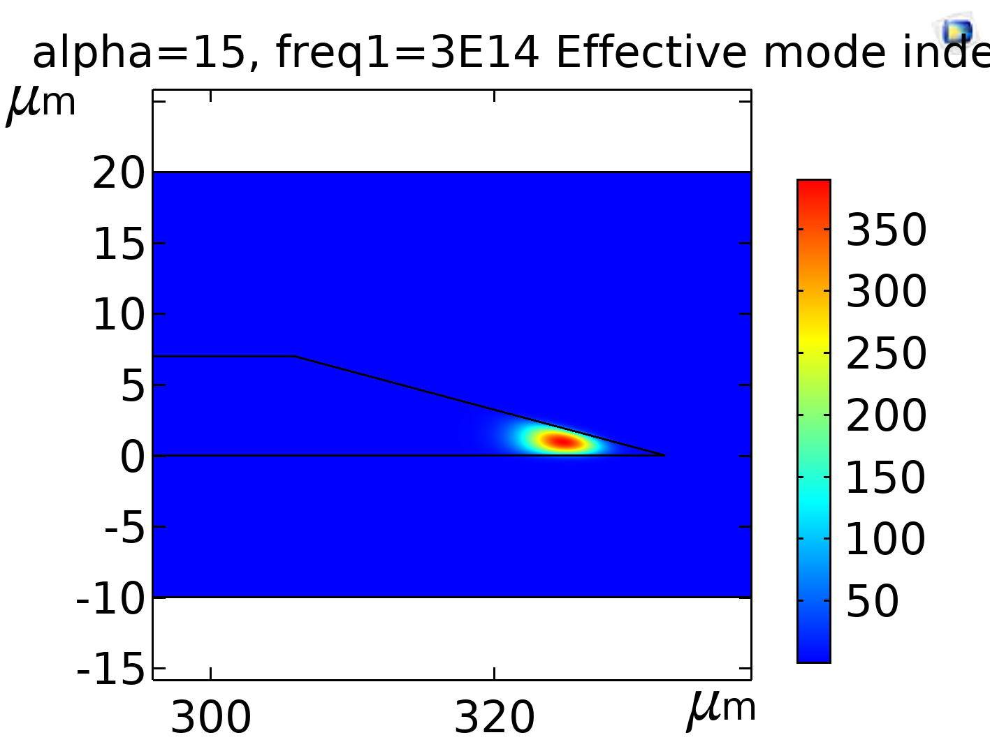
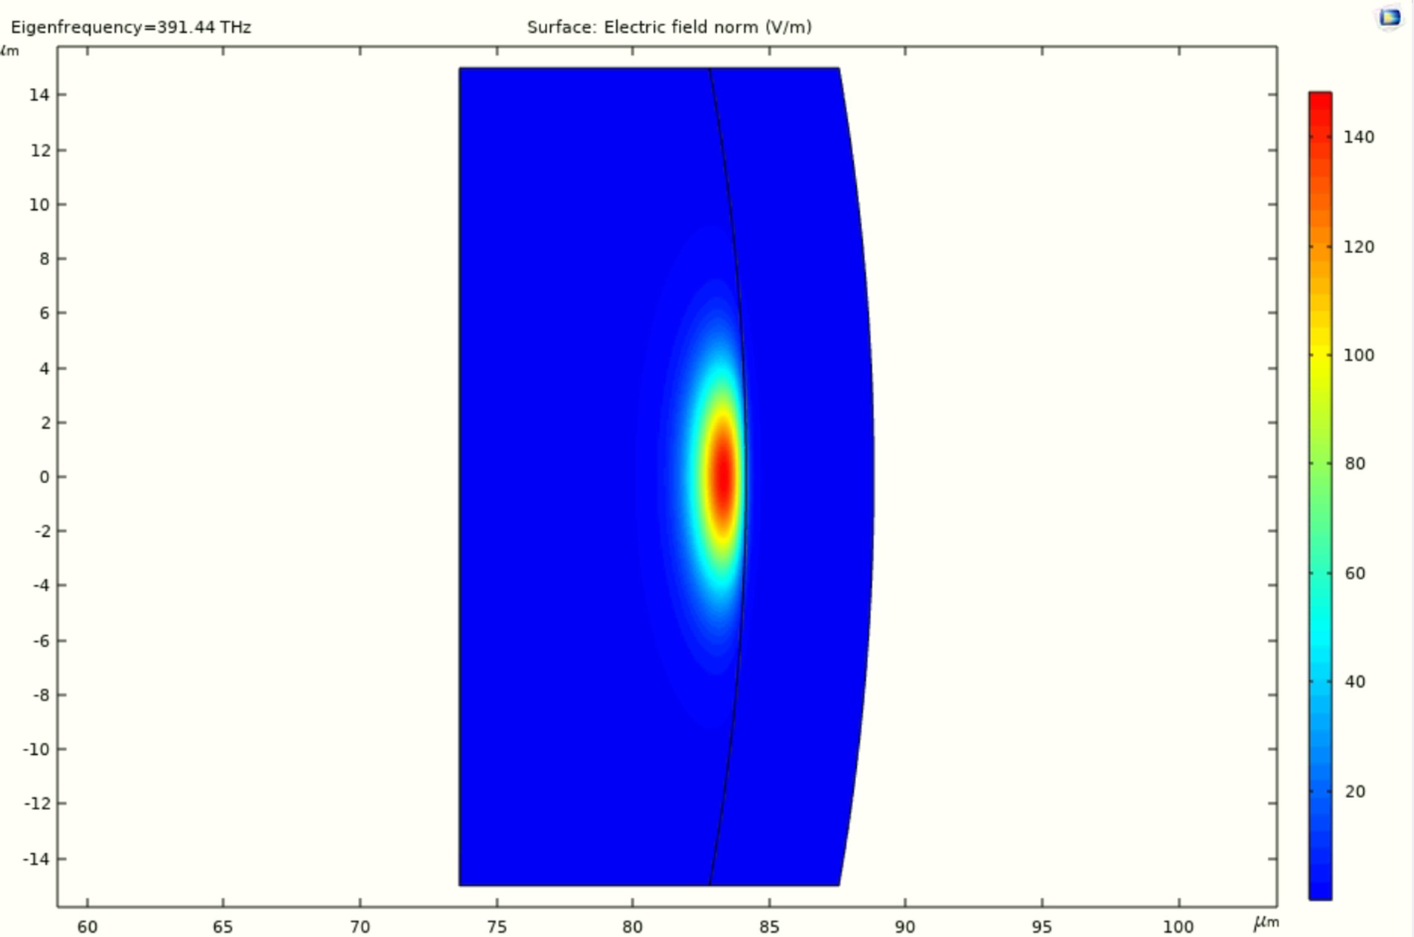
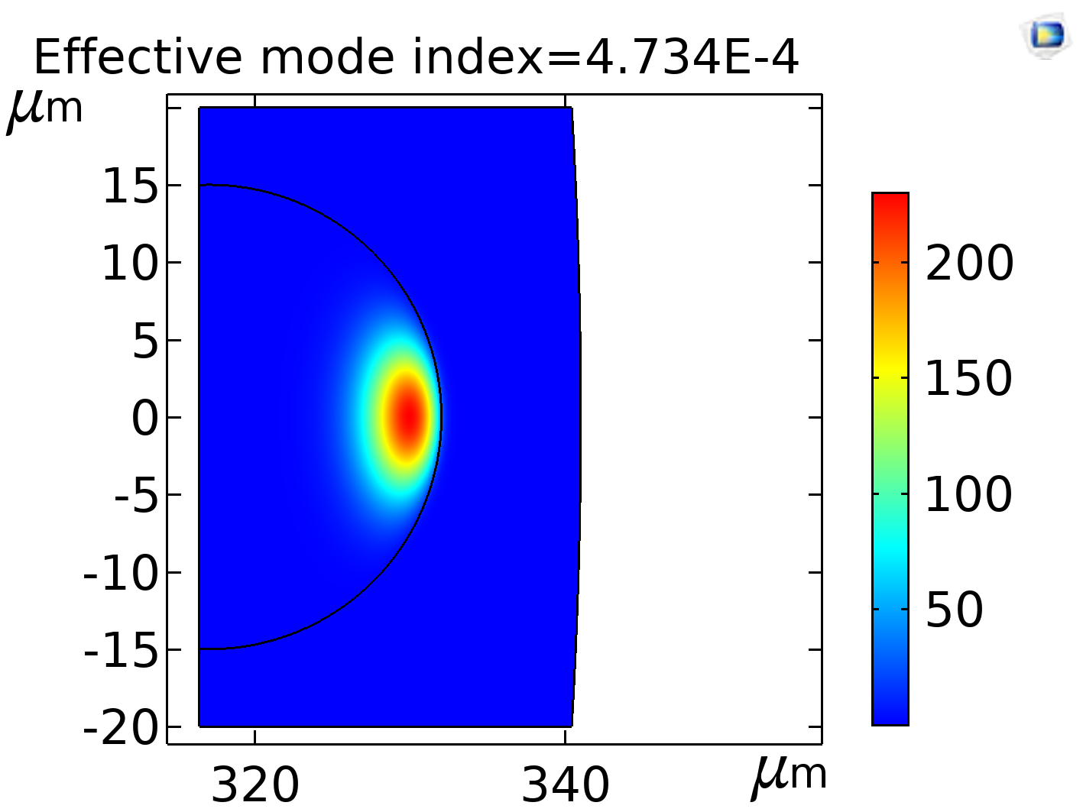
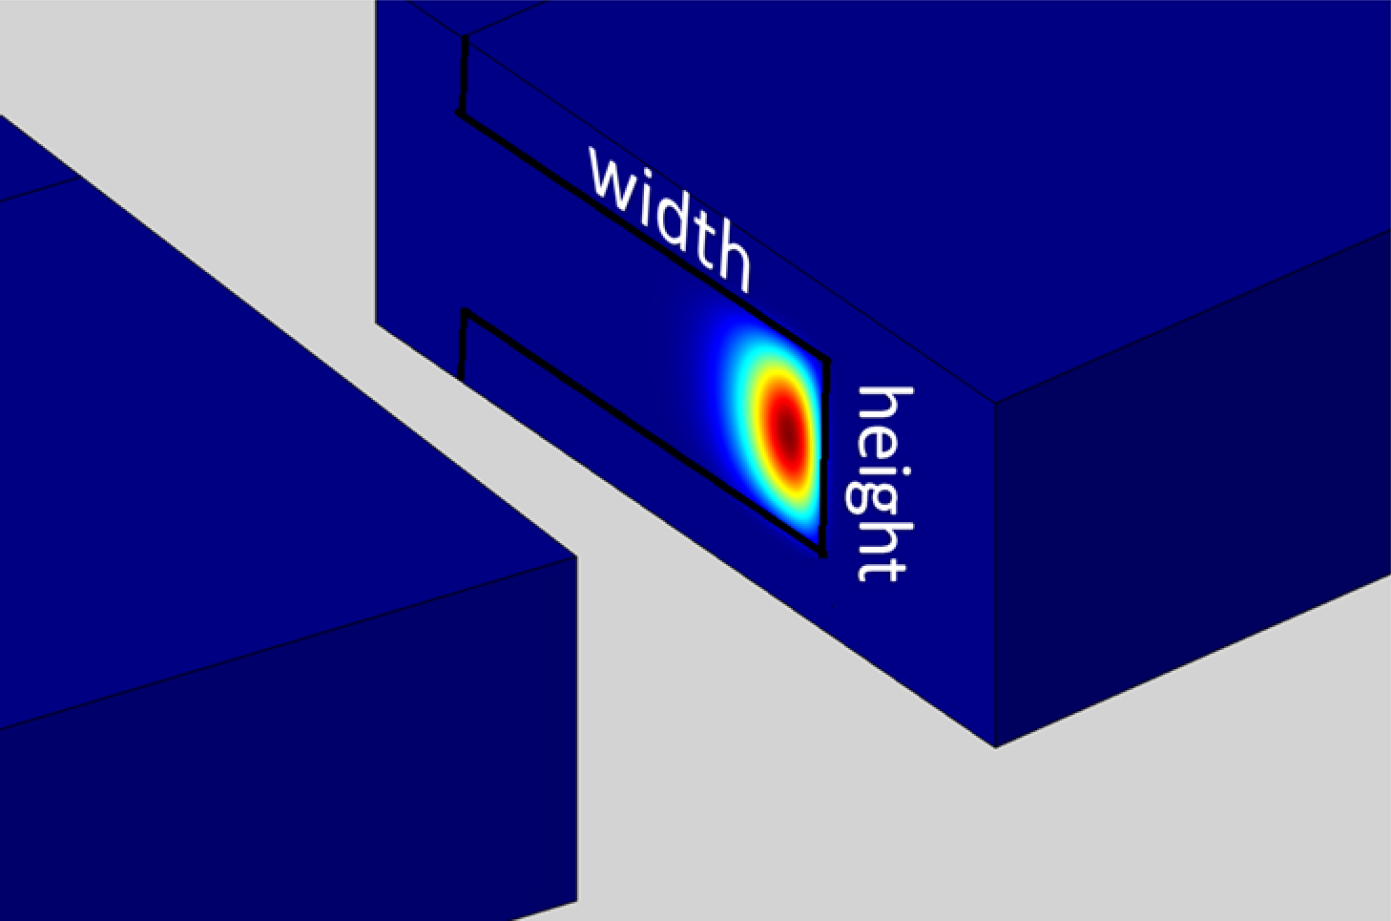
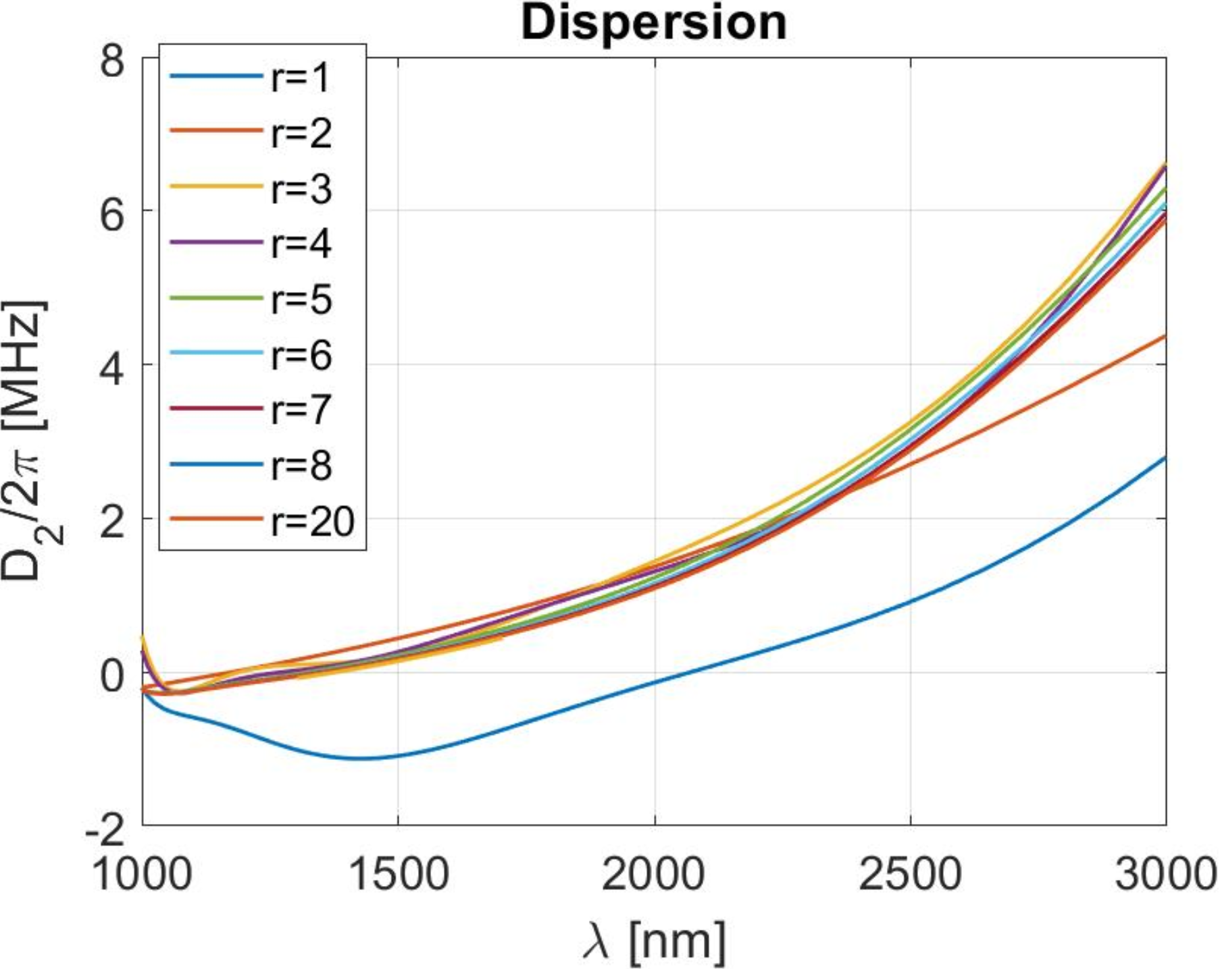
Dispersijas aprēķini dažādiem rezonatoriem

Slide 12
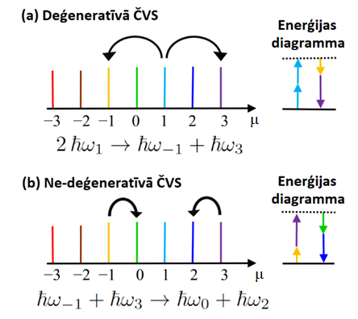
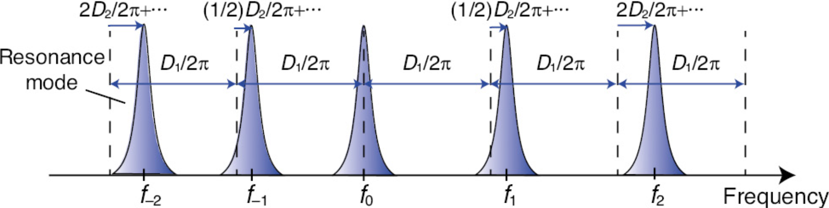
Četru viļņu samaisīšanās (ČVS)
[S. Fujii, T. Tanabe, (2020) Dispersion engineering and measurement of whispering gallery mode microresonator for Kerr frequency comb generation, Nanophotonics 9, 1087–1104]

Slide 13
Modelēšana
Lugiato-Lefevēra vienādojums
  Brīvā koda progammatūra pyLLE
[Moille, G., Li, Q., Lu, X., & Srinivasan, K. (2019). Pylle: A fast and user friendly lugiato-lefever equation solver. Journal of Research of the National Institute of Standards and Technology, 124(124012). https://doi.org/10.6028/jres.124.012]

Slide 14
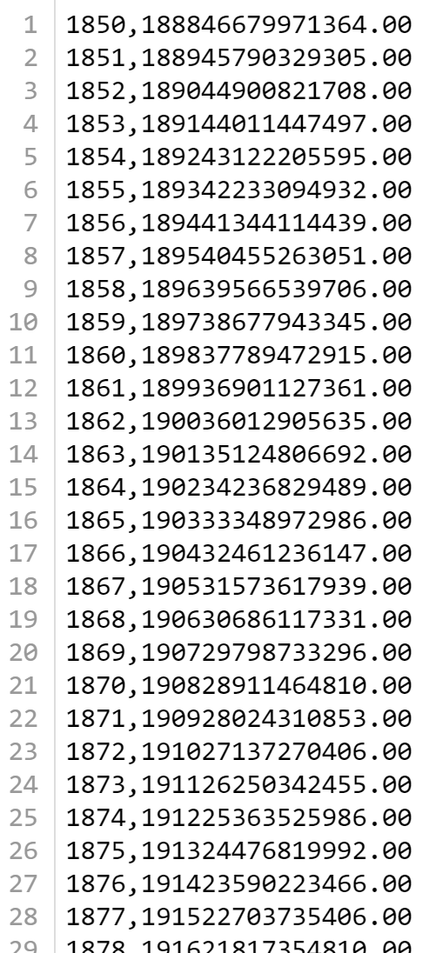
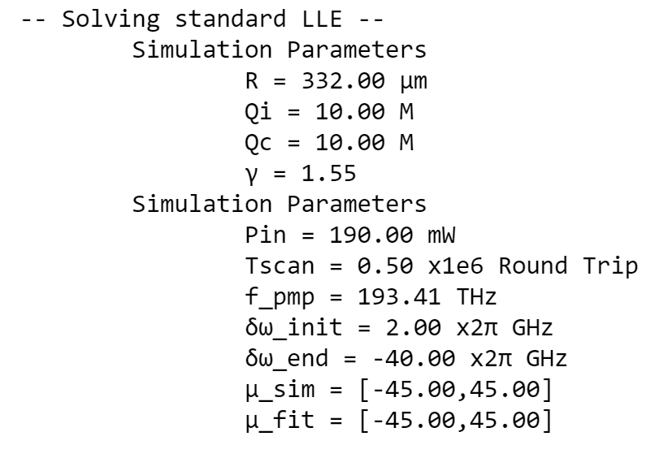
Modelēšana pyLLE
[Moille, G., Li, Q., Lu, X., & Srinivasan, K. (2019). Pylle: A fast and user friendly lugiato-lefever equation solver. Journal of Research of the National Institute of Standards and Technology, 124(124012). https://doi.org/10.6028/jres.124.012]

Slide 15
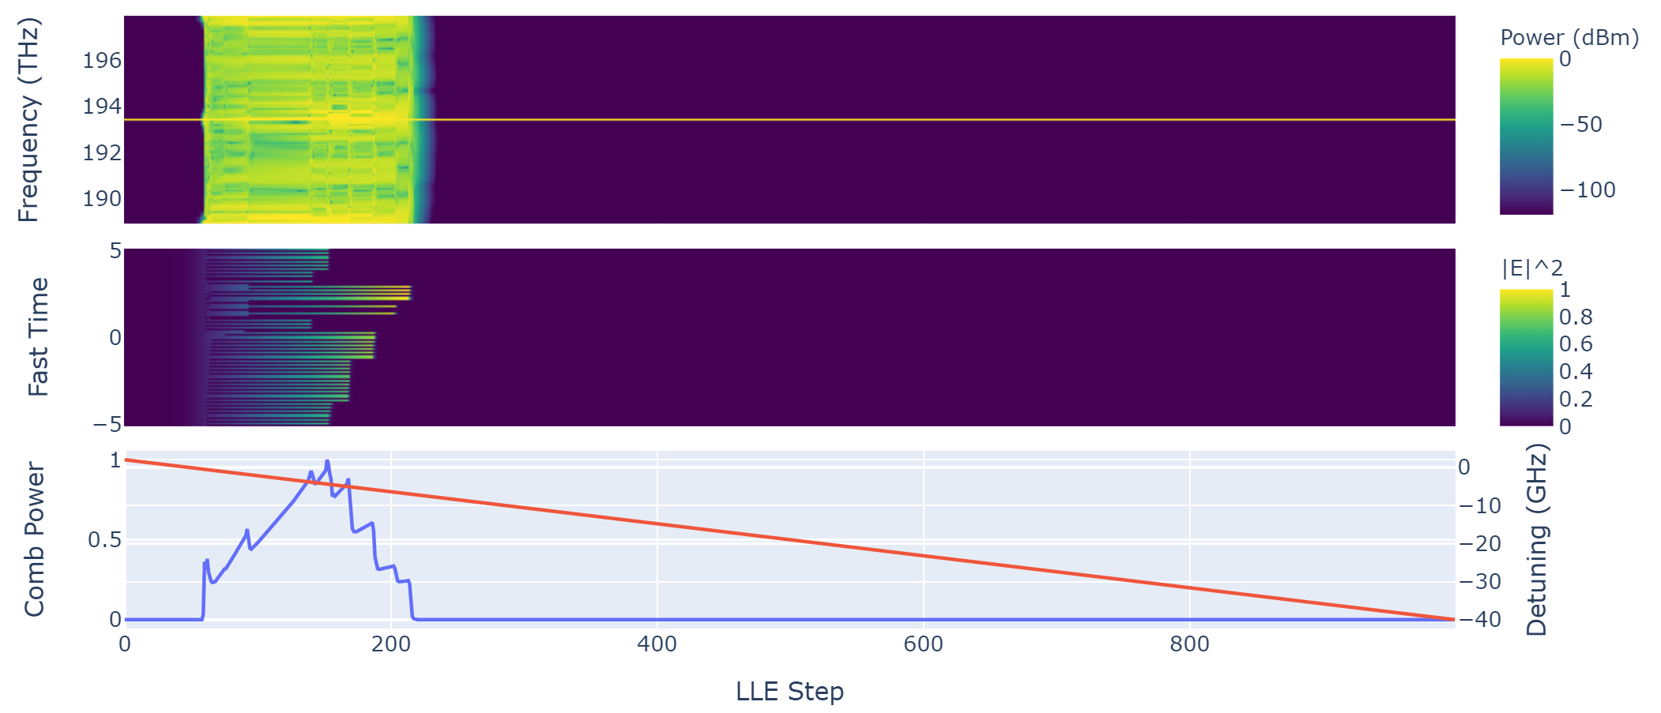
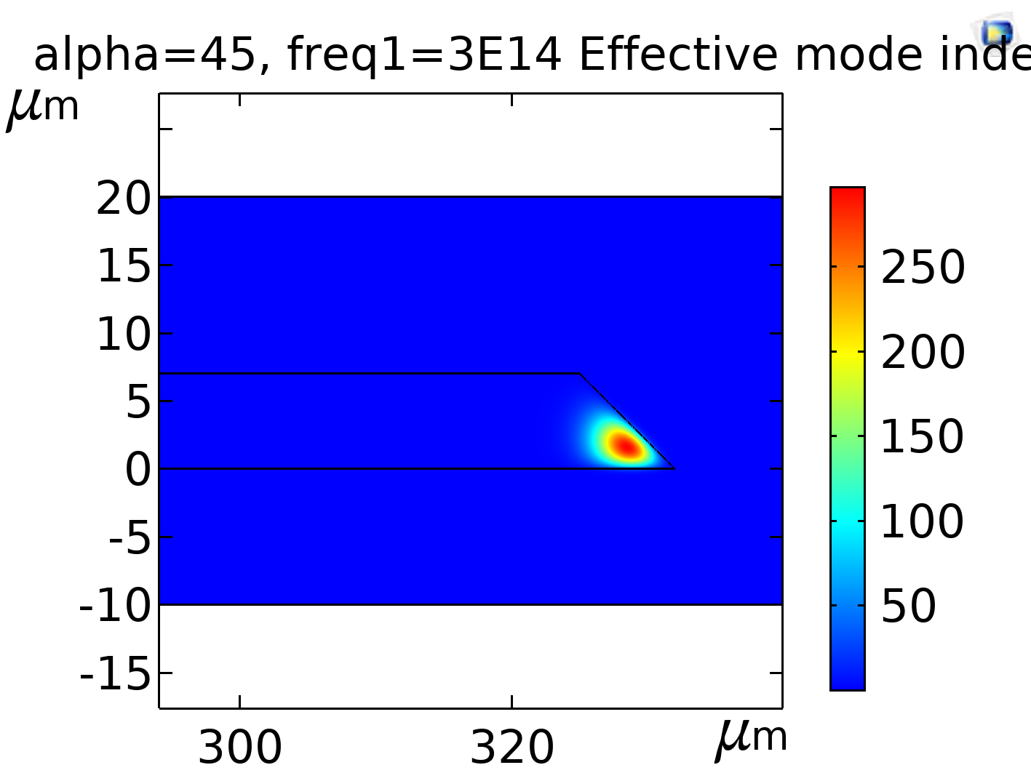
Modelēšana pyLLE
[Moille, G., Li, Q., Lu, X., & Srinivasan, K. (2019). Pylle: A fast and user friendly lugiato-lefever equation solver. Journal of Research of the National Institute of Standards and Technology, 124(124012). https://doi.org/10.6028/jres.124.012]

Slide 16
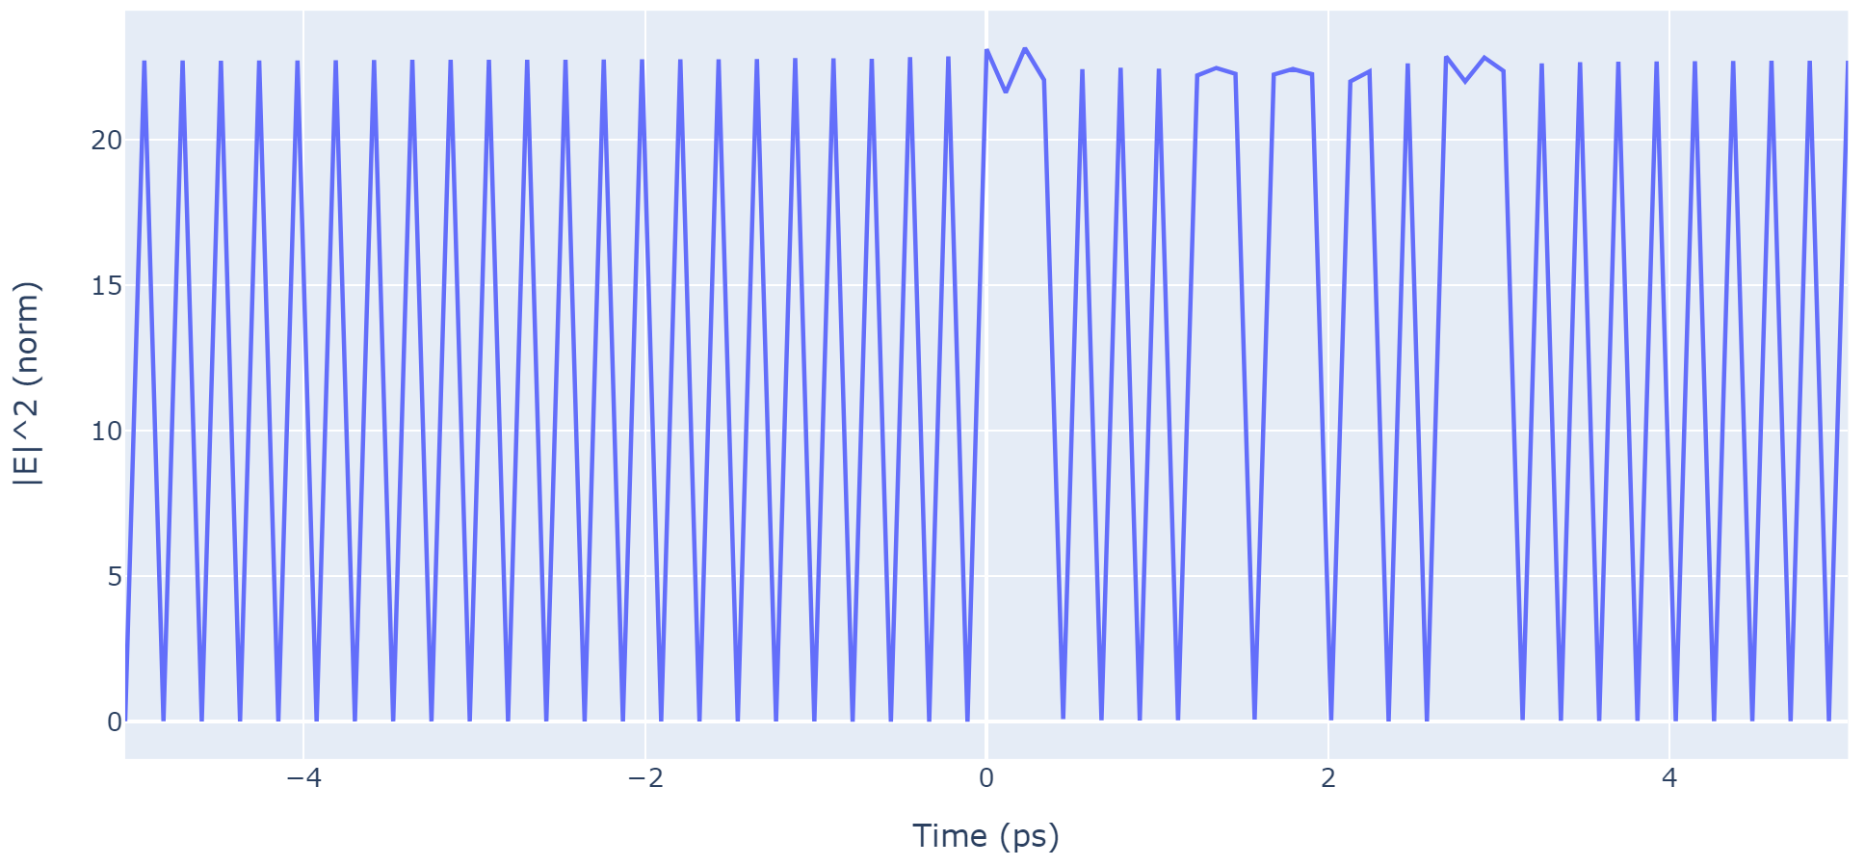
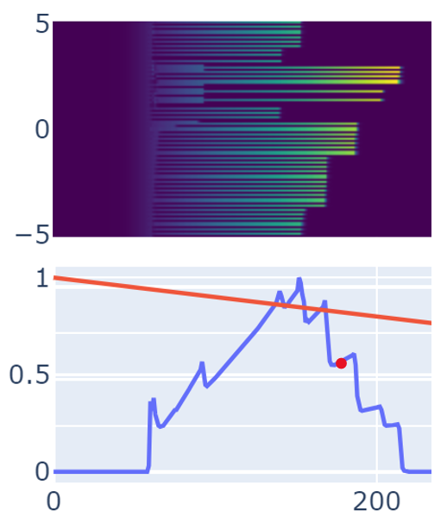
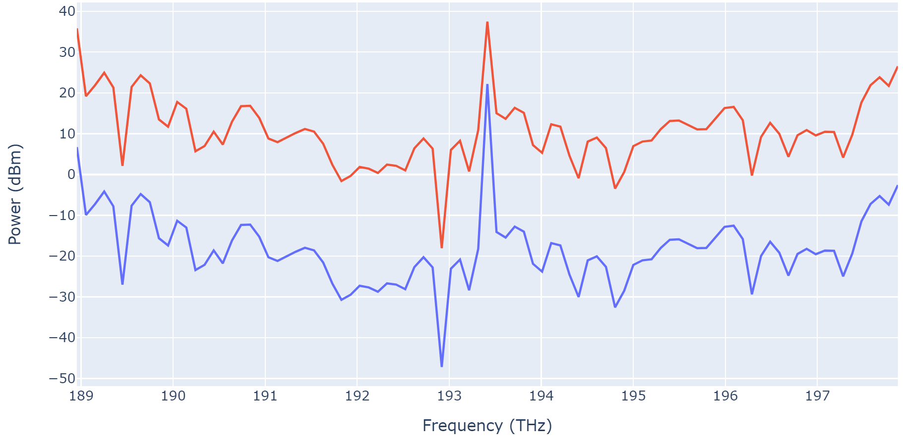
Modelēšana pyLLE
[Moille, G., Li, Q., Lu, X., & Srinivasan, K. (2019). Pylle: A fast and user friendly lugiato-lefever equation solver. Journal of Research of the National Institute of Standards and Technology, 124(124012). https://doi.org/10.6028/jres.124.012]

Slide 17
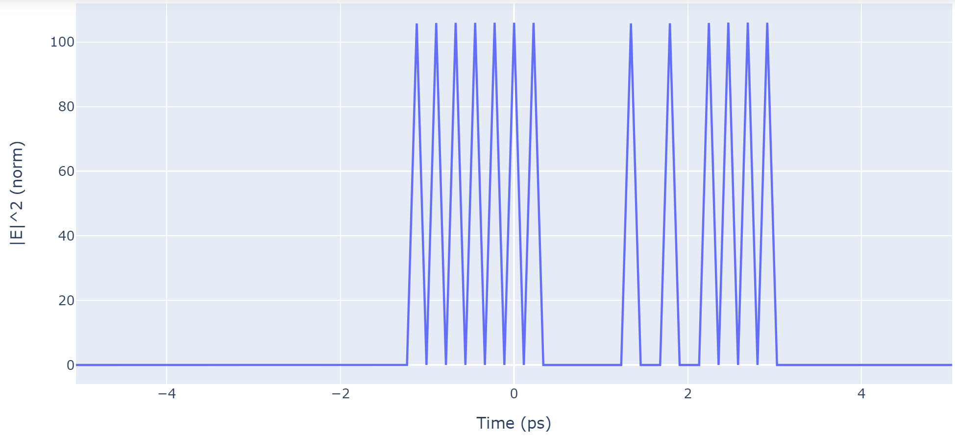
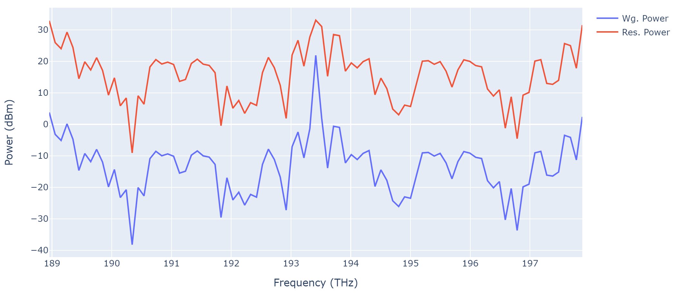
Modelēšana pyLLE
[Moille, G., Li, Q., Lu, X., & Srinivasan, K. (2019). Pylle: A fast and user friendly lugiato-lefever equation solver. Journal of Research of the National Institute of Standards and Technology, 124(124012). https://doi.org/10.6028/jres.124.012]

Slide 18
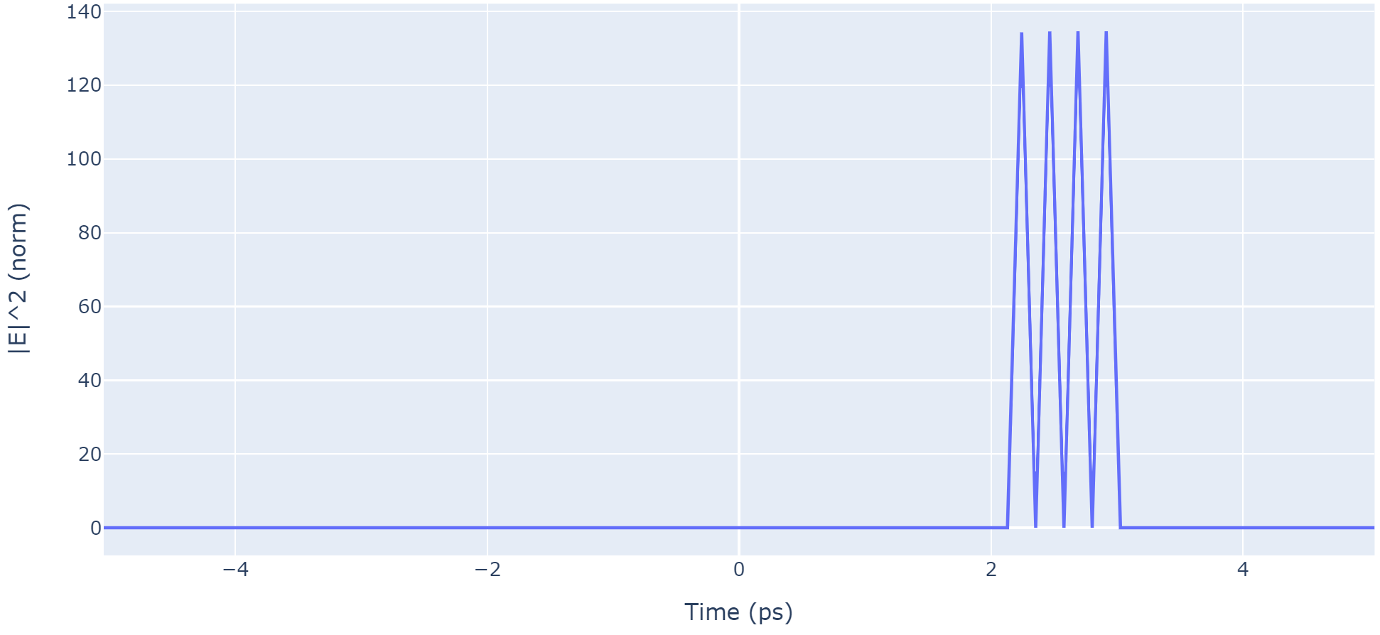
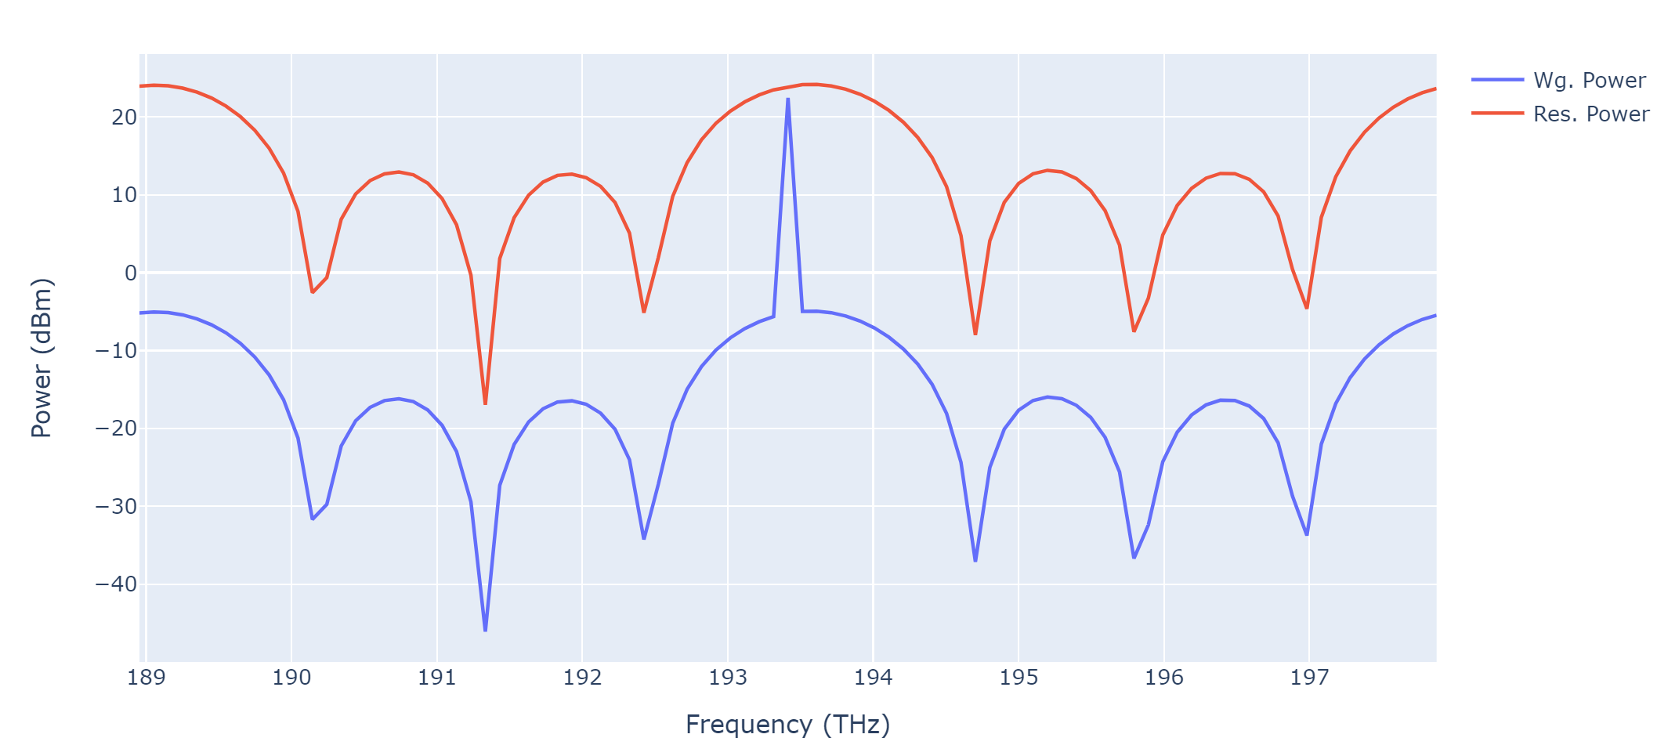
Modelēšana pyLLE
[Moille, G., Li, Q., Lu, X., & Srinivasan, K. (2019). Pylle: A fast and user friendly lugiato-lefever equation solver. Journal of Research of the National Institute of Standards and Technology, 124(124012). https://doi.org/10.6028/jres.124.012]

Slide 19
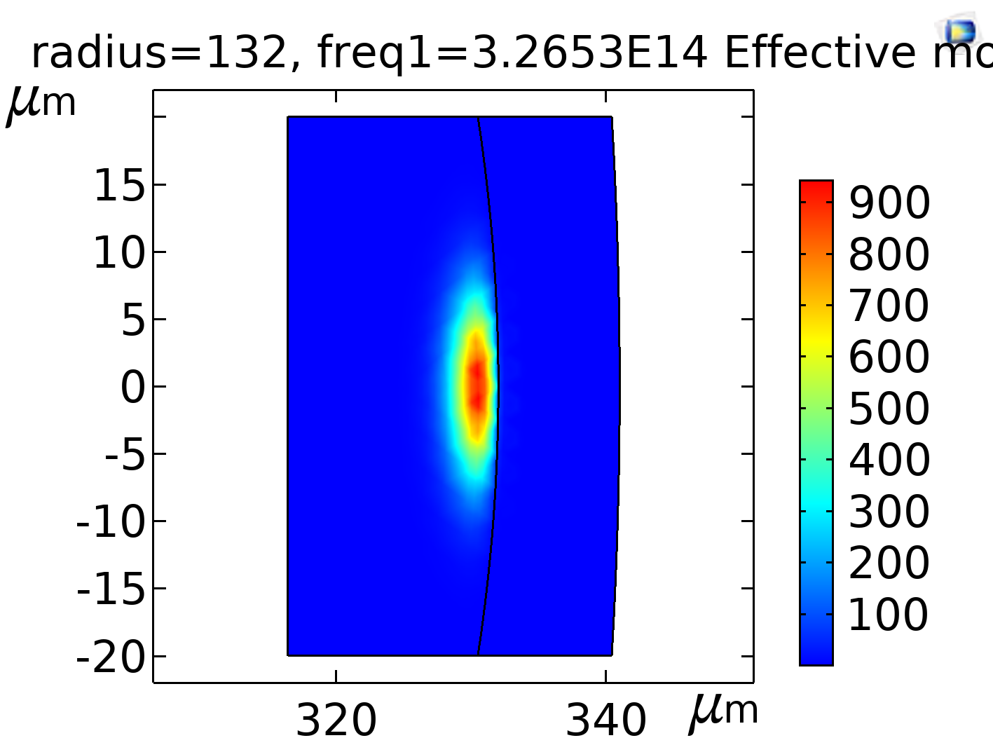
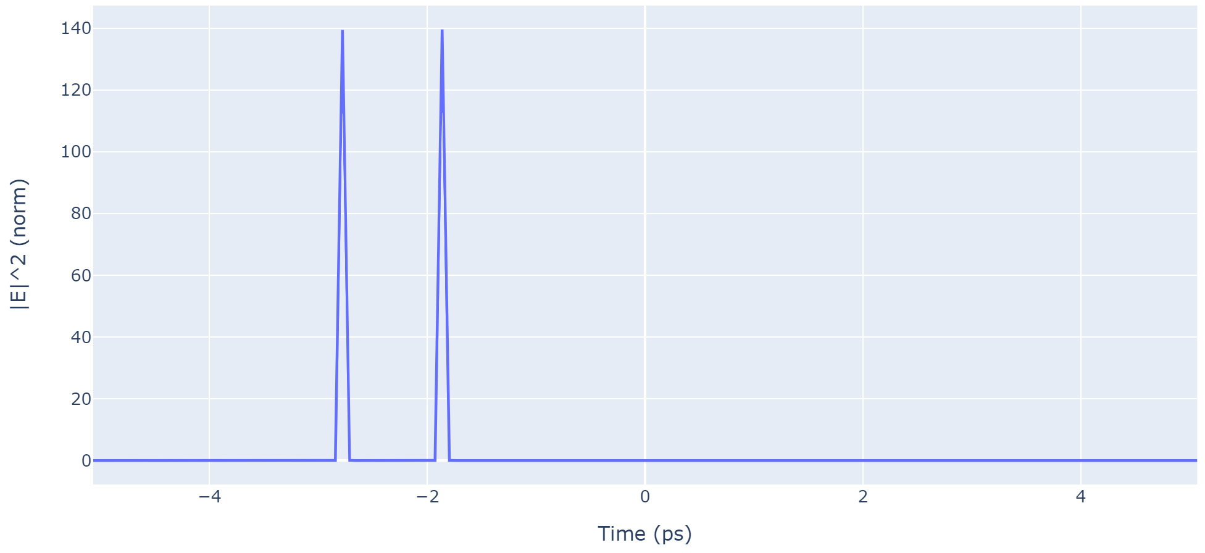
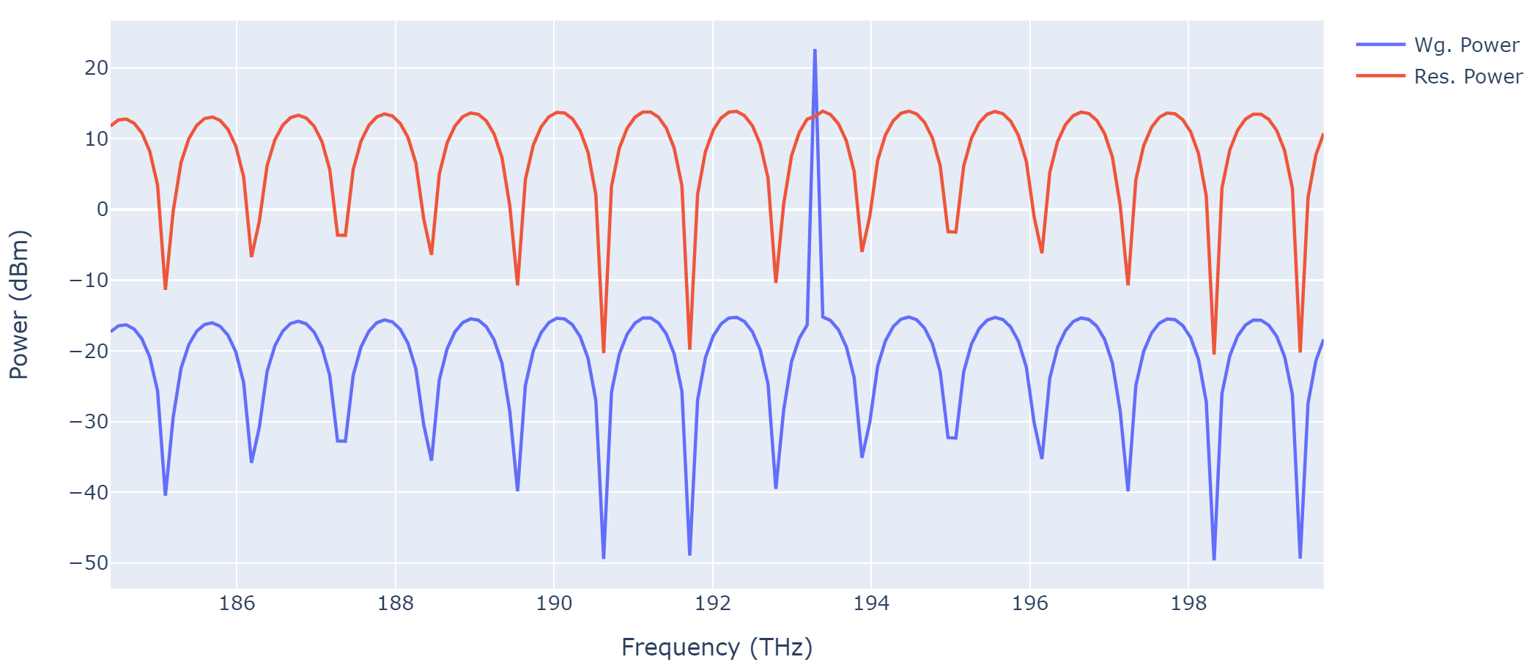
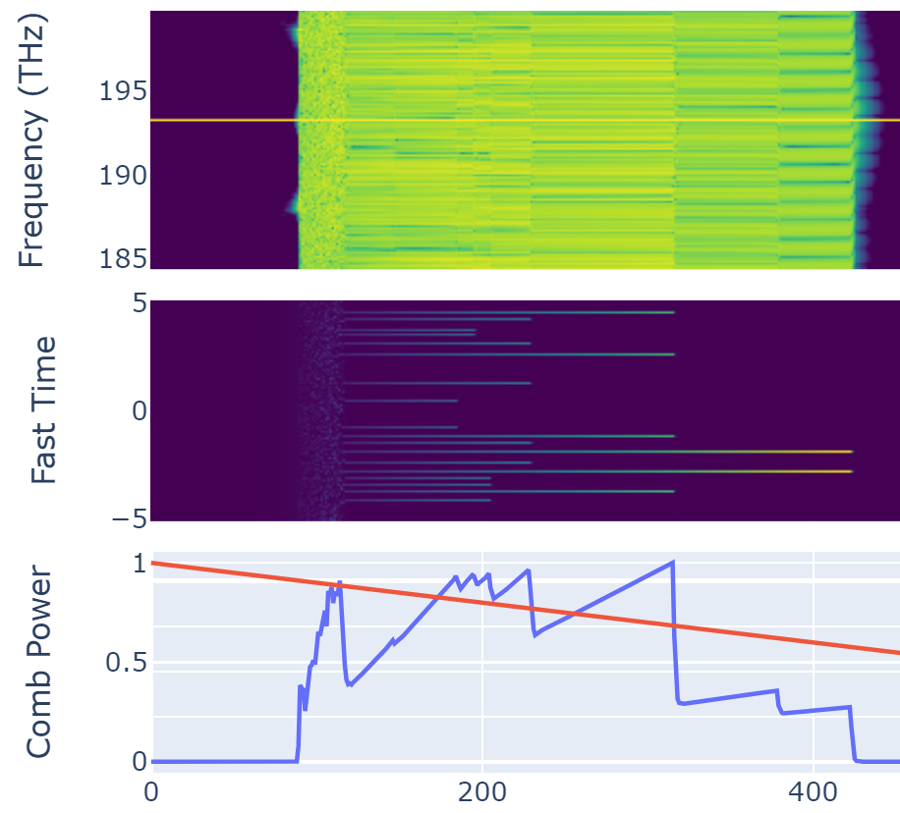
Modelēšana pyLLE
[Moille, G., Li, Q., Lu, X., & Srinivasan, K. (2019). Pylle: A fast and user friendly lugiato-lefever equation solver. Journal of Research of the National Institute of Standards and Technology, 124(124012). https://doi.org/10.6028/jres.124.012]

Slide 20
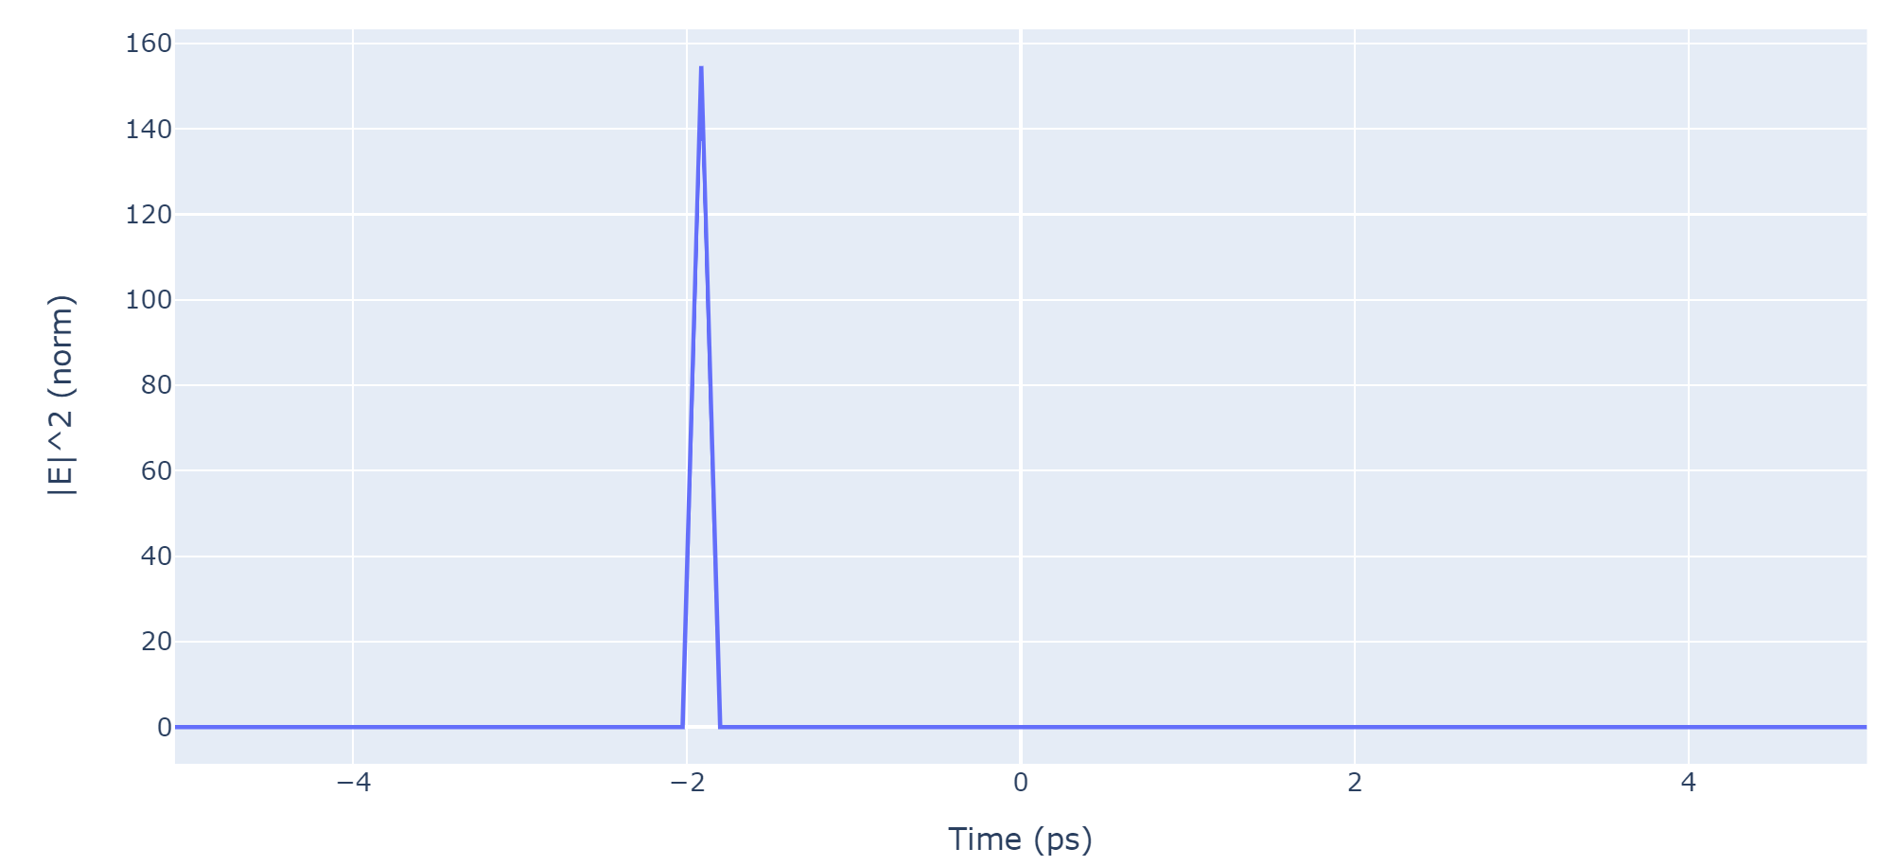
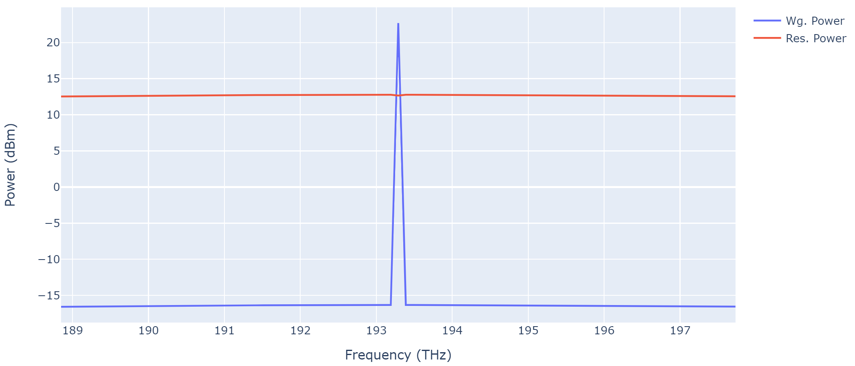
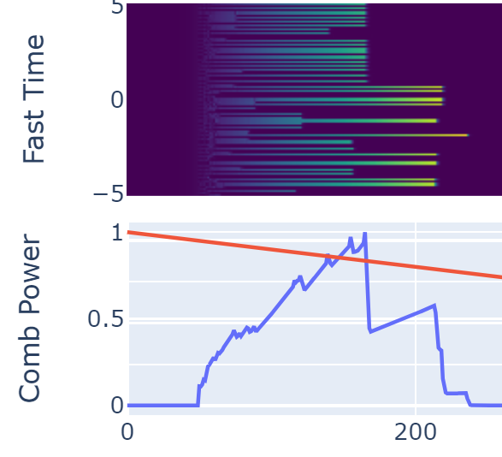
Modelēšana pyLLE
[Moille, G., Li, Q., Lu, X., & Srinivasan, K. (2019). Pylle: A fast and user friendly lugiato-lefever equation solver. Journal of Research of the National Institute of Standards and Technology, 124(124012). https://doi.org/10.6028/jres.124.012]

Slide 21
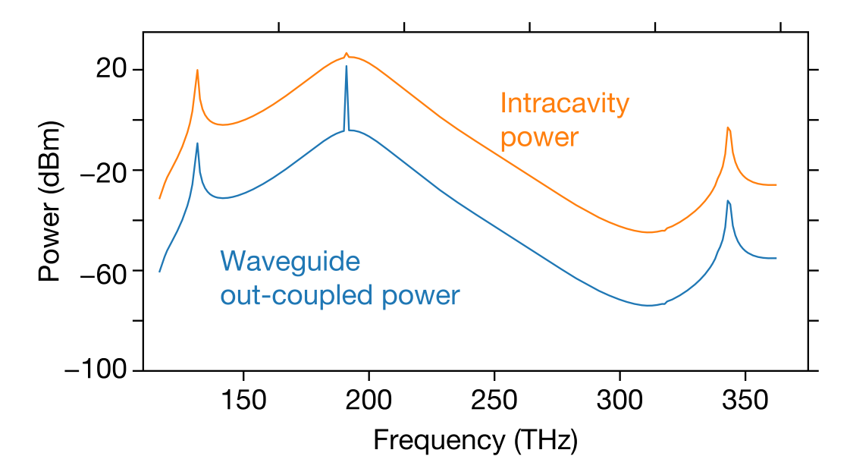
Modelēšana pyLLE
[Moille, G., Li, Q., Lu, X., & Srinivasan, K. (2019). Pylle: A fast and user friendly lugiato-lefever equation solver. Journal of Research of the National Institute of Standards and Technology, 124(124012). https://doi.org/10.6028/jres.124.012]

Slide 22
Secinājumi
Ir veikta dispersijas analīze dažāda veida rezonatoriem
Ar simulāciju palīdzību iespējams noteikt pie kādiem rezonatora parametriem veidosies frekvenču ķemme
Veiktas frekvenču ķemmes simulācijas
Pie toroīda ar mazo r=132 μm ir atrasts viena solitona režīms, kas veido labu frekvenču ķemmi

Slide 23

Paldies par uzmanību!

