Slide 1
Biophotonic techniques for rare disease diagnostics and evaluation of antibacterial resistance
Researcher Emilija V. Plorina
Institute of Atomic Physics and Spectroscopy

Slide 2
Rare disease diagnostics with multispectral imaging

Slide 3
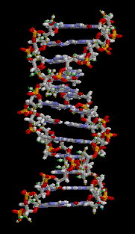
WHAT IS A RARE DISEASE?
Affects less than 1 in 2000 people
In EU rare disease databases around 6000 known diseases
Total prevalence 6 – 8% of the population
27 to 36 million individuals affected in the EU!
Most rare diseases have a genetic cause

Slide 4
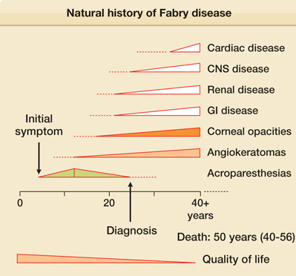
RARE DISEASE WITH SKIN INVOLVEMENT
Pathogenesis can be very different
Some rare diseases have skin symptoms, however, in fact many other internal organs are already involved at this point
Disorders that matched this description
Tumour predisposition disorders
Metabolic disorders

Slide 5
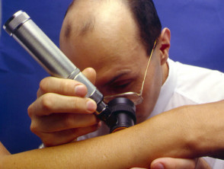
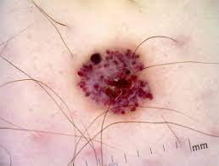
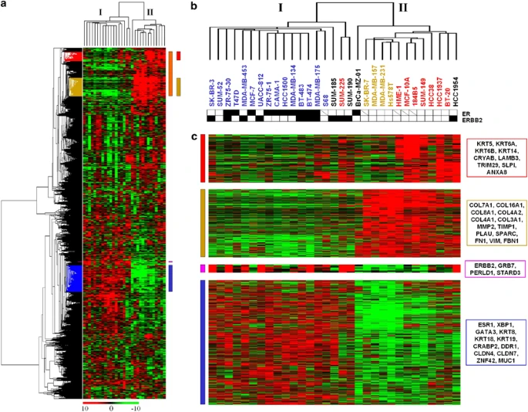
HOW ARE RARE SKIN DISEASES CURRENTLY DIAGNOSED?
Dermatological examination – high expertise of the dermatologist needed
Genetic testing – potential diagnosis is needed, increasing time and cost per each test (>800 tests exist, over 20 000 human genes known)

Slide 6
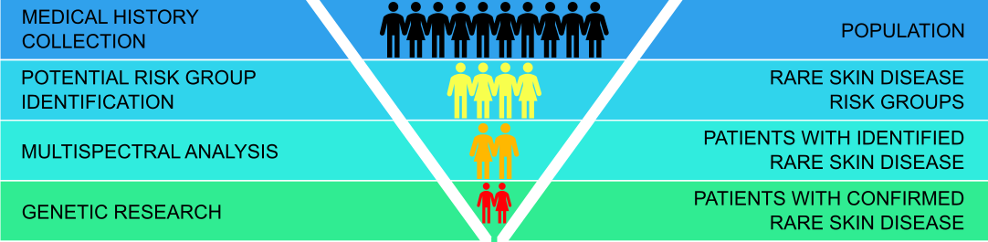
OUR IDEA STARTS WITH PATIENT IDENTIFICATION
POPULATION
RISK GROUP
CLINICAL DIAGNOSIS
GENETIC DIAGNOSIS
Identifying risk groups from medical history and survey data
Individuals in risk group are tested with multispectral imaging
Individuals identified by imaging are sent to genetic testing
Patient receives genetic confirmation

Slide 7
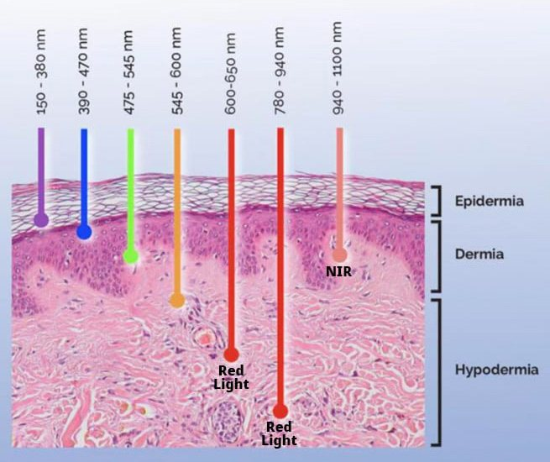
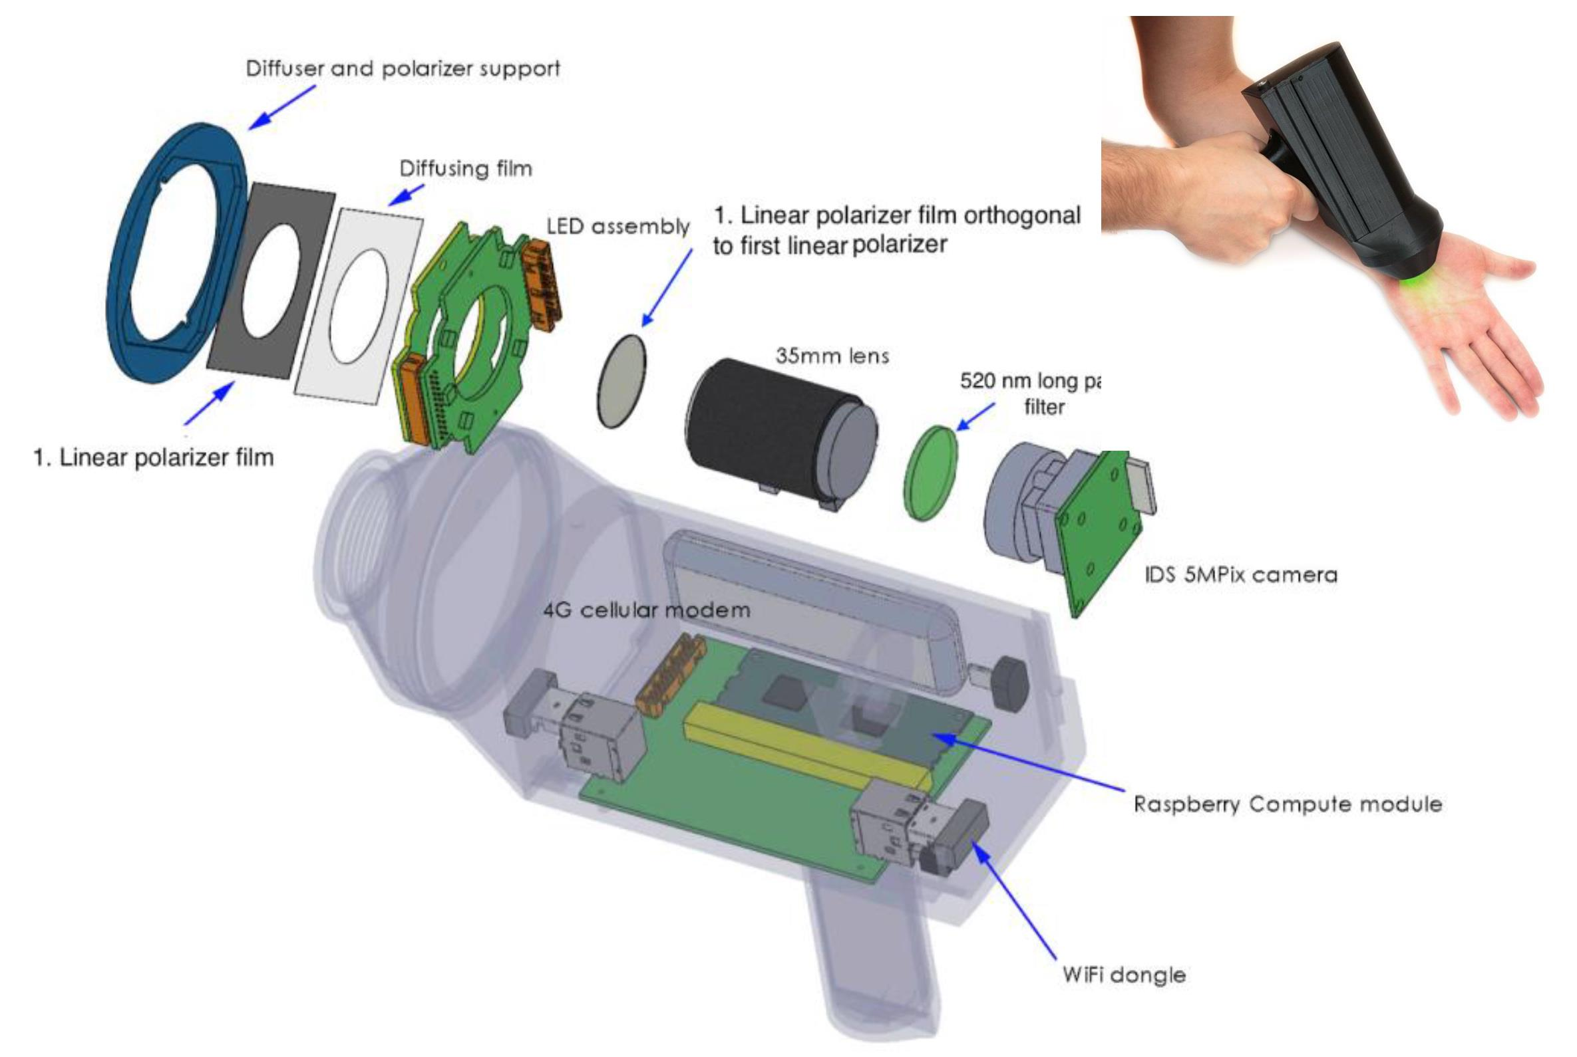
MULTISPECTRAL SKIN IMAGING
405 nm
525 nm
660 nm
965 nm

Slide 8
MULTISPECTRAL SKIN IMAGING
Common mole
Malignant melanoma

Slide 9
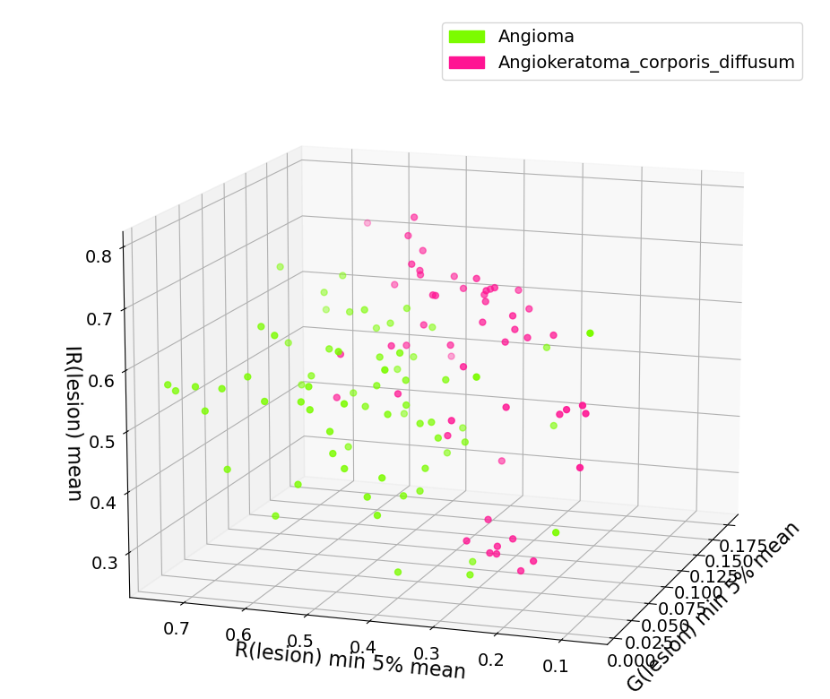
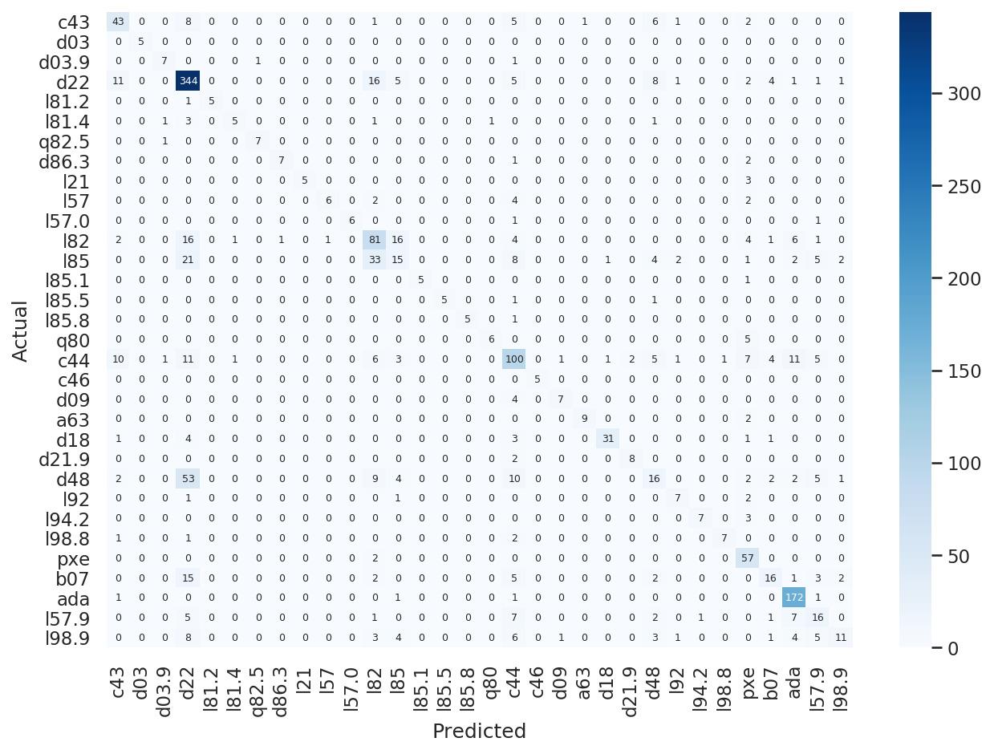
Individual approach is needed for each disease
Multispectral parameter analysis of imaging data
CNN validation set confusion matrix

Slide 10
ERDF PROJECT (01.07.2021. – 30.09.2023.)
Collaborators
Longenesis LTD
University of Latvia
Riga Technical university
Sammelweis University clinic, Budapest
Team
Leading researchers: Alexey Lihachev, Emil Syundyukov, Dmitrijs Bliznuks
Doctors: Ainars Rudzitis, Tatjana Linova, Norbert Kiss
PhD students: Emilija V. Plorina and others

Slide 11
Antibacterial resistance assessment with laser speckle imaging

Slide 12
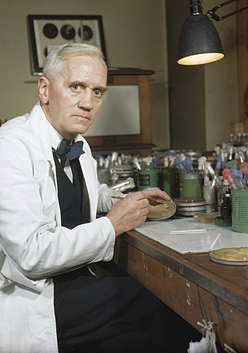
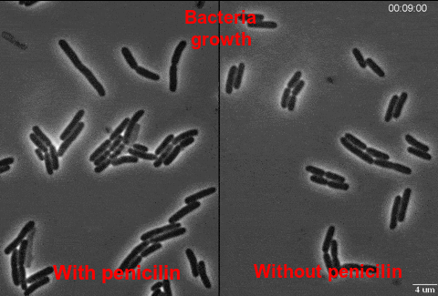
ANTIBIOTICS – MIRACLE OF MEDICINE OR IS IT?
Alexander Fleming discovered Penicillin in 1928

Slide 13
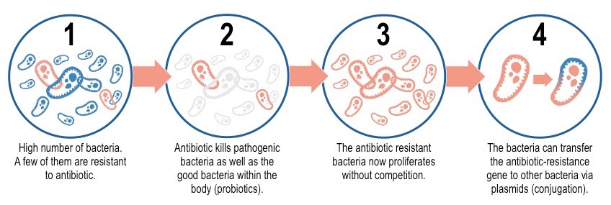
WHAT IS ANTIBACTERIAL RESISTANCE?
MAIN CAUSES:
Overuse and misuse of antibiotics and disenfectants
Agriculture – livestock and pesticide use
Spontaneous mutation
Pollution and other causes

Slide 14
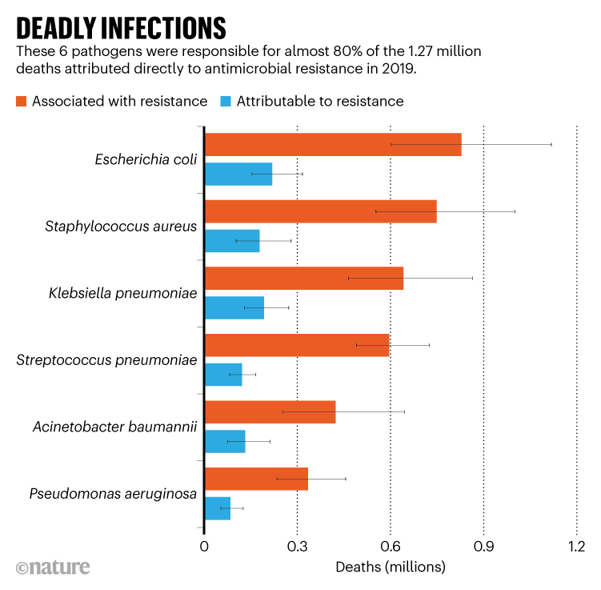
ANTIBACTERIAL RESISTANCE OUTCOMES
Person gets into a hospital with an infection
Standard antibiotic treatments do not work
Alternative antibiotic is found or, if the illness is mild enough, resolves on its own or
Estimated 4.95 million people died globally in 2019 from illnesses where resistant bacteria were involved and of those 1.27 million died directly from resistant infections

Slide 15
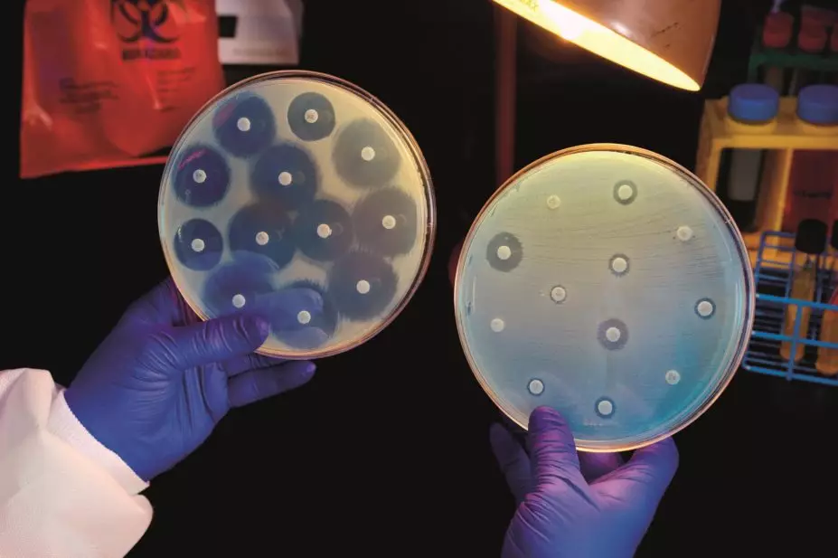
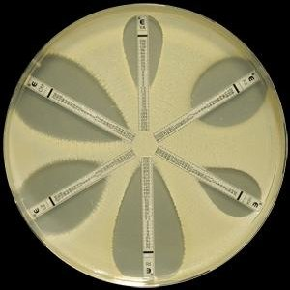
HOW IS ANTIBACTERIAL RESISTANCE DETERMINED?
Currently used methods such as diffusion method, e-test, dilution method and others require 16-24h for the bacterial colony to grow. These may be crucial hours lost in the treatment process of a patient.
Diffusion method
E-test

Slide 16
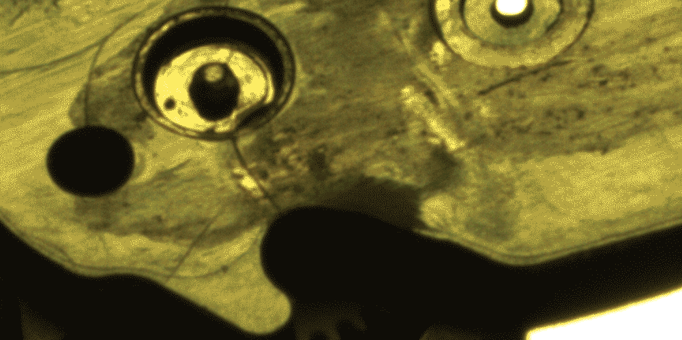
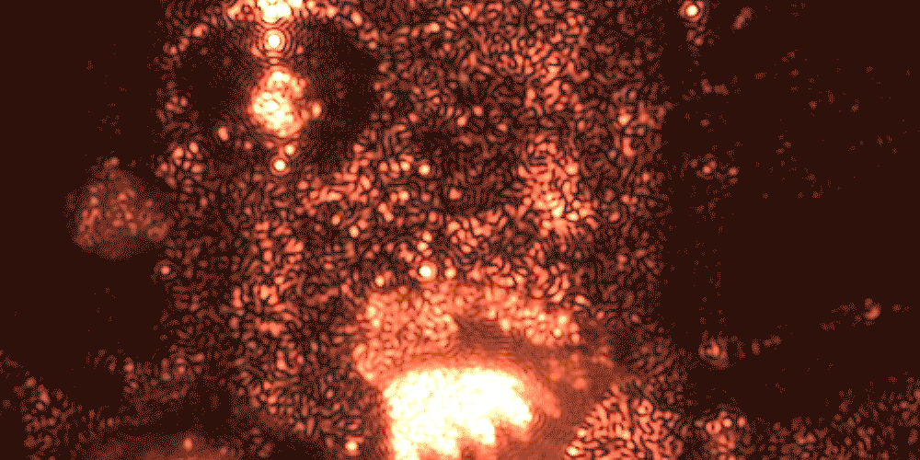
WHAT IS LASER SPECKLE IMAGING?
White light image
Laser speckle is an interference pattern produced by coherent light reflected or scattered from different parts of the illuminated surface
Laser speckle image

Slide 17
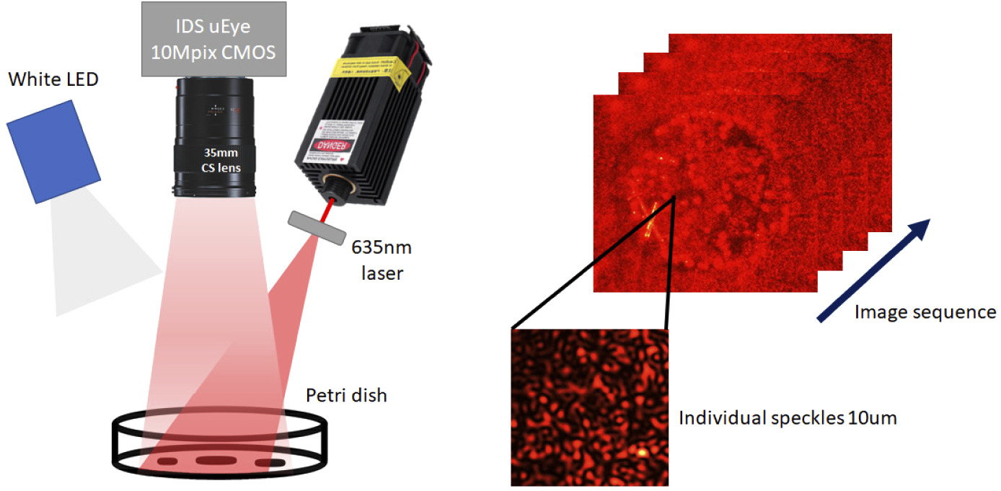
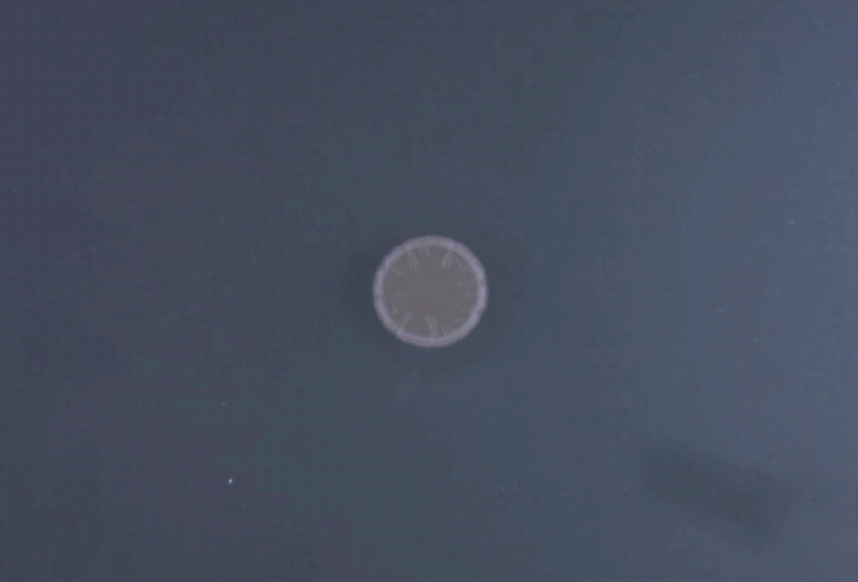
LASER SPECKLE IMAGING OF BACTERIAL GROWTH
Bacterial colony grows from the center to the edges. To detect growth the expansion of these edges has to be assessed.
Experimental setup where images were captured of bacterial growth process under 635 nm laser and white LED illumination.

Slide 18
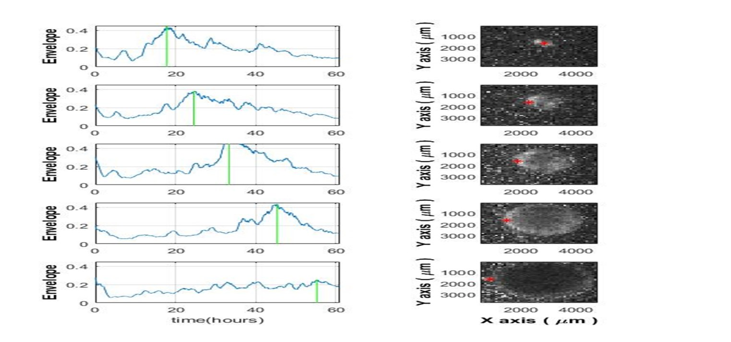
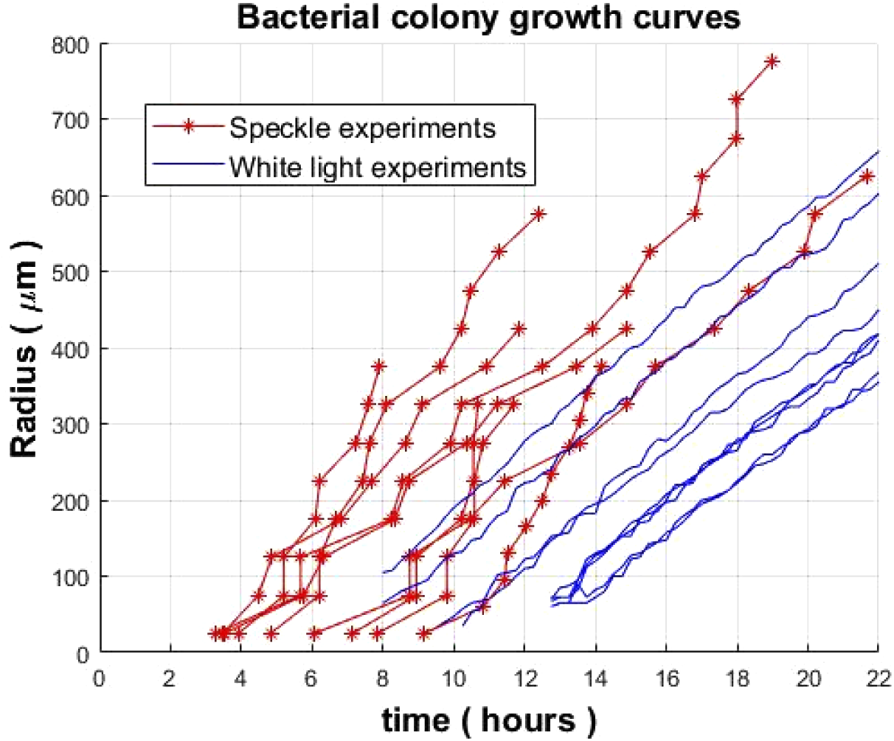
LASER SPECKLE IMAGING OF Vibrio natriegens
Balmages, I., Liepins, J., Zolins, S., Bliznuks, D., Lihacova, I., & Lihachev, A. (2021). Laser speckle imaging for early detection of microbial colony forming units. Biomedical optics express, 12(3), 1609–1620. https://doi.org/10.1364/BOE.416456
I. Balmages, J. Liepins, D. Bliznuks, S. Zolins, I. Lihacova, and A. Lihachev, "Laser Speckle Imaging Reveals Bacterial Activity Within Colony," in European Conferences on Biomedical Optics 2021 (ECBO), OSA Technical Digest (Optica Publishing Group, 2021), paper EW4A.29.

Slide 19
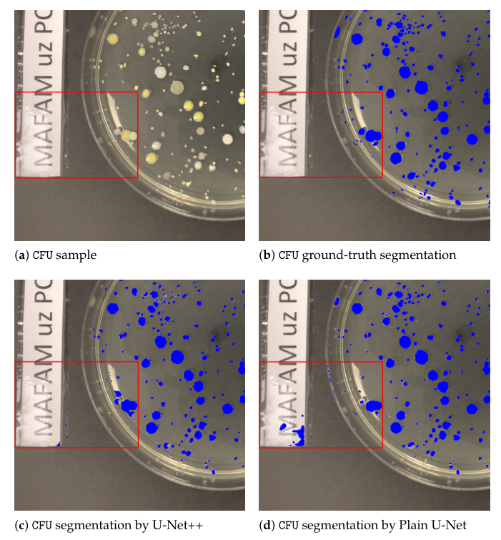
LASER SPECKLE IMAGING SYSTEM
Proposed prototype of a laser speckle imaging device
Segmentation using artificial intelligence for detection of specific zones of the petri dish
Jumutc V, Bļizņuks D, Lihachev A. Multi-Path U-Net Architecture for Cell and Colony-Forming Unit Image Segmentation. Sensors (Basel). 2022 Jan 27;22(3):990. doi: 10.3390/s22030990. PMID: 35161735; PMCID: PMC8839202.

Slide 20
ERDF PROJECT (01.01.2022. – 30.11.2023.)
Collaborators
University of Latvia
Riga Technical university
Pauls Stradiņš Clinical University Hospital
Team
Leading researchers: Alexey Lihachev,
Dmitrijs Bliznuks, Ilze Lihacova
Doctors: Aigars Reinis, Svjatoslavs Kistkins
PhD students: Ilya Balmages, Emilija V. Plorina and others

Slide 21
THANK YOU!
Acknowledgement
This work has been supported by European Regional Development Fund projects “Effective identification and multimodal diagnosis system for rare skin diseases” (No. 1.1.1.1./20/A/072) and “Rapid assessment system of antibacterial resistance for patients with secondary bacterial infections” (No. 1.1.1.1/21/A/034)

