Slide 1
Laser speckle imaging system for antibacterial resistance assessment
Emilija V. Plorina, Ilya Balmages, Aigars Reinis, Svjatoslavs Kistkins, Alexey Lihachev,
Dmitrijs Bliznuks, Ilze Lihacova

Slide 2
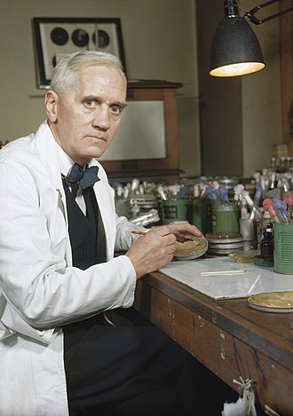
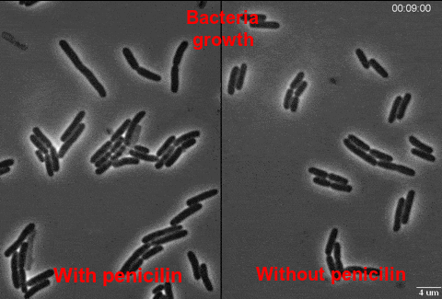
ANTIBIOTICS – MIRACLE OF MEDICINE OR IS IT?
Alexander Fleming discovered Penicillin in 1928

Slide 3
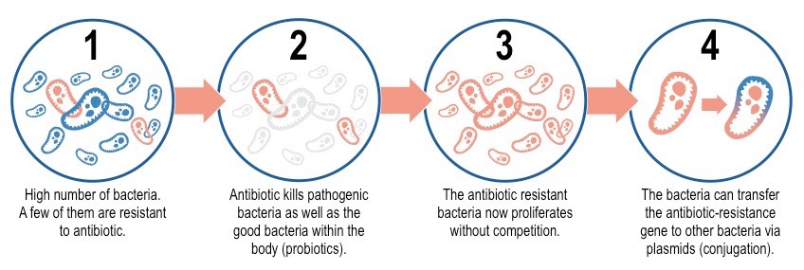
WHAT IS ANTIBACTERIAL RESISTANCE?
MAIN CAUSES:
Overuse and misuse of antibiotics and disenfectants
Agriculture – livestock and pesticide use
Spontaneous mutation
Pollution and other causes

Slide 4
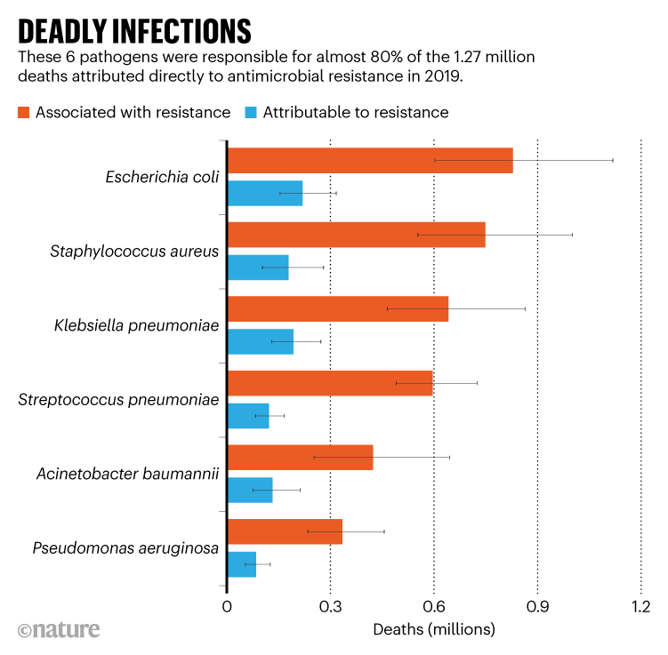
ANTIBACTERIAL RESISTANCE OUTCOMES
Person gets into a hospital with an infection
Standard antibiotic treatments do not work
Alternative antibiotic is found or, if the illness is mild enough, resolves on its own or
Estimated 4.95 million people died globally in 2019 from illnesses where resistant bacteria were involved and of those 1.27 million died directly from resistant infections

Slide 5
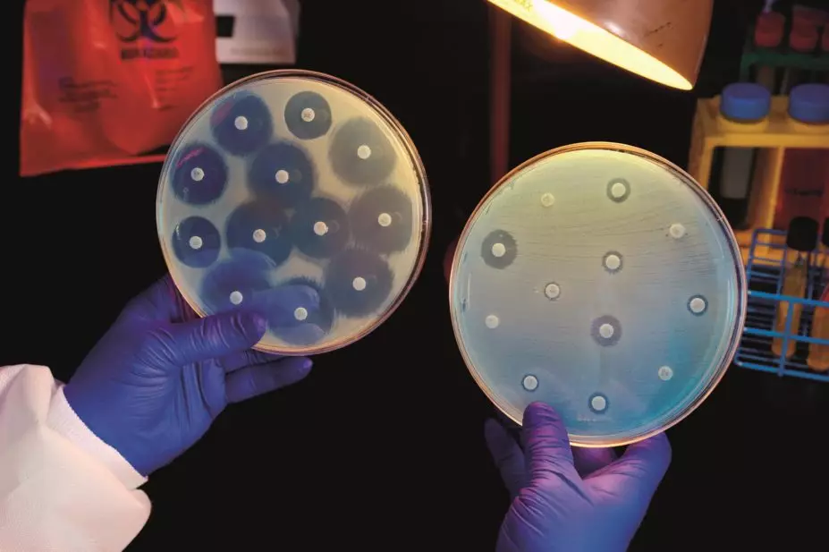
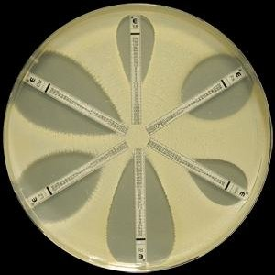
HOW IS ANTIBACTERIAL RESISTANCE DETERMINED?
Currently used methods such as diffusion method, e-test, dilution method and others require 16-24h for the bacterial colony to grow. These may be crucial hours lost in the treatment process of a patient.
Diffusion method
E-test

Slide 6
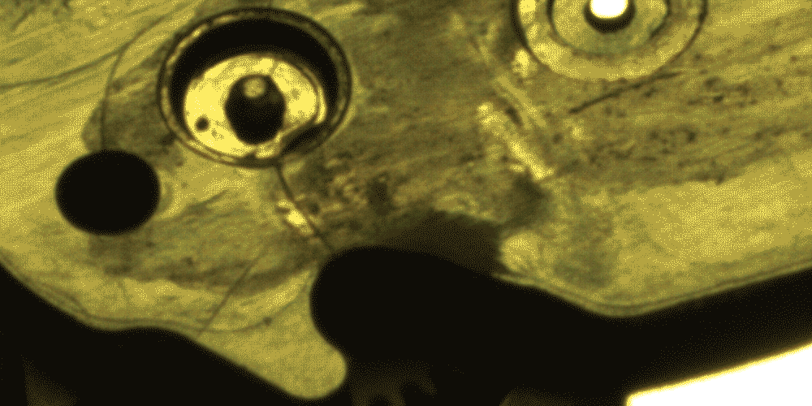
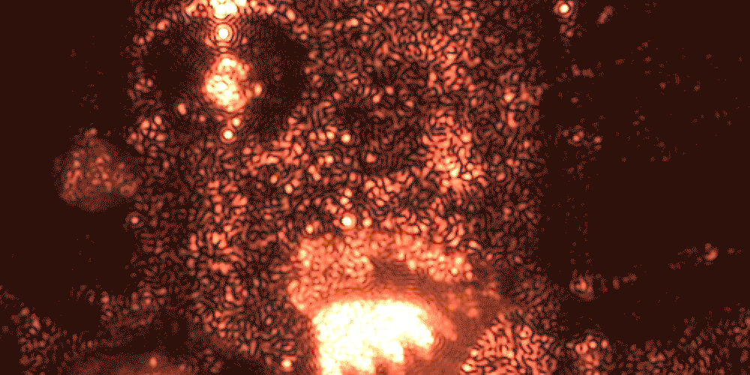
WHAT IS LASER SPECKLE IMAGING?
White light image
Laser speckle is an interference pattern produced by coherent light reflected or scattered from different parts of the illuminated surface
Laser speckle image

Slide 7
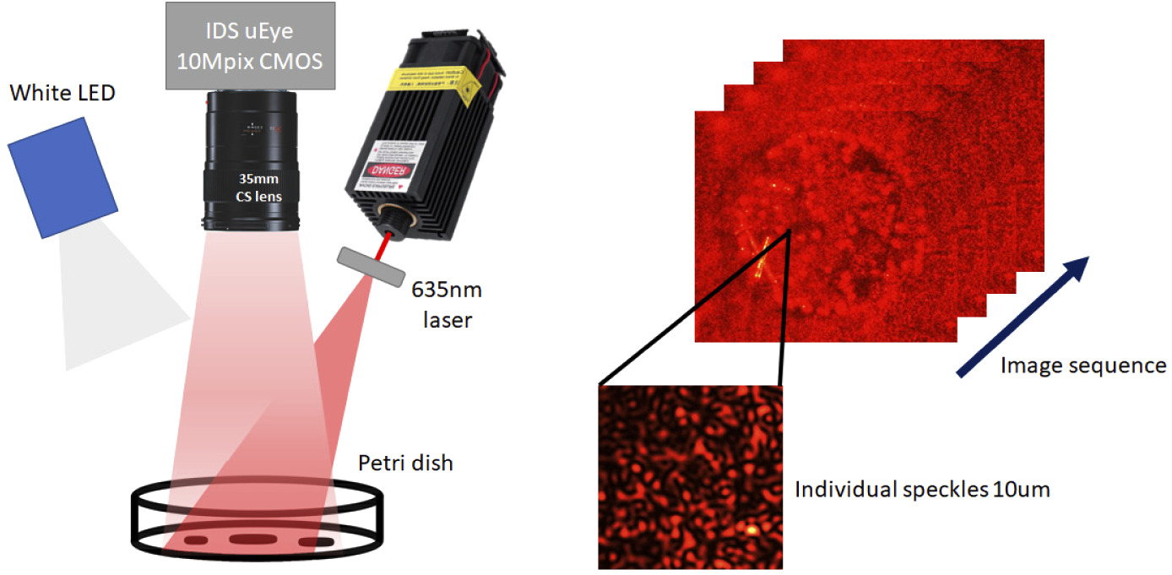
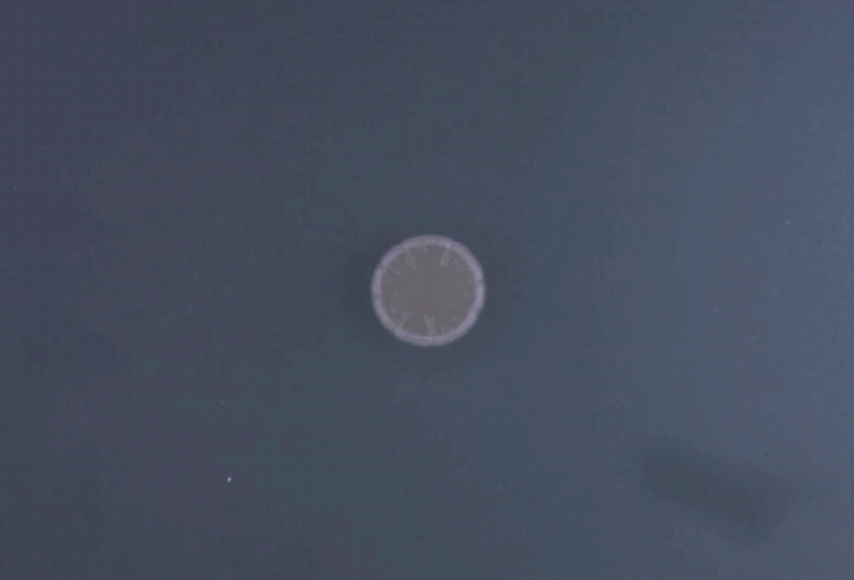
LASER SPECKLE IMAGING OF BACTERIAL GROWTH
Bacterial colony grows from the center to the edges. To detect growth the expansion of these edges has to be assessed.
Experimental setup where images were captured of bacterial growth process under 635 nm laser and white LED illumination.

Slide 8
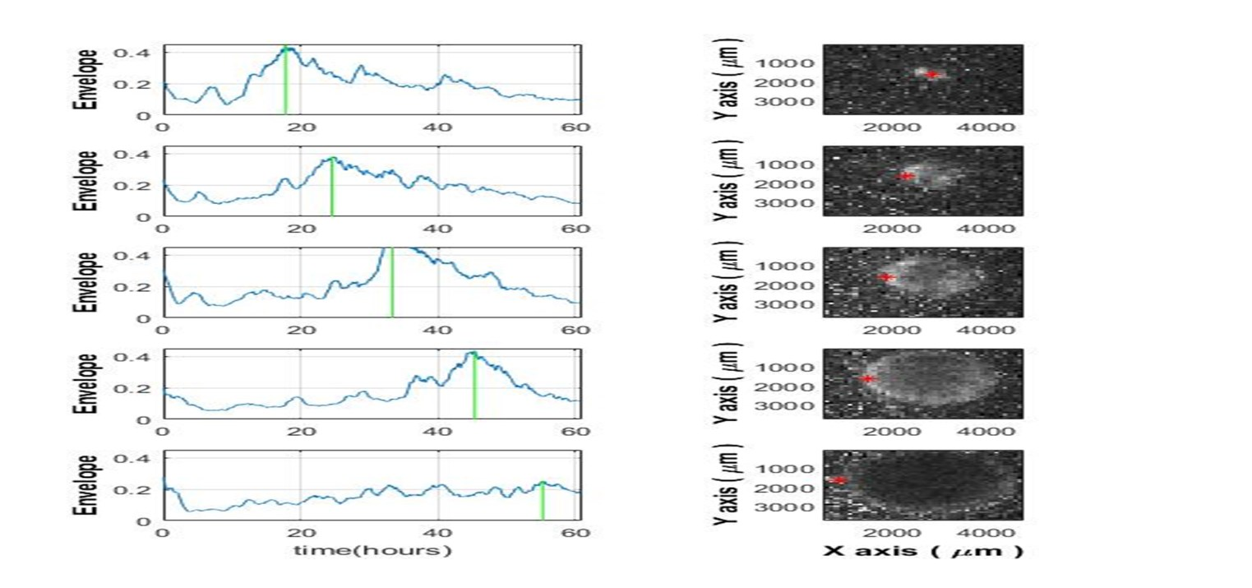
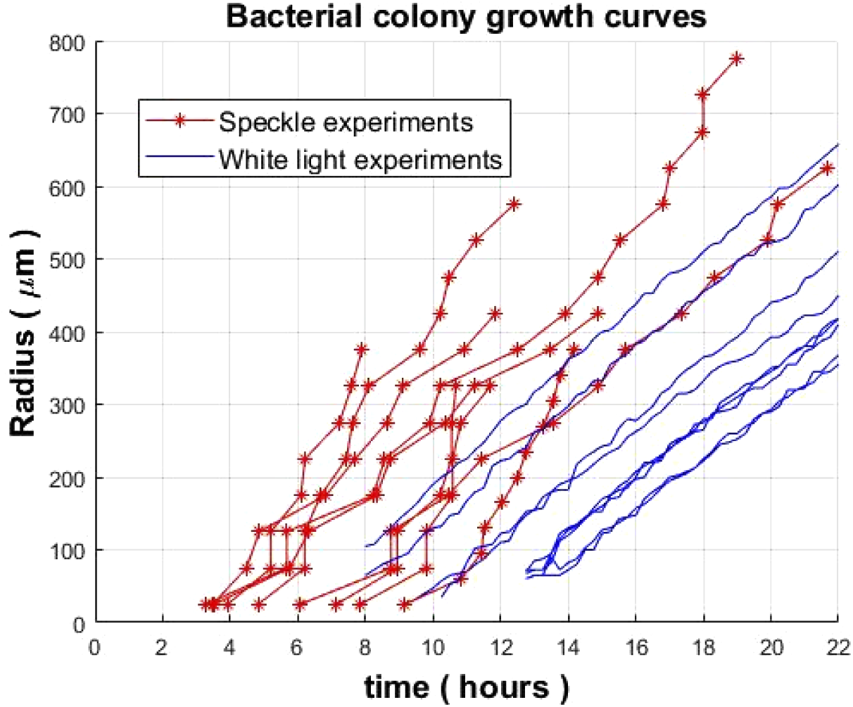
LASER SPECKLE IMAGING OF Vibrio natriegens
Balmages, I., Liepins, J., Zolins, S., Bliznuks, D., Lihacova, I., & Lihachev, A. (2021). Laser speckle imaging for early detection of microbial colony forming units. Biomedical optics express, 12(3), 1609–1620. https://doi.org/10.1364/BOE.416456
I. Balmages, J. Liepins, D. Bliznuks, S. Zolins, I. Lihacova, and A. Lihachev, "Laser Speckle Imaging Reveals Bacterial Activity Within Colony," in European Conferences on Biomedical Optics 2021 (ECBO), OSA Technical Digest (Optica Publishing Group, 2021), paper EW4A.29.

Slide 9
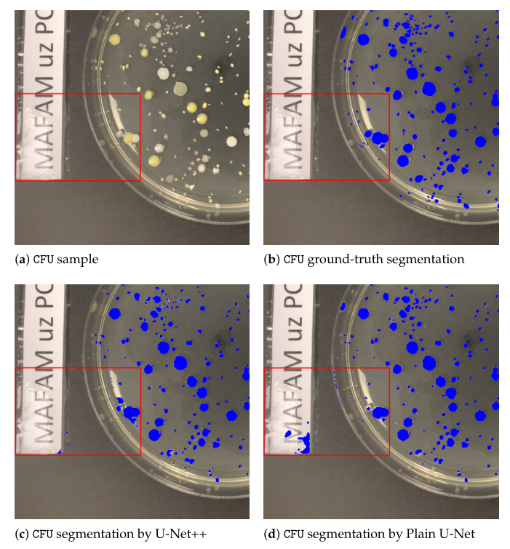
LASER SPECKLE IMAGING SYSTEM
Proposed prototype of a laser speckle imaging device
Segmentation using artificial intelligence for detection of specific zones of the petri dish
Jumutc V, Bļizņuks D, Lihachev A. Multi-Path U-Net Architecture for Cell and Colony-Forming Unit Image Segmentation. Sensors (Basel). 2022 Jan 27;22(3):990. doi: 10.3390/s22030990. PMID: 35161735; PMCID: PMC8839202.

Slide 10
ERDF PROJECT (01.01.2022. – 30.11.2023.)
Collaborators
University of Latvia
Riga Technical university
Pauls Stradiņš Clinical University Hospital
Team
Leading researchers: Alexey Lihachev,
Dmitrijs Bliznuks, Ilze Lihacova
Doctors: Aigars Reinis, Svjatoslavs Kistkins
PhD students: Ilya Balmages, Emilija V. Plorina and others

Slide 11
THANK YOU!
Acknowledgement
This work has been supported by European Regional Development Fund project “Rapid assessment system of antibacterial resistance for patients with secondary bacterial infections” (No. 1.1.1.1/21/A/034)

