Slide 1
Laser Speckle Imaging Technology for Rapid Determination of Antibacterial Resistance Aigars Reinis Riga, Latvia

Slide 2
Head Doctor, Joint Laboratory, P.Stradiņš Clinical University Hospital
Leading Researcher, Scientific Institute, PSCUH
Assistant professor, Dep. of Biology and Microbiology, Riga Stradiņš
University
Program director of Clinical Microbiology Residency program, RSU
Assessor and technical expert, Latvian National Accreditation Bureau
Vice-President, Latvian Society of Medical microbiology

Slide 3
Acknoledgements
Ilze Lihacova, Institute of Atomic Physics and Spectroscopy, University of Latvia
Alexey Lihachev, Institute of Atomic Physics and Spectroscopy, University of Latvia
Dmitrijs Bliznuks, Institute of Computer Control, Automation and Computer Engineering, Riga Technical University, Riga, Latvia
Ilya Balmages, Institute of Computer Control, Automation and Computer Engineering, Riga Technical University, Riga, Latvia
The other colleagues
This work has been supported by European Regional Development Fund project “Rapid assessment system of antibacterial resistance for patients with secondary bacterial infections” (No. 1.1.1.1/21/A/034)

Slide 4
Introduction
Laser speckles are produced by coherent light (laser beam) reflected from an illuminated uneven surface.
Due to the bacteria movement and the changes of optical properties of the media, the observed surface pattern changes over time [1].
Laser speckle imaging was used to identify submicron objects, and the proposed additional sensitive subpixel correlation method allow detection of small changes that cannot be observed with the standard method.
This non-invasive, non-contact optical method has been used in our previous studies to describe microbial growth activity [2] and reveal hidden effects in bacterial behavior [3, 4].
[1] J.W. Goodman, Speckle Phenomena in Optics. Theory and Application, Roberts and Company, Chapter 8, Englewood, Colorado, (2007). [2] I. Balmages, J. Liepins, S. Zolins, D. Bliznuks, I. Lihacova and A. Lihachev, "Laser speckle imaging for early detection of microbial colony forming units," Biomed. Opt. Express, doi: 10.1364/BOE.416456 (2021). [3] Balmages, I., Liepins, J., Auzins, E. T., Bliznuks, D., Baranovics, E., Lihacova, I., Lihachev, A. “Use of the speckle imaging sub-pixel correlation analysis in revealing a mechanism of microbial colony growth”, Scientific Reports, 13(1), 2613, doi: 10.1038/s41598-023-29809- , (2023). [4] Balmages, I., Reinis, A., Kistkins, S., Bliznuks, D., Plorina, E. V., Lihachev, A., Lihacova, I., Laser speckle imaging for visualization of hidden effects for early detection of antibacterial susceptibility in disc diffusion tests. Frontiers in Microbiology, 14, doi: 10.3389/fmicb.2023.1221134, (2023).

Slide 5
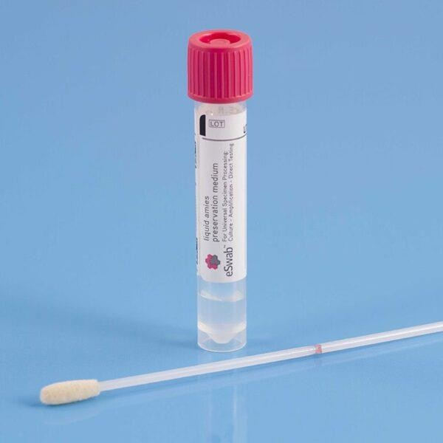
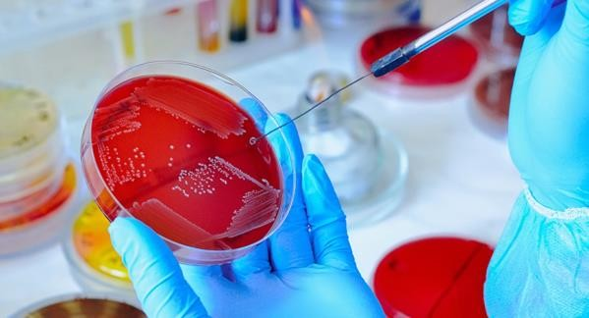
Microbiological diagnostics
Identification
AB susceptibility

Slide 7
Materials and methods
Experiments were performed at the Pauls Stradins Clinical University Hospital Joint Laboratory on different bacteria and their corresponding antibiotics
The laser speckles were generated by a single mode 658 nm diode-pumped solid-state laser (output power 60 mW). Images were captured at 20-s intervals by a CMOS camera. To read the inscriptions on the antibiotic discs, an RGB image was captured under white LED illumination.

Slide 8
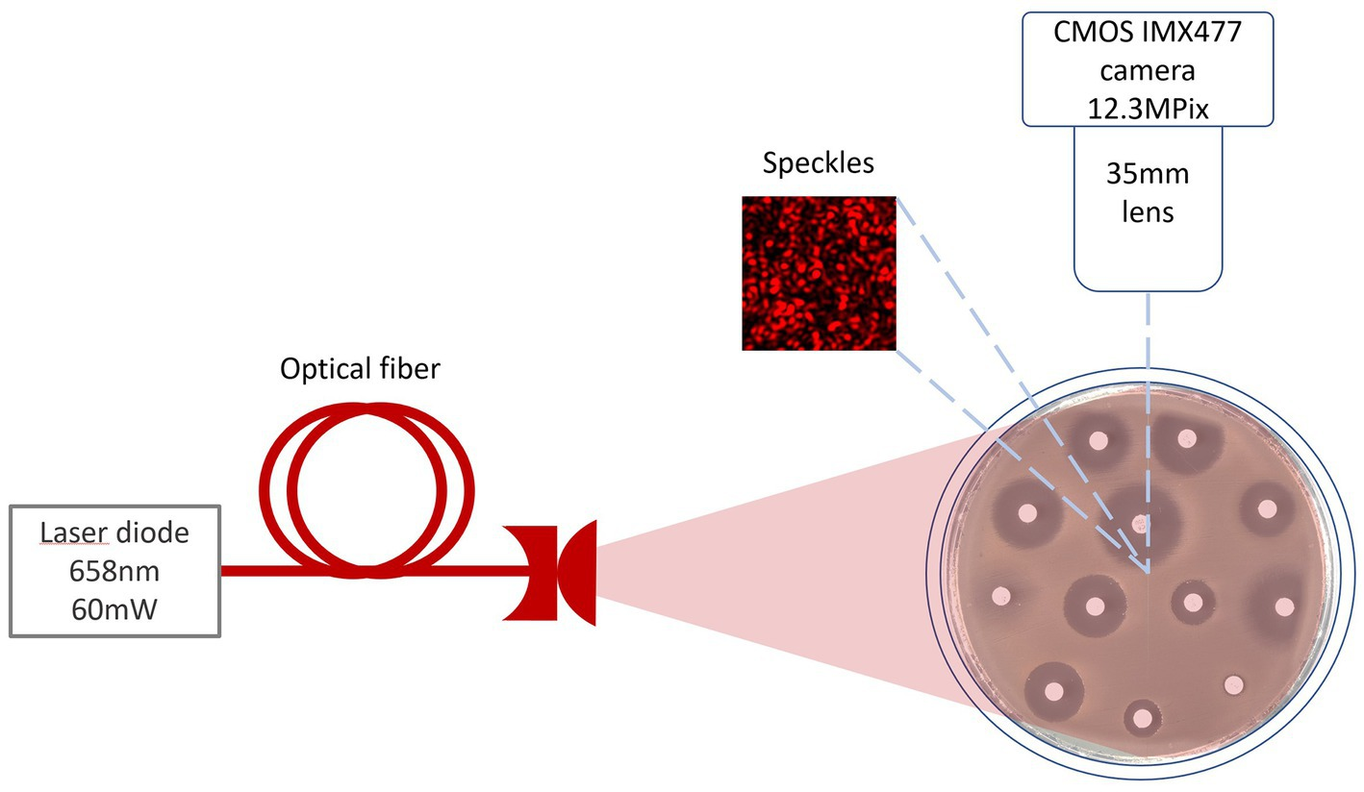

Slide 9
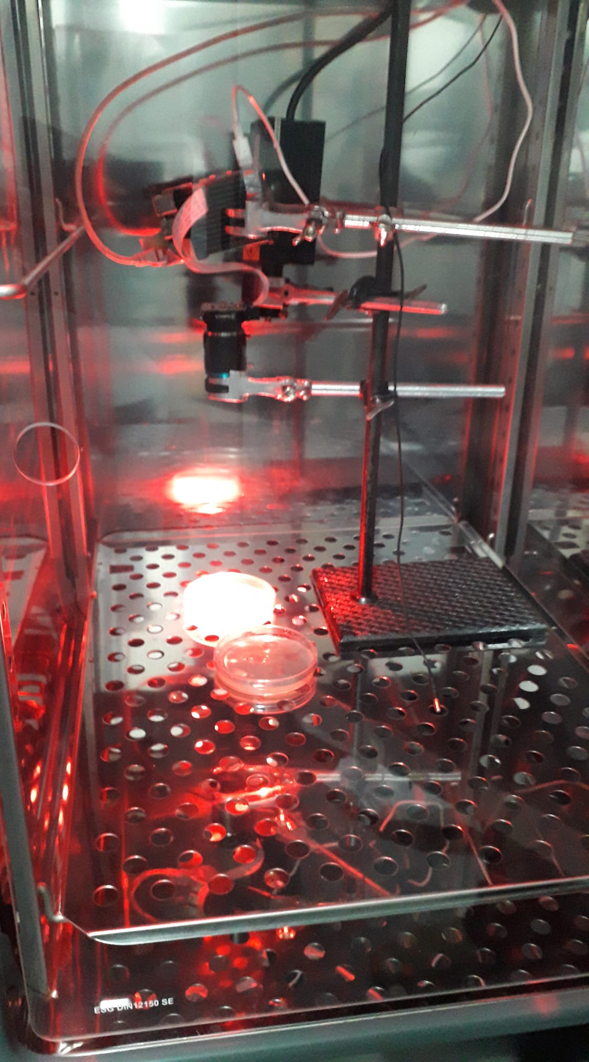
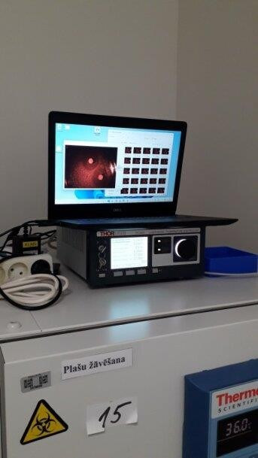

Slide 10
Clinical isolates of Escherichia coli (E. coli) and Klebsiella aerogenes (K. aerogenes) bacteria were selected for the experiment.
We chose cefotaxime disk (CTX, 5 μg) and ampicillin disk (AM, 10 μg) for K. aerogenes and ciprofloxacin disk (CIP, 5 μg) for E. coli, and amikacin disk (AK, 30 μg), for an experiment without bacteria.
To avoid artifacts, the experiments were performed in a separate room, in an incubator at 37°C.
The bacterial suspensions were made in saline to the density of a 0.5 McFarland turbidity standard. Culturing on the Petri dish was prepared according to a EUCAST (The European Committee on Antimicrobial Susceptibility Testing) standard procedure.
To estimate how the diffusion of antibiotics, drying of the agar surface and other artifacts influence the observed signal, Petri dishes with agar and antibiotics (without bacteria) were prepared for reference measurements.

Slide 11
Laser speckle image conversion to time signals
The images captured at 20 s intervals were processed by dividing the experimental field into small sections of NxN pixels. A two-dimensional normalized cross-correlation was performed between consecutive NxN image fragments throughout the experiment.

Slide 12
The artificial neural network (artificial intelligence) was trained to recognize the formation of the bacterial growth inhibition zone, distinguish it from various artifacts, recognize the antibiotic discs themselves, measure the zone, predict its diameter

Slide 13
Results
Balmages, I., Reinis, A., Kistkins, S., Bliznuks, D., Plorina, E. V., Lihachev, A., Lihacova, I., Laser speckle imaging for visualization of hidden effects for early detection of antibacterial susceptibility in disc diffusion tests. Frontiers in Microbiology, 14, doi: 10.3389/fmicb.2023.1221134, (2023).

Slide 14
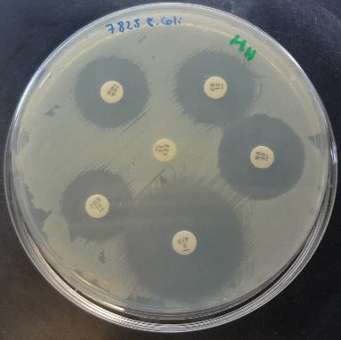
Disk-Diffusion Susceptibility Test
The importance of bacteriological analysis is growing. The standard approach - disk-diffusion test allows estimating the susceptibility of bacteria to an antibiotic. It is possible to assess the susceptibility of bacteria by using the inhibition zone diameter. The bacteriologist usually measures the inhibition zone diameter manually. The proposed methods aim to perform automatic inhibition zone measurement that saves bacteriologists time and lowers patient treatment-related risks.
Inhibition Zones Measurement

Slide 15
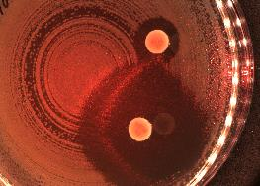
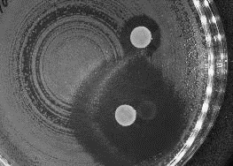
Workflow
1.
2.
Take an Image
Image Pre-processing
Petri dish localization
Antibiotic disks localization
Inhibition Zones Measurement
3.
4.
5.

Slide 16
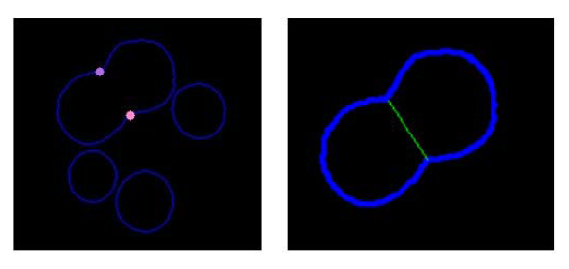
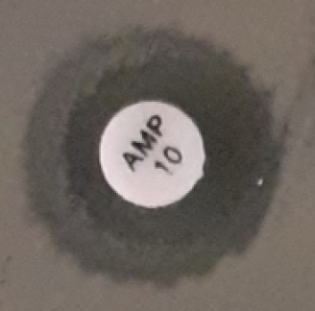
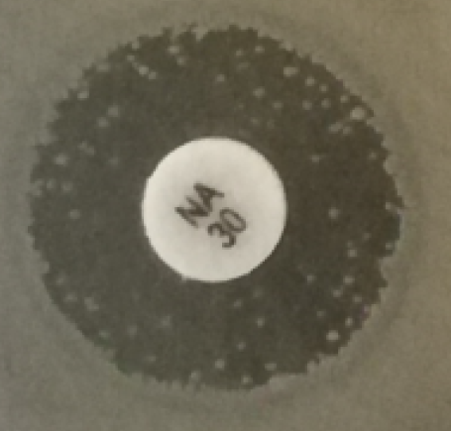
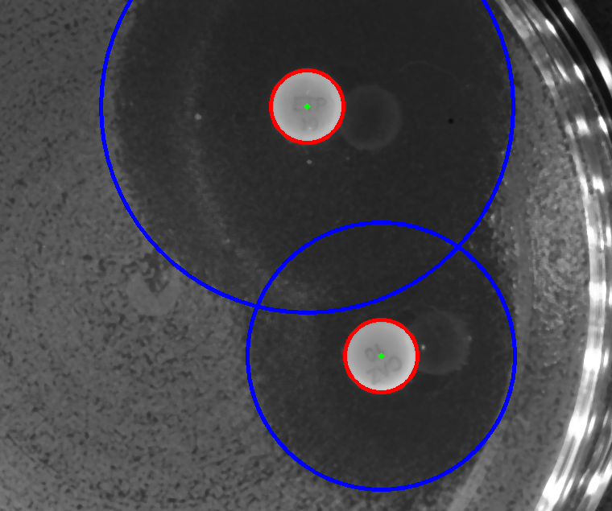
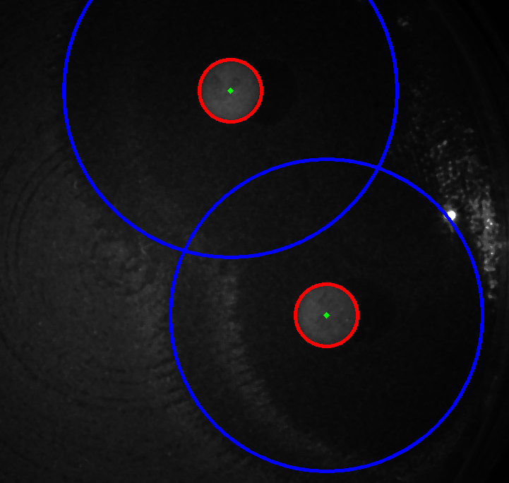
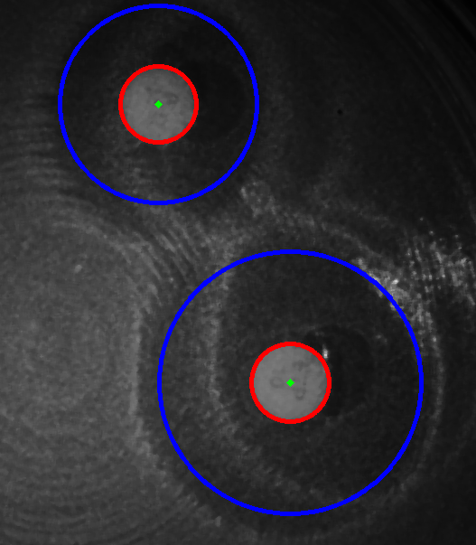
Challenges
Non-circular
inhibition shape
Double
Inhibition Zones
Overlapping zones
Colonies within the zone

Slide 17
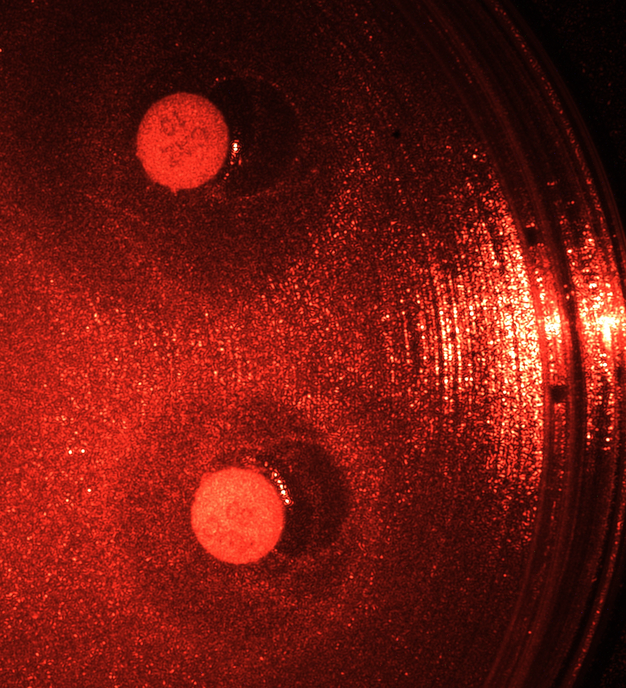
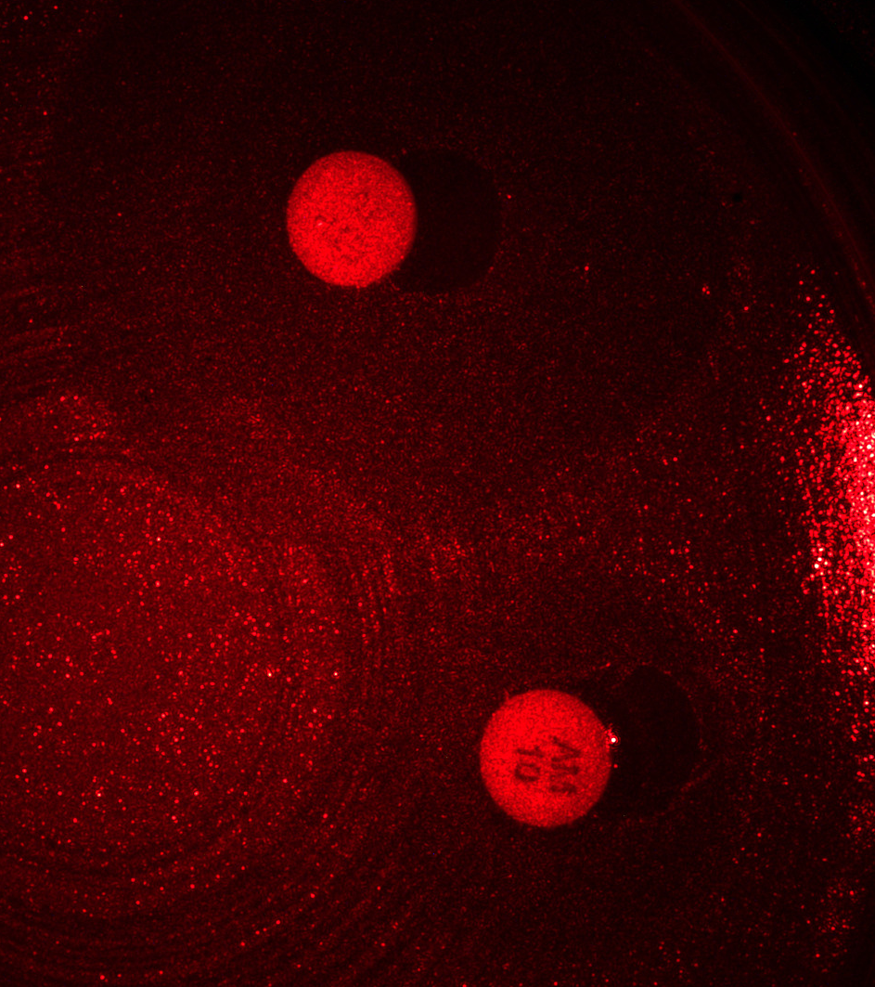
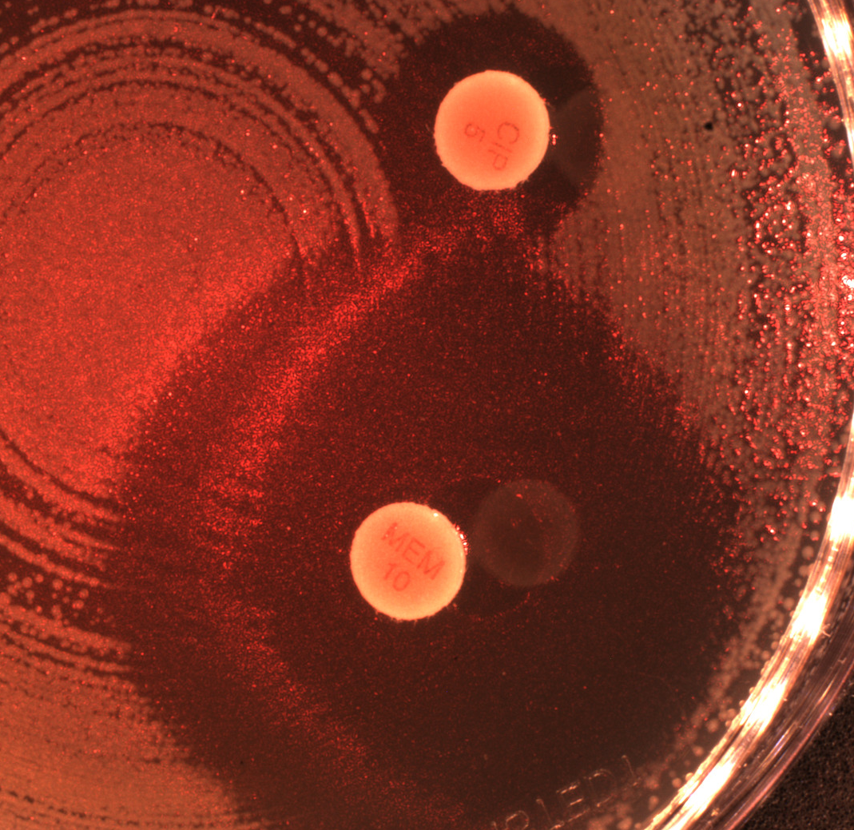
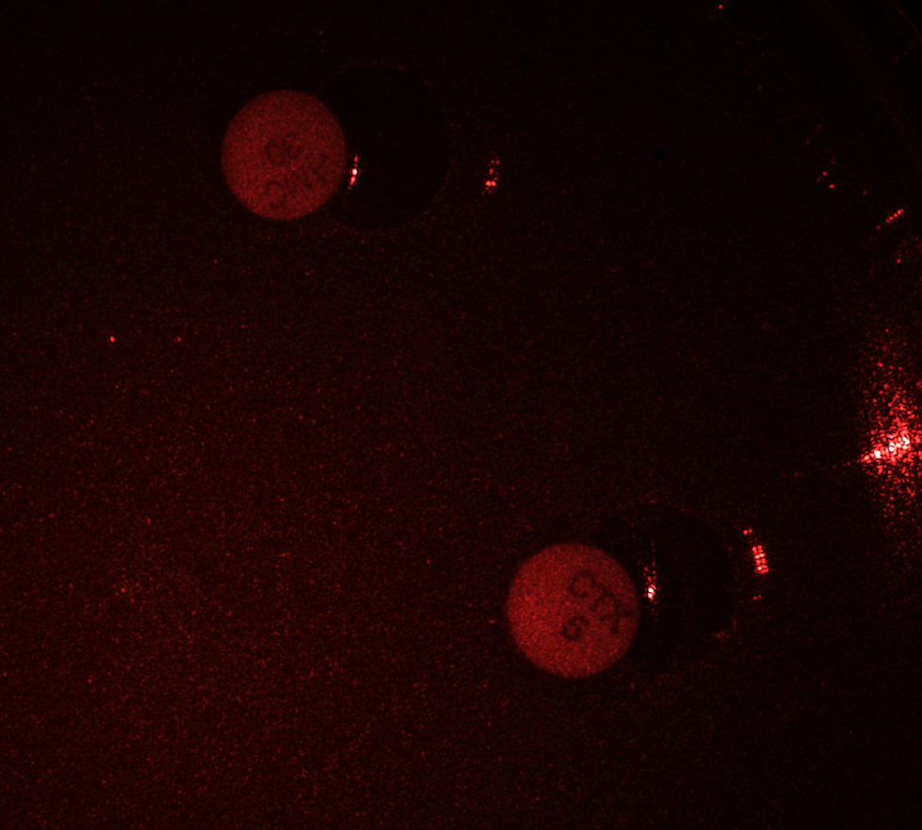
Challenges
Light reflections
Indistinct zone
boundaries
Zone and plate
borders overlaping
Low contrast

Slide 18
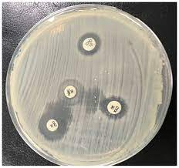
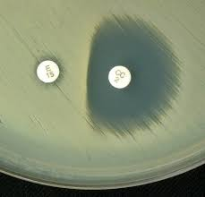
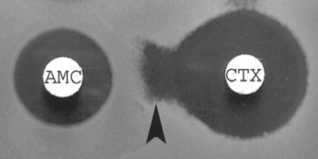
Inducible Clindamycin Resistance (D Test)
ESBL positive strains

Slide 19
Spatio-temporal changes of the zone of inhibition (top), and zone of inhibition formation in the growth of bacteria around the antibiotic disc (bottom). Bacteria: E. coli, antibiotic CIP 5 µg.

Slide 20
The upper spectrogram shows the initial measured activity of bacteria and Agar in the certain area (1x1mm) using the laser speckle method. The color indicates intensity activity. The most active bacteria growth period can be seen from 5 to 10 hours.
An artificial network was trained to classify the area as a sterile or resistive zone. Five images below show the so-called “Attention map”, that defines which image (spectrogram) area was important to make a classification.
The area of interest shows that AI correctly identifies that the most important for classification is the initial growth period.
But this spectrogram includes all growth periods when the sterile zone is visible by the naked eye. The most interesting thing is that if the spectrogram length is limited to 6 hours, AI still classifies (predicts) if the zone will be sterile or resistant with an accuracy of around 80%.

Slide 21
Conclusions
In the present study, we have demonstrated the ability of subpixel analysis of laser speckle time series images for dynamic visualization of zones of inhibition produced by antimicrobials.
The obtained results demonstrate the ability to follow changes in the radius of the zone of inhibition from early times when it cannot yet be detected by classical methods.
Thus, this allows for a detailed analysis of the dynamics of the zone of inhibition, which in the future will make it possible to predict the diameter of the zone of inhibition around the antibiotic disk faster than using the disk diffusion method without laser speckle technology.
The practical implementation of the obtained technology will allow the laboratory to send the results and their interpretation to the clinic much faster. This study will serve as a foundation for a deeper understanding of the zone of inhibition formation processes and the possibility of describing this zone using mathematical models, which will become the basis for further prediction of the zone of inhibition in our future studies.

Slide 22
Thank you very much for your kind attention :)
Aigars.reinis@stradini.lv
Aigars.reinis@rsu.lv

