Slide 1
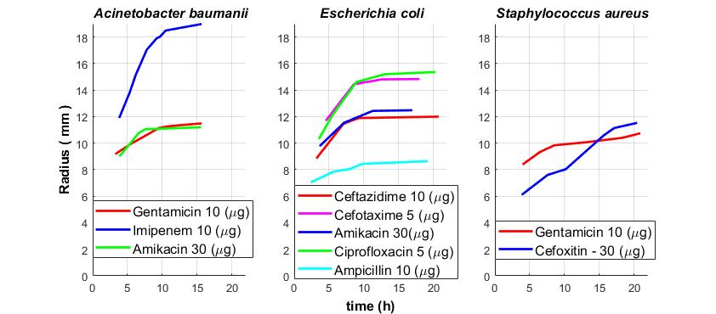
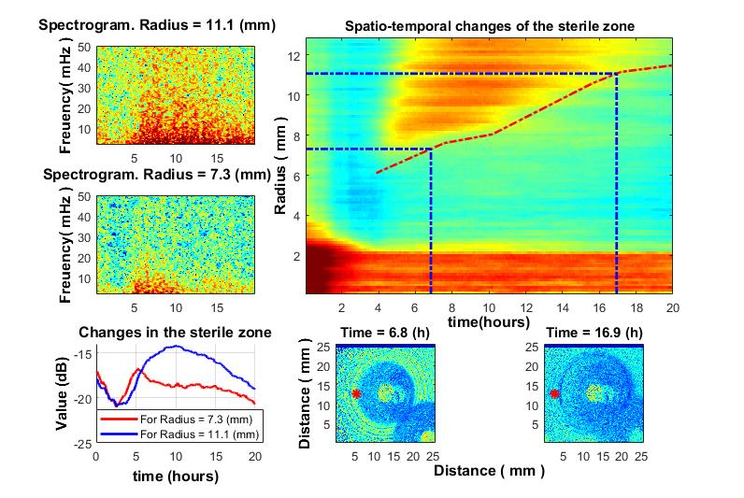
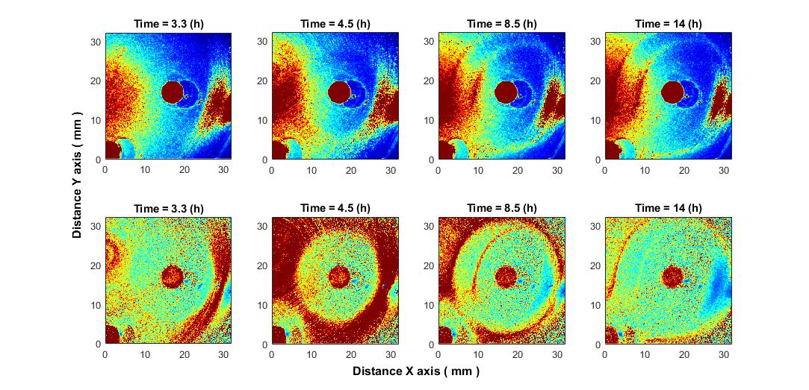
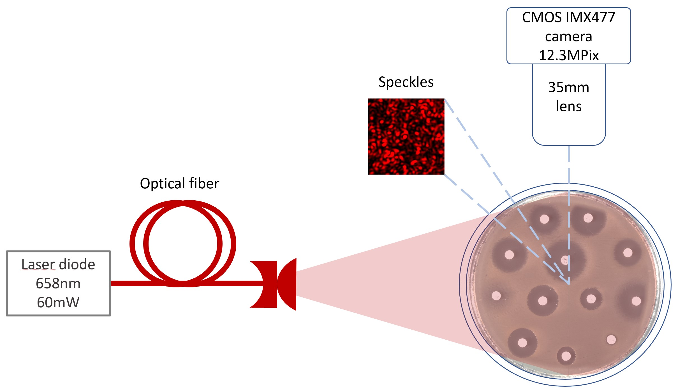
Laser speckle imaging-assisted disk diffusion test for early estimation of sterile zone radius
Ilya Balmages*^{1,2}, Dmitrijs Bliznuks² , Aigars Reinis^{3,4}, Svjatoslavs Kistkins³, Emilija Vija Plorina¹, Alexey Lihachev¹, Ilze Lihacova¹
¹University of Latvia, Institute of Atomic Physics and Spectroscopy, Jelgavas 3, Riga, Latvia
²Riga Technical University, Zunda krastmala 10, Riga, Latvia
³Pauls Stradins Clinical University Hospital, Pilsoņu 13, Riga, Latvia
⁴Riga Stradins University, Department of Biology and Microbiology, Dzirciema 16, Riga, Latvia
* Ilya.Balmages@rtu.lv
Introduction
Algorithm
Results
Radius of the sterile zone
Purpose of the study.
The laser speckle imaging technique with sub-pixel correlation analysis allows to identify changes in the sterile zone radius, and makes it possible to predict these changes significantly earlier than the disk diffusion method which is recommended by the European Committee on Antimicrobial susceptibility testing (EUCAST) [1]. Results are oriented towards speeding and facilitating epidemiological analysis.
Suggested method.
In previous studies using laser speckle imaging technique, we managed to determine the bacteria growth after 2-3 hours from the beginning of activity [2]. In the laser speckle imaging method, a laser beam is scattered on a Petri dish where the test bacteria and antibiotic discs are located. The laser speckles reflected from the surface are recorded sequentially in time. A sub-pixel correlation analysis was proposed to detect small changes in the sequence of laser speckle images, and the effects associated with changes in bacterial activity can be observed.
Experiments were performed at the Pauls Stradins Clinical University Hospital Joint Laboratory on different bacteria and their corresponding antibiotics [3].
The experimental setup.
The laser speckles were generated by a 658 nm diode pumped solid state laser (output power 60 mW). Images were captured with 10-second intervals by a CMOS camera ( Fig.1).
Algorithm description
The entire field of the experiment was divided into NxN pixels sections. The following steps are performed for each section separately.
Two-dimensional normalized correlation between consecutive images was performed.
The value of offset was found at the location of the correlation peak. This value characterizes the changes that occur between frames.
To find a more accurate value of the offset, interpolation was performed within the maximum of the correlation function.
Offsets obtained between each pair of adjacent samples were accumulated.
To avoid the influence of local transient spikes, a signal envelope within a certain window was used.
Performing the described algorithm between each pair of consecutive frames for the entire sequence creates a “time signal”. An increase of signal values will be observed when bacterial growth occurs.
Algorithm Benefits.
By sensitive correlation subpixel analysis, the changes in bacterial activity can be detected
The subpixel correlation technique allow to detect submicron bacterial events earlier (Fig.2).
After a few hours from the start of the experiment a disc of the sterile zone begins to form around the antibiotic. that is significantly earlier than by the disk diffusion method for the same bacterial species [4] A spatio-temporal behavior of the sterile zone is obtained (Fig. 3).
Having also analyzed the signal in the time and frequency domain, it can be noted that as it moves away from the antibiotic, the energy level decreasing (which means the appearance of a sterile zone in this place) occurs later, and also the signal becomes more high frequency, (spectrograms in Fig.3). This behavior is correlated with the "Change in sterile zone" curves for the corresponding radii.
The several different bacteria species were used, which reacted to different antibiotics types. Spatiotemporal curves were obtained (Fig. 4).
Figure 4. Spatio-temporal curves for different bacteria species as a response to different types of antibiotics.
Conclusions
The ability of sub-pixel correlation analysis of laser speckle images to find radius growth curves of sterile zones for different bacteria species and different types of antibiotics was demonstrated. The results are aimed at developing an algorithm to make early predictions of the radius of the sterile zone around the antibiotic disk.
Bibliography
[1] Tenover F.C. Antimicrobial Susceptibility Testing, Editor(s): Thomas M. Schmidt, Encyclopedia of Microbiology (Fourth Edition), Academic Press, 2019, Pages 166-175, ISBN 9780128117378.
[2] Balmages. I., et al. "Laser speckle imaging for early detection of microbial colony forming units," Biomed. Opt. Express 12, 1609-1620 (2021)
[3] Karlowsky J.A., et al. Comparison of four antimicrobial susceptibility testing methods to determine the in vitro activities of piperacillin and piperacillin-tazobactam against clinical isolates of Enterobacteriaceae and Pseudomonas aeruginosa. J Clin Microbiol. 2003 Jul;41(7):3339-43. doi: 10.1128/JCM.41.7.3339-3343.2003. PMID: 12843088; PMCID: PMC165312
[4] https://www.eucast.org/clinical_breakpoints/
Figure 3. The growth of S. aureus around the Cefoxitin 30 μg disc. 1) Spatio-temporal changes of the sterile zone (top-right). Spatiotemporal sterile zone growth curve (red). The blue lines in the direction to down indicate the times at which the disk images were taken. The blue lines in the direction to the left indicate the radii at which the spectrograms were taken. 2) Sterile zone formation (2 time points) (bottom-right and bottom-center). The red stars indicate where the spectrograms were taken from. 3) Spectrogram for signal in near and in far radius from antibiotic (2 radius points). 4) Change of signal envelope over time for 2 different radii around the antibiotic (bottom-left).
Acknowledgments
This work has been supported by the European Regional Development Fund project “Rapid assessment system of antibacterial resistance for patients with secondary bacterial infections” (No. 1.1.1.1/21/A/034).
Figure 2. The images in the top row show the raw data, while the images in the bottom row show the result of the correlation analysis.
Figure 1. Setup scheme for burst image capturing of bacteria growing process under 658 nm laser illumination.

