Slide 1
Research projects at University of Latvia Biophotonics laboratory
Researcher Msc. Med phys. Emilija Vija Plorina

Slide 2
Outline
My background and previous collaboration with Sammelweis university.
Project “Fast and Non-contact Optical Estimation of Microorganisms Activity”
Project “Rapid assessment system of antibacterial resistance for patients with secondary bacterial infection”
Project “Skin Cancer Early Diagnostics Accuracy Improvement by Using Neural Networks”
Paper “Differentiation of seborrheic keratosis from basal cell carcinoma, nevi and melanoma by RGB autofluorescence imaging”
Paper “Autofluorescence imaging for recurrence detection in skin cancer postoperative scars”
Future plans

Slide 3
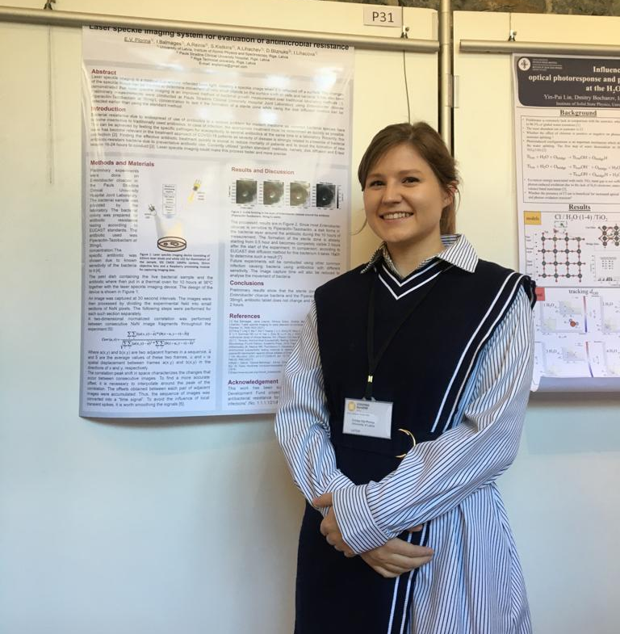
My background
Education:
In 2019 received professional bachelor degree in medical physics and medical physical technology engineer qualification from Riga Technical University
In 2021 received professional master’s degree in medical physics from Riga Technical University
In October, 2021 started medical physics doctoral studies in University of Latvia
Work:
Since 2017 have worked at the Biophotonics laboratory of the Institute of Atomic Physics and Spectroscopy, University of Latvia as laboratory assistant, research assistant and researcher

Slide 4
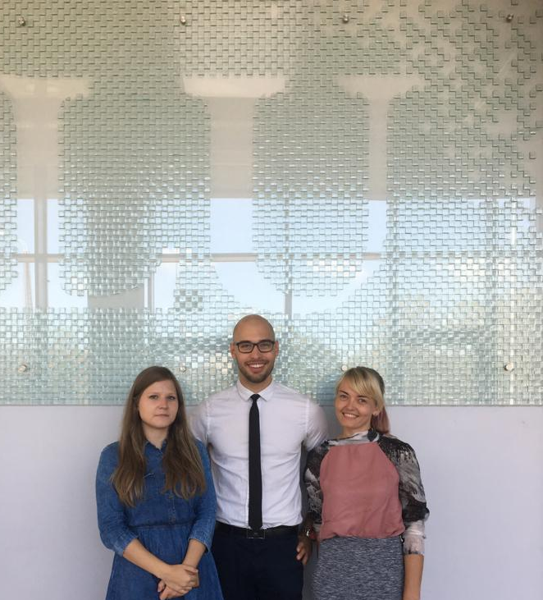
Previous collaboration

Slide 5
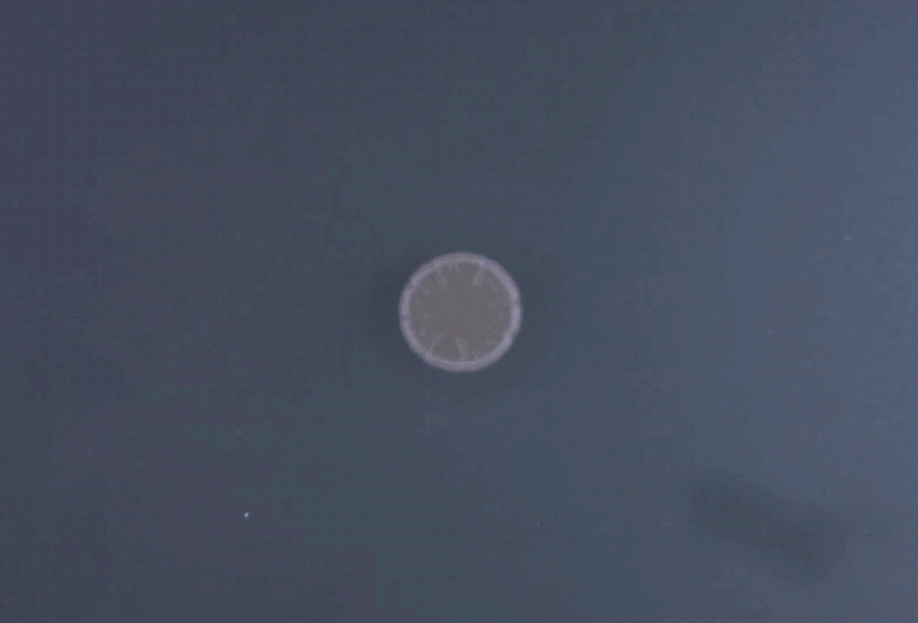
Project “Fast and Non-contact Optical Estimation of Microorganisms Activity”
Took place from 2018 to 2020
Aim of the project - to develop and test a new contactless optical technology for rapid assessment of microbiological activity under laboratory conditions
For this laser speckle imaging technology was chosen.

Slide 6
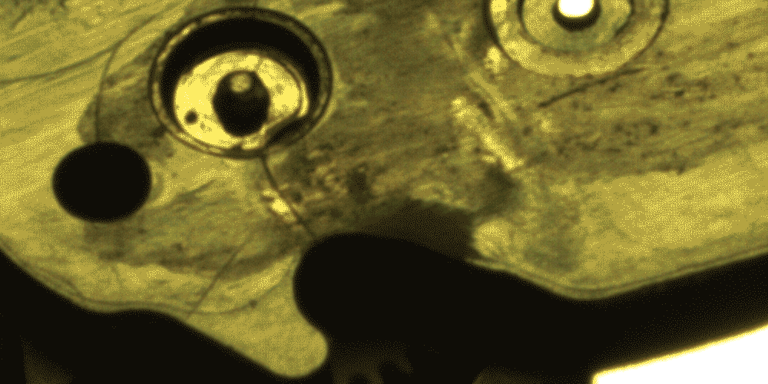
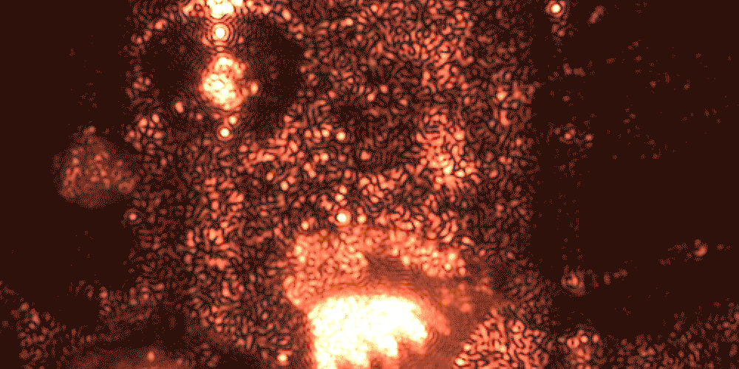
What is laser speckle imaging?
White light image
Laser speckle is an interference pattern produced by coherent light reflected or scattered from different parts of the illuminated surface
Laser speckle image

Slide 7
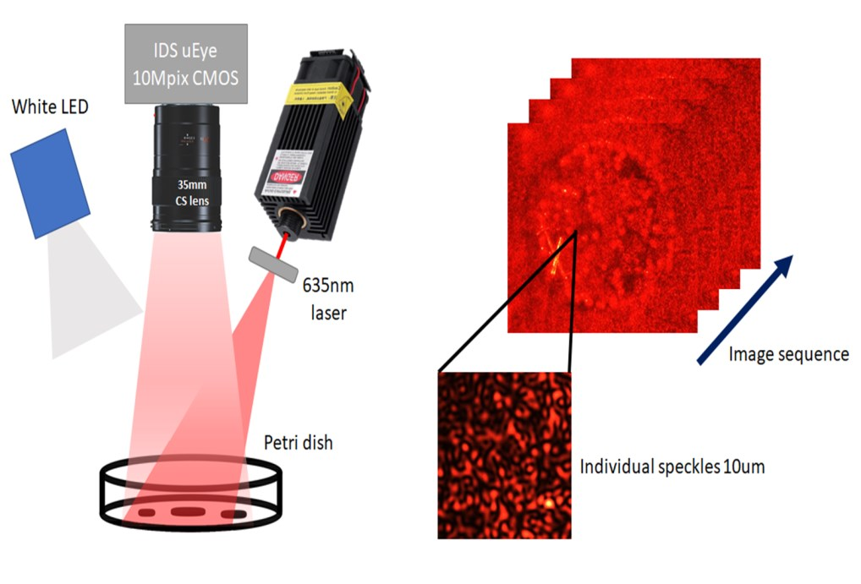
Method

Slide 8
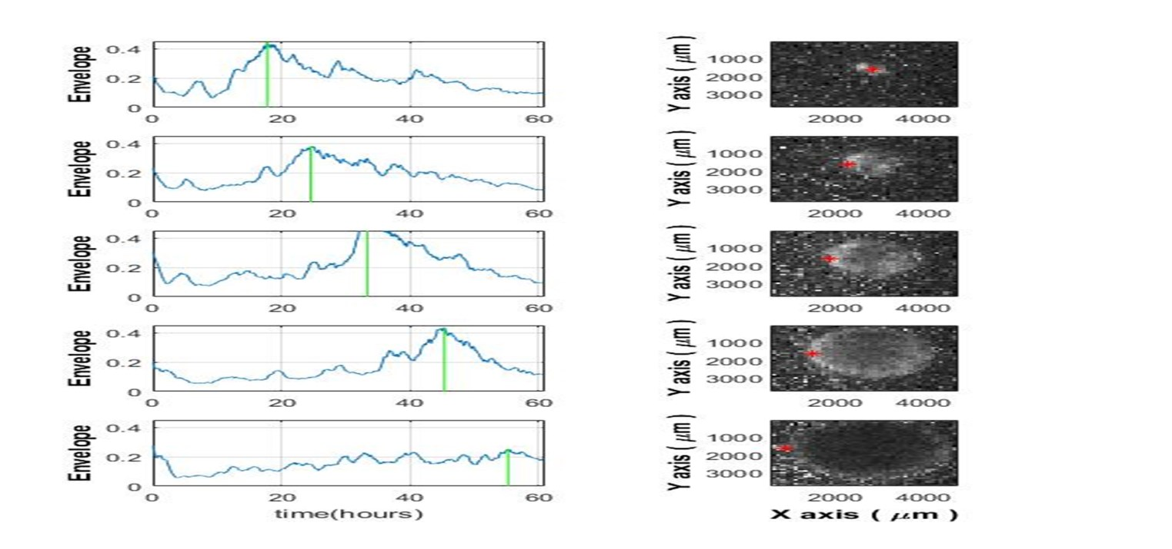
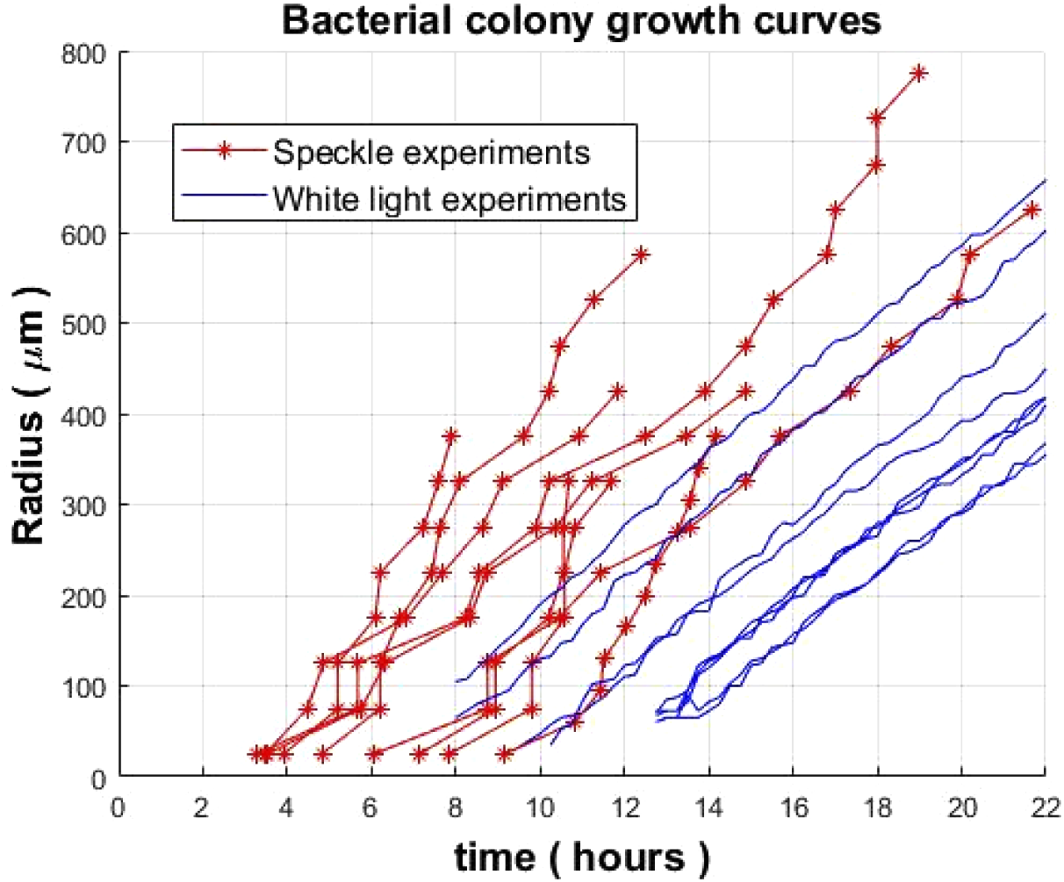
Results – laser speckle imaging of Vibrio natriegens

Slide 9
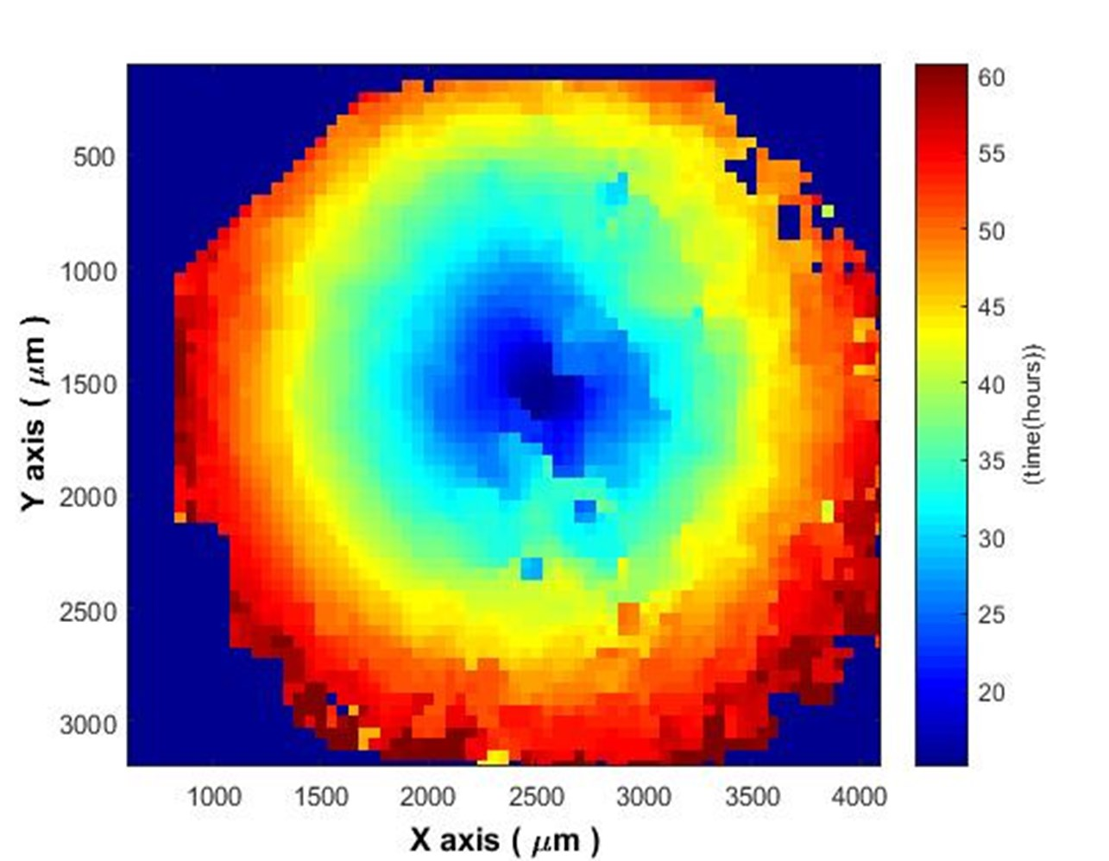
Results
Publications:
D. Bliznuks, A. Lihachev, J. Liepins, D. Uteshev, Y. Chizhov, A. Bondarenko, and K. Bolochko, "Automated microorganisms activity detection on the early growth stage using artificial neural networks," in Clinical and Preclinical Optical Diagnostics II, Vol. EB101 of SPIE Proceedings (Optica Publishing Group, 2019), paper 11075_60
Ilya Balmages, Dmitrijs Bliznuks, Janis Liepins, Stivens Zolins, Alexey Lihachev, "Laser speckle time-series correlation analysis for bacteria activity detection," Proc. SPIE 11359, Biomedical Spectroscopy, Microscopy, and Imaging, 113591D (1 April 2020); https://doi.org/10.1117/12.2541663
D. Bliznuks, Y. Chizhov, A. Bondarenko, D. Uteshev, J. Liepins, S. Zolins, A. Lihachev, I. Lihacova, "Embedded neural network system for microorganisms growth analysis," Proc. SPIE 11457, Saratov Fall Meeting 2019: Optical and Nano-Technologies for Biology and Medicine, 1145720 (9 April 2020); https://doi.org/10.1117/12.2564404
Lihachev, A., Bļizņuks, D., Liepiņš, J., & Lihacova, I. (2021). Laser Applications for Estimation of Microbial Activity and Investigation of NIR Skin Autofluorescence. Journal of Biomedical Photonics & Engineering, 7(4), 040305. doi:http://dx.doi.org/10.18287/JBPE21.07.040305
Ilya Balmages, Janis Liepins, Stivens Zolins, Dmitrijs Bliznuks, Ilze Lihacova, and Alexey Lihachev, "Laser speckle imaging for early detection of microbial colony forming units," Biomed. Opt. Express 12, 1609-1620 (2021)
Balmages, J. Liepins, D. Bliznuks, S. Zolins, I. Lihacova, and A. Lihachev, "Laser Speckle Imaging Reveals Bacterial Activity Within Colony," in European Conferences on Biomedical Optics 2021 (ECBO), OSA Technical Digest (Optica Publishing Group, 2021), paper EW4A.29.

Slide 10
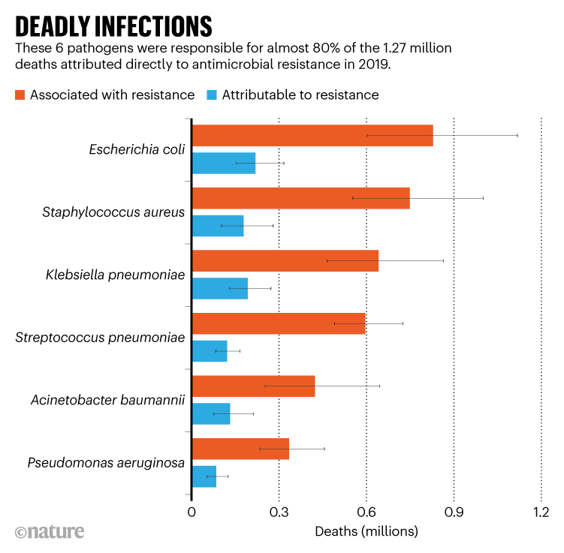
Project “Rapid assessment system of antibacterial resistance for patients with secondary bacterial infection”
Started in January, 2022
The aim of the project is to create a laser speckle imaging prototype that can quicker identify antibiotic resistance of bacteria than current methods.
The main steps would be – 1) Creation of laser speckle imaging system; 2) Development of algorithm for sterile zone idenitfication; 3) Clinical tests and validation; 4) Result dissemination;

Slide 11
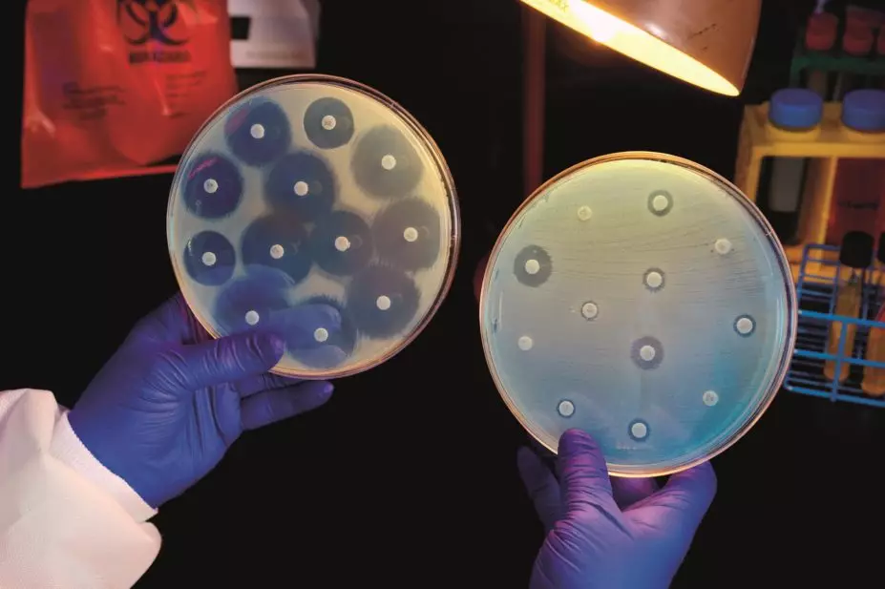
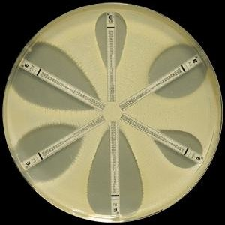
Currently used methods such as diffusion method, e-test, dilution method and others require 16-24h for the bacterial colony to grow. These may be crucial hours lost in the treatment process of a patient.
Diffusion method
E-test

Slide 12
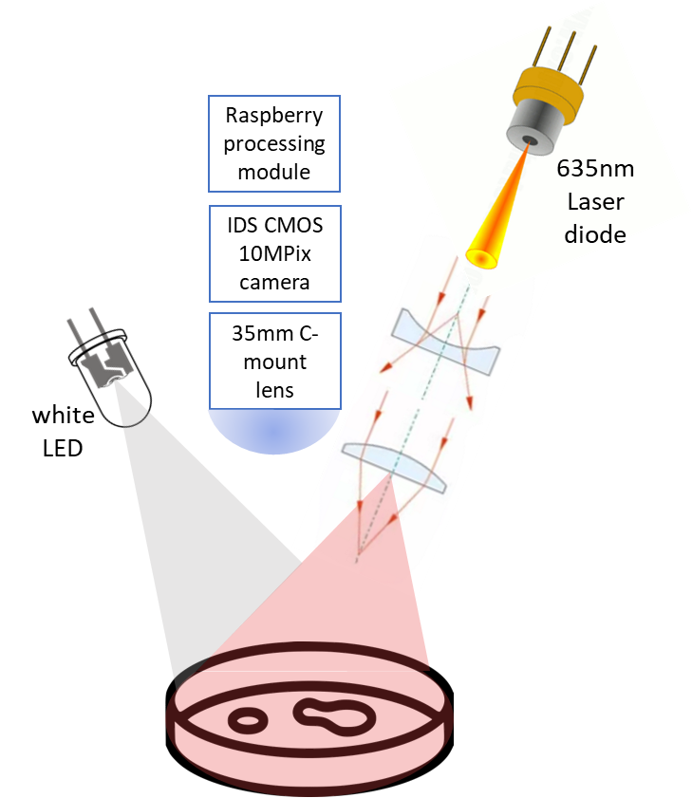
Current setup
Target setup

Slide 13
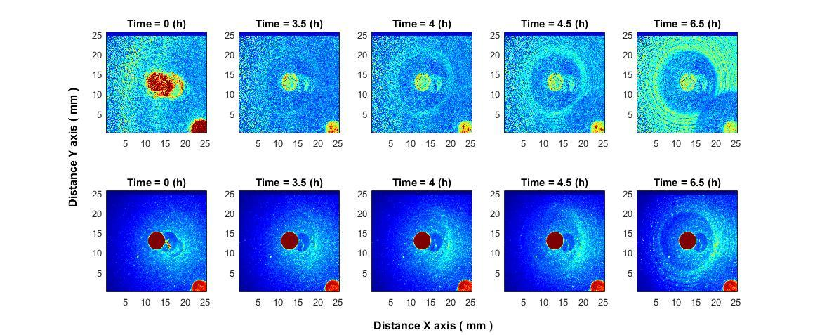
Recent results – laser speckle imaging ofStaphylococcus aureus with cefoxitin disc (30 µg)

Slide 14
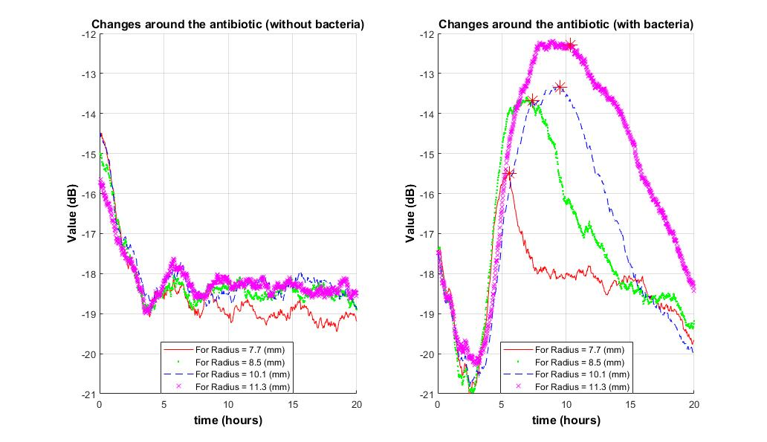
Recent results

Slide 15
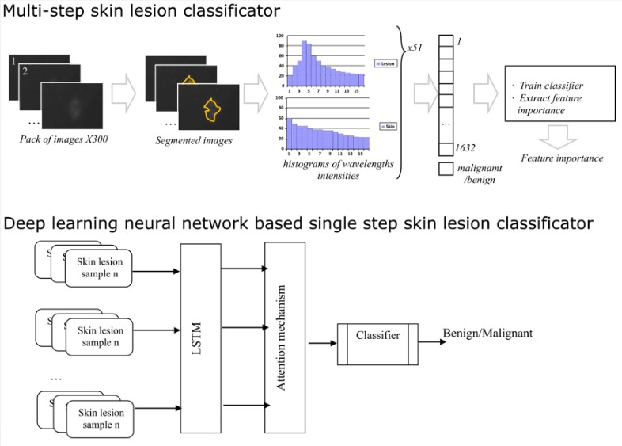
Project “Skin Cancer Early Diagnostics Accuracy Improvement by Using Neural Networks”
Took place from 2018 to 2020
Aim: To improve the multispectral imaging device and the multispectral image processing system with neural networks.

Slide 16
Results – saliency maps

Slide 17
Results – my master’s thesis “Accuracy of automatic multispectral skin lesion image segmentation”
Percentage of data from the main database that created both marker and lesion masks successfully:
44.61%

Slide 18
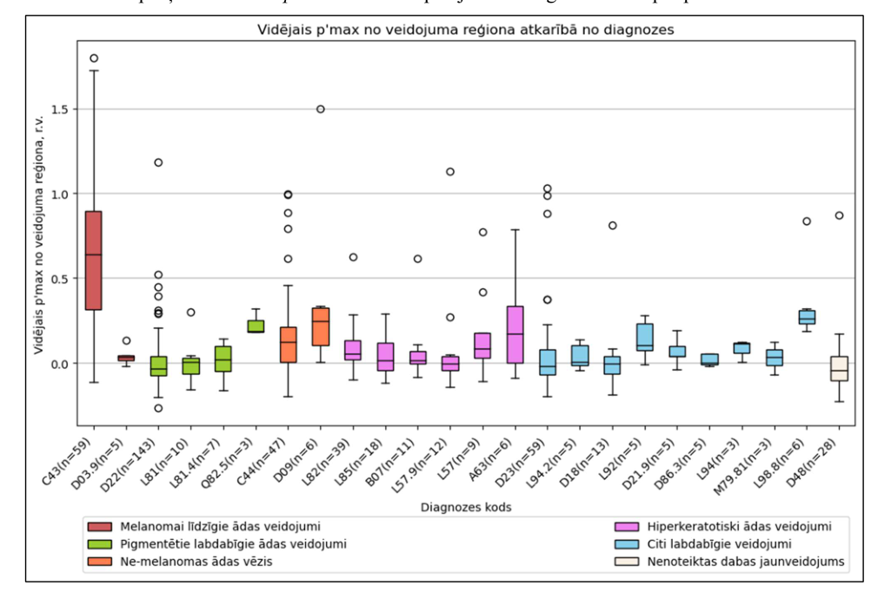
Results from master’s thesis for p’
$$p^{′}=\log_{10}{(\frac{I\left(526\right)∗I_{skin}\left(663\right)∗I_{skin}(964)}{I_{skin}\left(526\right)∗I\left(663\right)∗I(964)})}$$

Slide 19
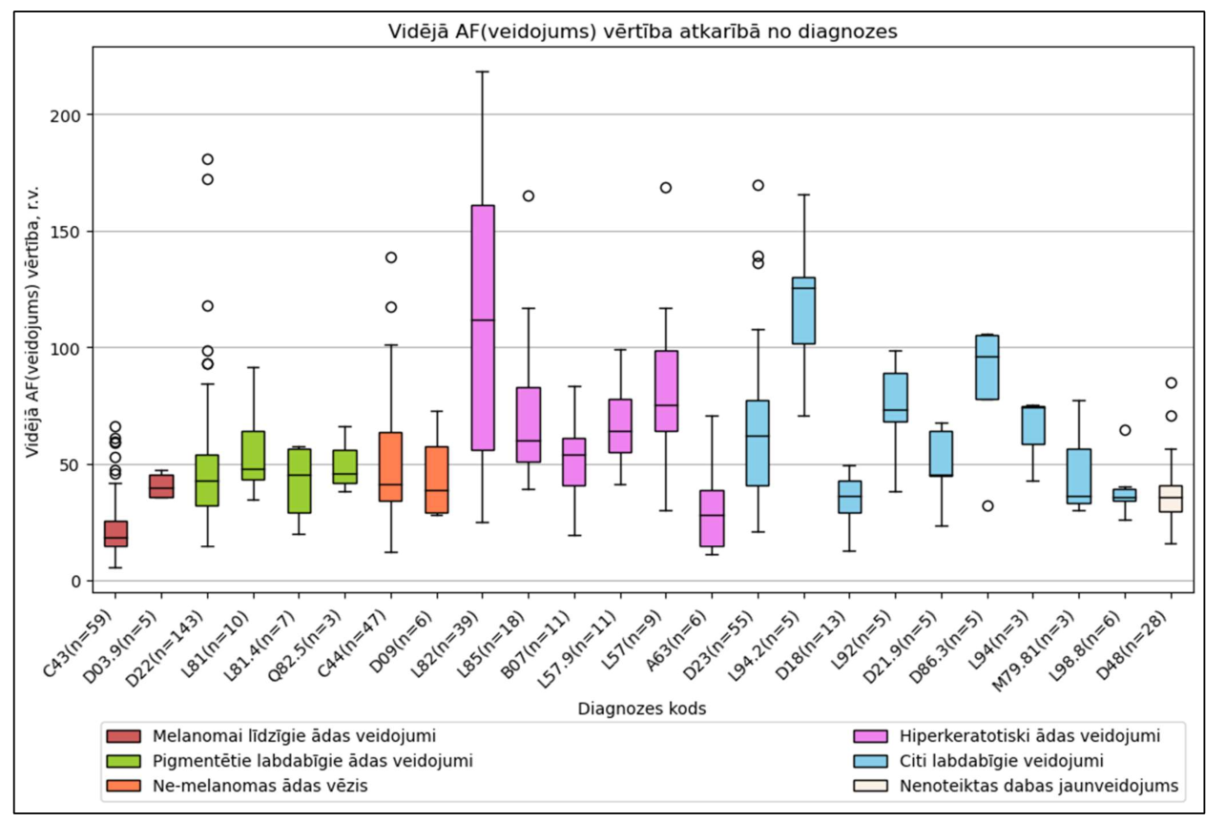
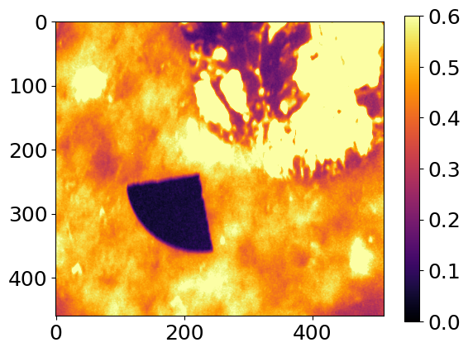
Results from master’s thesis for autofluorescence

Slide 20
Project results
Publications:
Katrina Bolochko, Dmitrijs Bliznuks, Dilshat Uteshev, Ilze Lihacova, Alexey Lihachev, Yuriy Chizhov, and Andrey Bondarenko "Towards to deep neural network application with limited training data: synthesis of melanoma's diffuse reflectance spectral images", Proc. SPIE 11074, Diffuse Optical Spectroscopy and Imaging VII, 110741O (11 July 2019); https://doi.org/10.1117/12.2527173
D. Bliznuks, Y. Chizhov, A. Bondarenko, D. Uteshev, A. Lihachev, I. Lihacova, “Identification of the most informative wavelengths for non-invasive melanoma diagnostics in spectral region from 450 to 950 nm,” SPIE Saratov Fall Meeting 2019, 23-27 September, Saratov, Russia. (Submitted, will be published).
A. Bondarenko, Y. Chizhov, D. Uteshev, D. Bliznuks, A. Lihachev, and I. Lihacova "Use of machine learning approaches to improve non-invasive skin melanoma diagnostic method in spectral range 450 - 950nm", Proc. SPIE 11353, Optics, Photonics and Digital Technologies for Imaging Applications VI, 113531D (2020).
D. Bliznuks, E. Cibulska, A. Bondarenko, Y. Chizhov, I. Lihacova, “Deep learning model deploying on embedded skin cancer diagnostic device,” SPIE Proc, Third International Conference Biophotonics Riga 2020 (submitted)
J. Spigulis, I. Kuzmina, I. Lihacova, V. Lukinsone, B. Cugmas, A. Grabovskis, E. Kviesis-Kipge, A. Lihachev, “Biophotonics research in Riga: recent projects and results,” SPIE Proc, Third International Conference Biophotonics Riga 2020 (submitted).

Slide 21
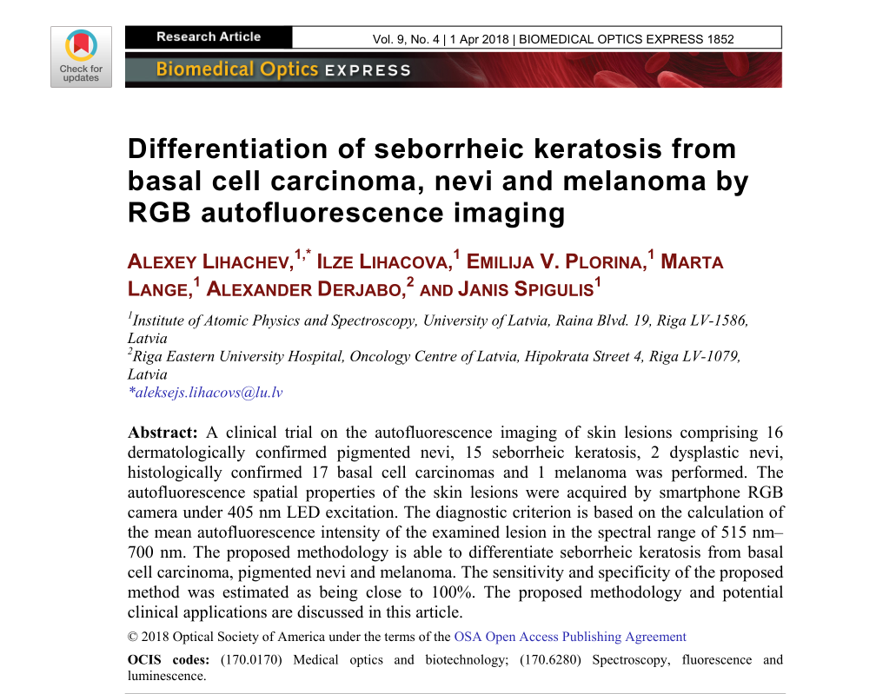

Slide 22
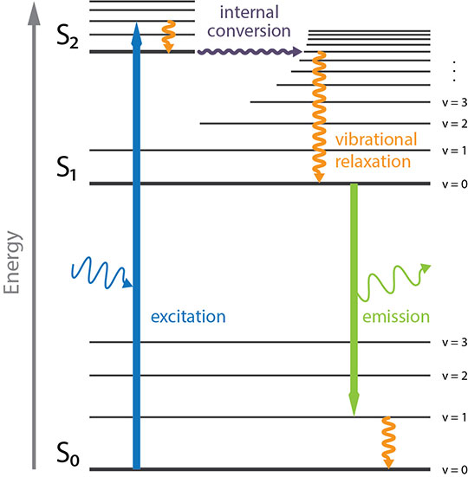
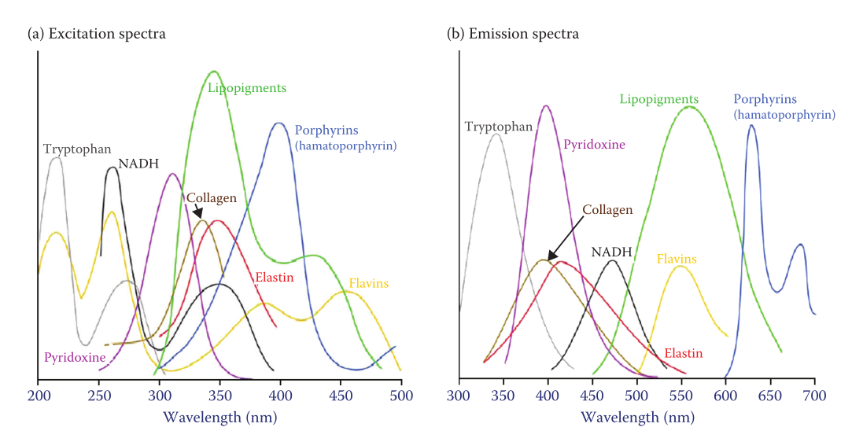
Skin autofluorescence

Slide 23
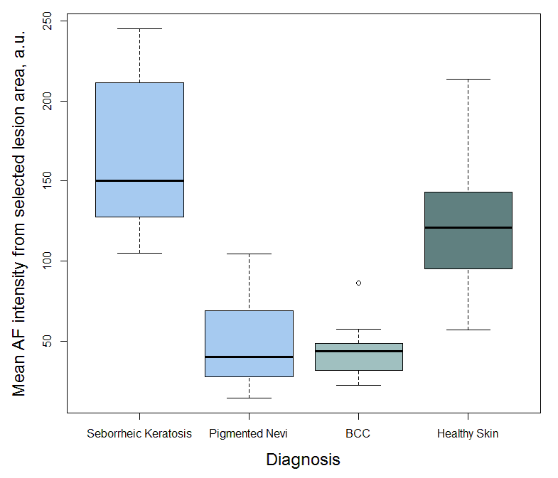
Results with 17 BCC, 15 SK and 16 nevi measurements
Autofluorescence images of basal cell carcinoma
Autofluorescence images of seborrheic keratosis

Slide 24
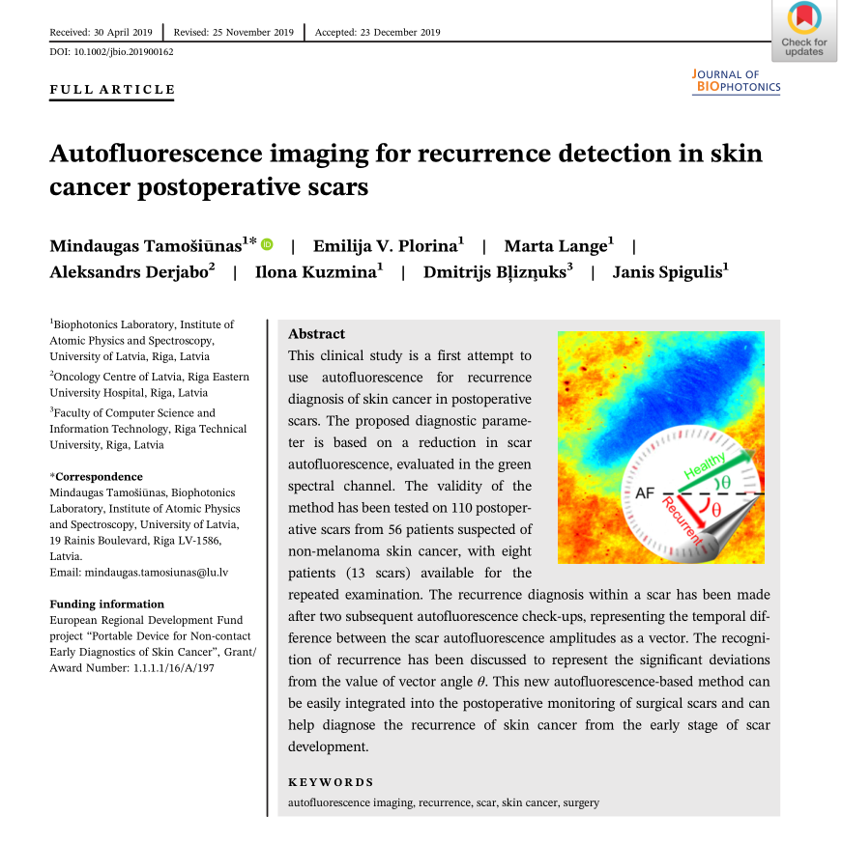

Slide 25
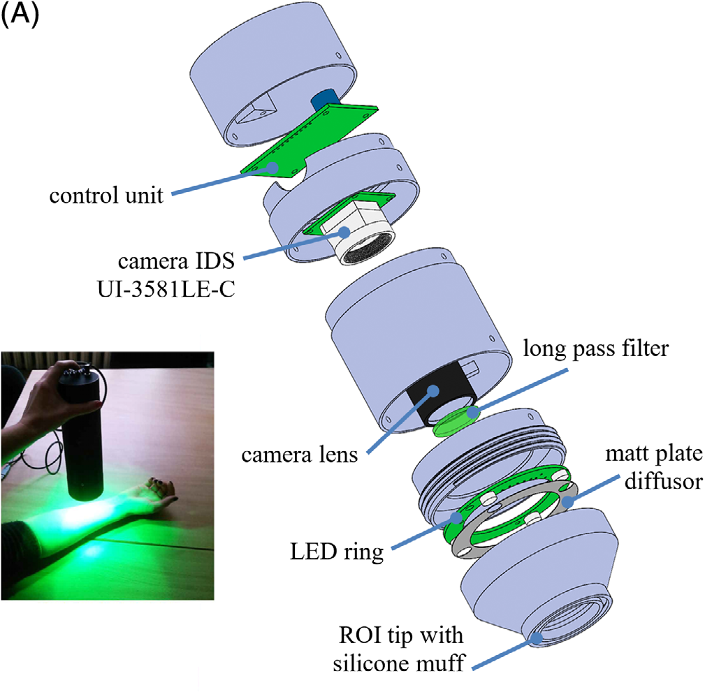
Method

Slide 26
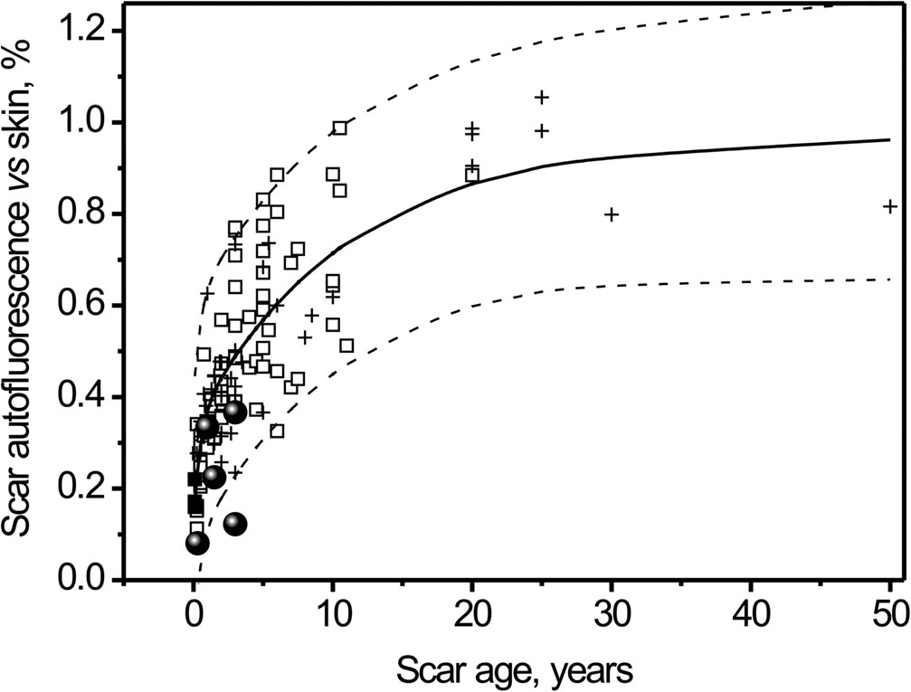
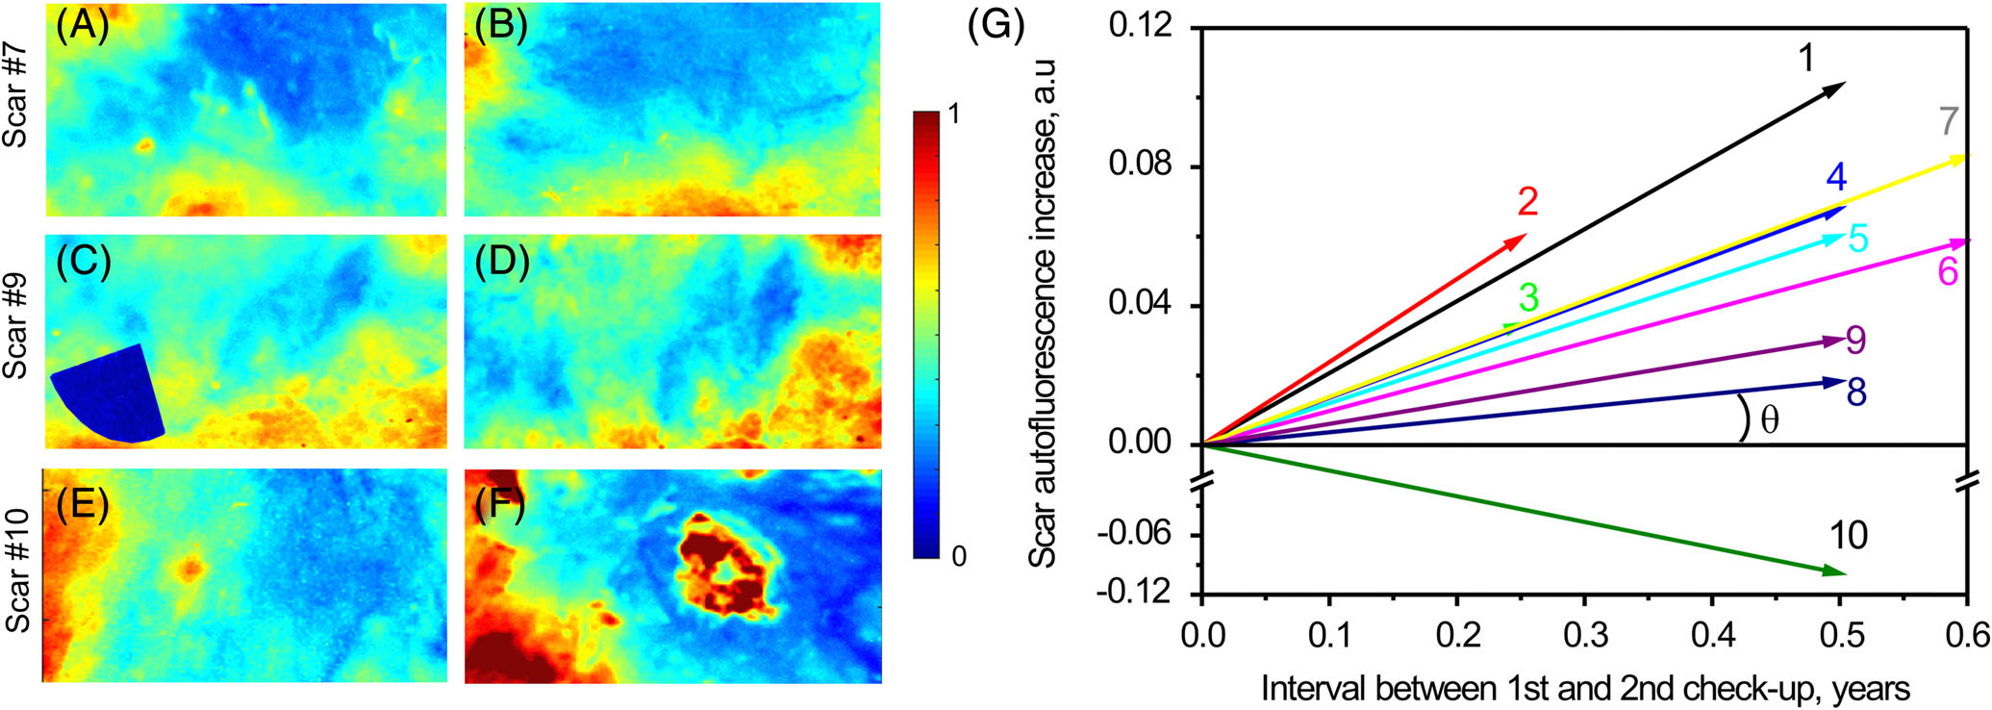

Slide 27
Future plans
Gathering more recurrent and non-recurrent skin cancer postoperative scar autofluorescence data
Gathering more autofluorescence and diffuse reflectance measurements of many different skin lesions
Improving the segmentation of images and sensitivity of processing algorithms
Gathering more resistant bacteria laser speckle imaging data with most common resistant bacteria and different antibiotics
Creating new prototypes that integrate the latest findings

Slide 28
Aknowledgment
Research is supported by European Regional Development Fund project:
No. 1.1.1.1/21/A/034 “Rapid assessment system of antibacterial resistance for patients with secondary bacterial infections”
And European Social Fund project:
No. 8.2.2.0/20/I/006 "Strengthening of the capacity of doctoral studies at the University of Latvia within the framework of the new doctoral model”

Slide 29
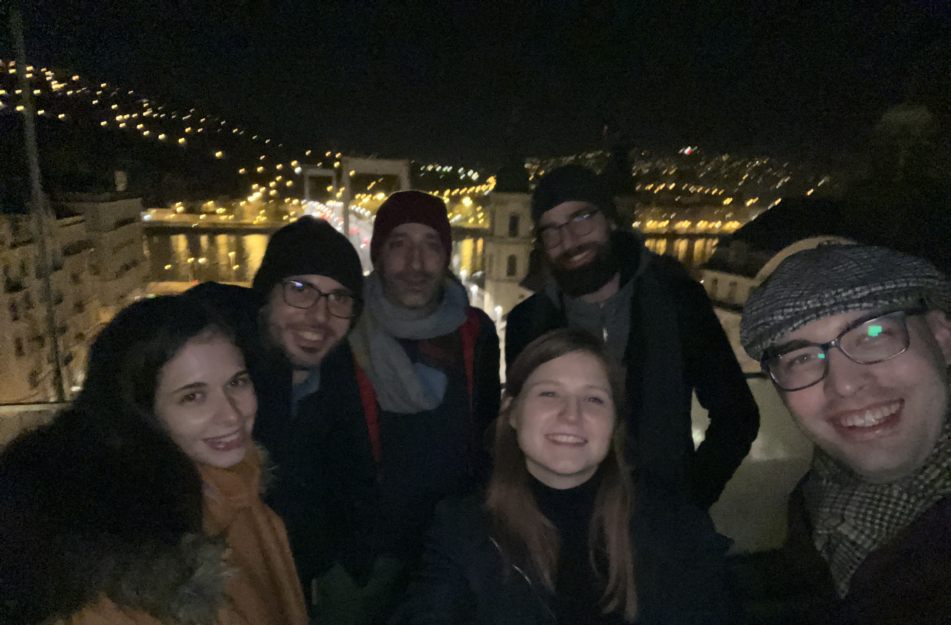

Slide 30
Thank you for your attention!

