Slide 1
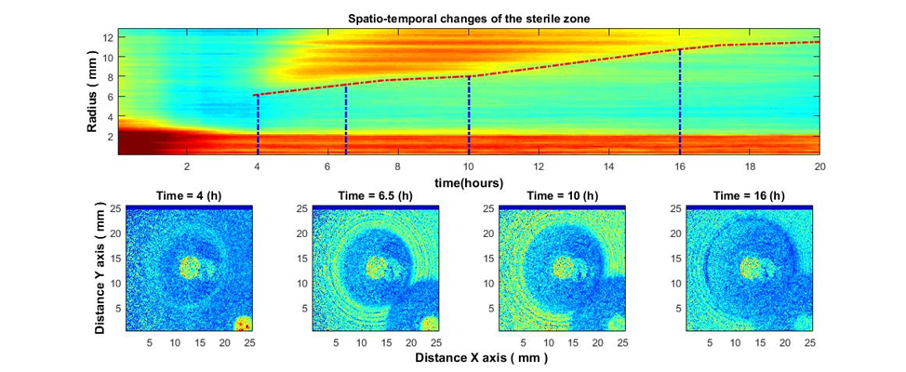
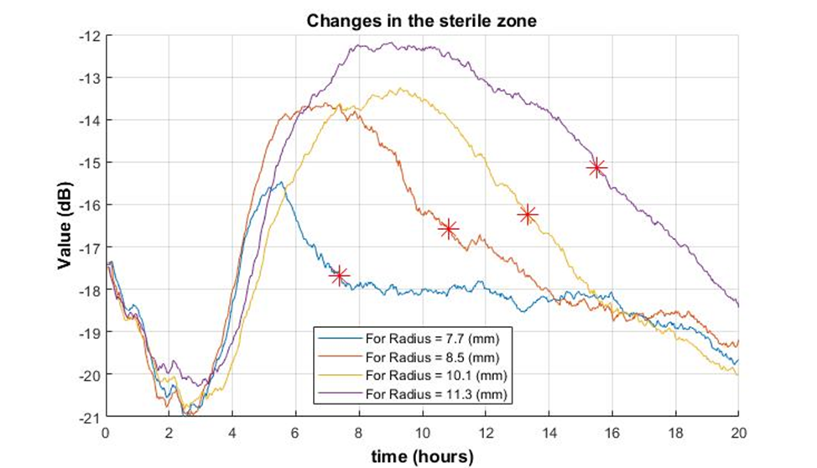
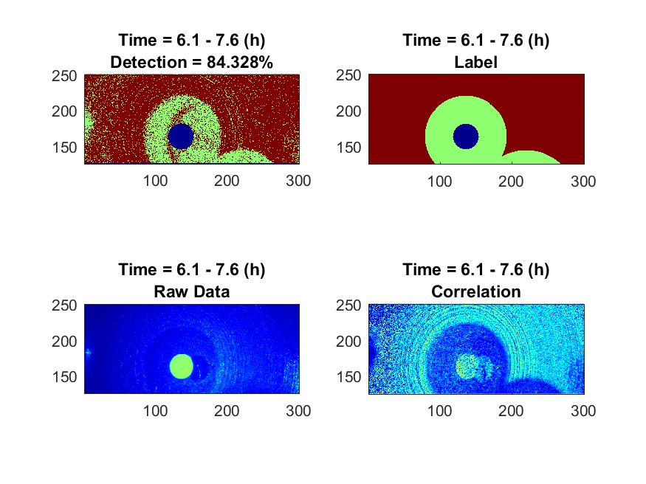
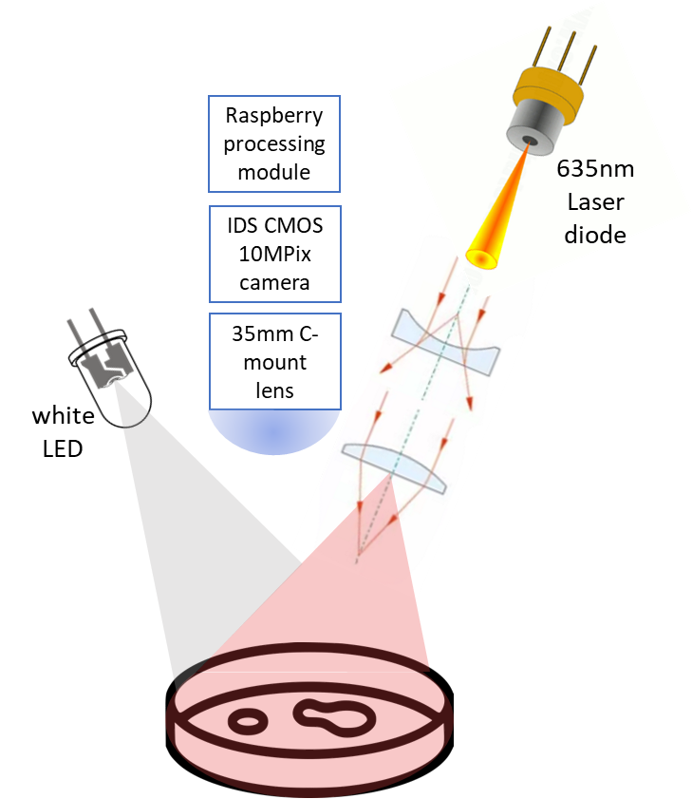
Image-assisted disc diffusion test for rapid evaluation of antimicrobial susceptibility
P 1518
Aigars Reinis ^{1, 2}, Ilya Balmages ³, Svjatoslavs Kistkins ¹, Dmitrijs Bliznuks ⁴, Inese Polaka ⁴, Emilija
Vija Plorina ³, Nityanand Jain ^{1, 2}, Alexey Lihachev ³, Ilze Lihacova ³
¹Pauls Stradins Clinical University Hospital, Riga, Latvia; ²Riga Stradins University, Department of Biology and Microbiology, Riga, Latvia; ³Institute of Atomic Physics and Spectroscopy, University of Latvia, Riga, Latvia; ⁴Riga Technical University, Riga, Latvia
E-mail: aigars.reinis@stradini.lv
Abstract
Epidemiological threats are increasing and causing signs of global crisis. One of them is antimicrobial multiresistance (AMR) which stems from the increased untargeted use of antibiotics. The main problem of phenotypic AMR tests is that after the preparation and inoculation of the test culture takes 24-72 h to read the results. One of the options for the rapid evaluation of bacterial antibiotic susceptibility is a non-contact optical technique called - laser speckle contrast imaging.
Introduction
Results and Discussion
The Neural network was used to classify between the zones of bacterial activity and the sterile zones formed around antibiotic discs and allows to follow the change in the sterile zones size.
Based on the obtained results, a statistical analysis of the dependence of the size and growth rate of the sterile zone on different antibiotics for the different species of bacteria will be carried out.
Methods and Materials
An experiment based on a disk diffusion test was performed by using S. aureus and two antibiotics-enriched disks: Cefoxitin - 30 μg and Gentamicin 10 μg. in the Pauls Stradins Clinical University Hospital Joint Laboratory. The bacterial colony was prepared for disk diffusion test according to EUCAST guidelines [1]. The specific antibiotic was chosen due to known sensitivity of the bacteria to it. The duration of the experiment was 18±2 hours and the time between frames was 10 seconds.
The Mueller-Hinton agar with bacterial culture and the antibiotic disks was incubated 18±2 hours at 36ºC together with the laser speckle imaging device. The design of the device is shown in Figure 1.
The obtained laser speckle time series images were processed using the sub-pixel correlation analysis method [2]. The obtained results are shown in Figures 2-4.
The Neural network (Multilayer perceptron) was used to classify between the zones of bacterial activity and the sterile zones formed around antibiotic disks (Fig. 4). Gentamicin disk was used as a training set, and Cefoxitin disk - a test set.
Figure 2. Spatio-temporal changes of the sterile zone (top), and sterile zone formation in the growth of S. aureus around the Cefoxitin - 30 μg disc (bottom).
Figure 3. Change of signal envelope over time for several different radii around the antibiotic the Cefoxitin - 30 μg, with bacteria S. aureus. It is observed that as it moves away from the centre, the fall (which means the appearance of a sterile zone in this place) occurs later (stars).
Figure 4. Detection of the sterile zone, using a neural network, around the disc Cefoxitin - 30 μg, bacteria: S. aureus. 1) bottom left -raw speckle image, 2) bottom right - speckle image after subpixel correlation analysis, 3) top right - labeling, 4) top left -classification result.
The formation of the sterile zone is becoming visible 2-3 hours after the start of the experiment. In comparison, according to EUCAST disk diffusion method for this bacterium it takes 18±2h to determine such a result [3].
The decrease in the signals value occurred in a dynamic manner (7.7 mm-6 h; 8.5 mm-7.3 h; 10.1 mm-9.3 h; 11.3 mm-10.5 h) representing the radius of the sterile zone. Outside the sterile zone, the signal decreased much later and simultaneously for different radii. The signals in both zones definitely differed from each other. The correct classification reached 85 percent (6.1-7.6 h).
Future experiments will be conducted using other common infection causing bacteria using antibiotics with different susceptibility. The image capture time will also be reduced to analyse the movement of bacteria.
Figure 1. The experimental setup consists of a 658 nm diode pumped solid state laser (output power 60 mW) spread homogeneously over the petri dish surface and a white light emitting diode to obtain images in white light. Laser speckle images were recorded with an IDS CMOS 10 Mpix camera every 10 seconds.
Conclusions
The study shows that image-assisted disc diffusion test would identify antimicrobial susceptibility faster than using the disk diffusion method without laser speckle technology.
Acknowledgement
References
This work has been supported by European Regional Development Fund project “Rapid assessment system of antibacterial resistance for patients with secondary bacterial infections” (No. 1.1.1.1/21/A/034).
[1] Antimicrobial susceptibility testing. EUCAST disk diffusion method. Version 10.0, January 2022.
[2] Ilya Balmages, Janis Liepins, Ernests Tomass Auzins, Dmitrijs Bliznuks, Edgars Baranovics, Ilze Lihacova & Alexey Lihachev, “Use of the speckle imaging sub-pixel correlation analysis in revealing a mechanism of microbial colony growth.” Sci Rep 13, 2613 (2023).
[3] https://www.eucast.org/clinical_breakpoints/

