Slide 1
BUILDING ROBUST INFORMATION
SYSTEMS FOR REMOTE SENSING
DATA MANAGEMENT
Riga Technical University, Faculty of Computer Science and Information Technology
Pāvels Osipovs
Senior Researcher
05.10.2023
Notes:
Greetings dear conference participants. In this presentation I’ll speak about some experience we got after several years of the work on the few scientific projects.

Slide 2
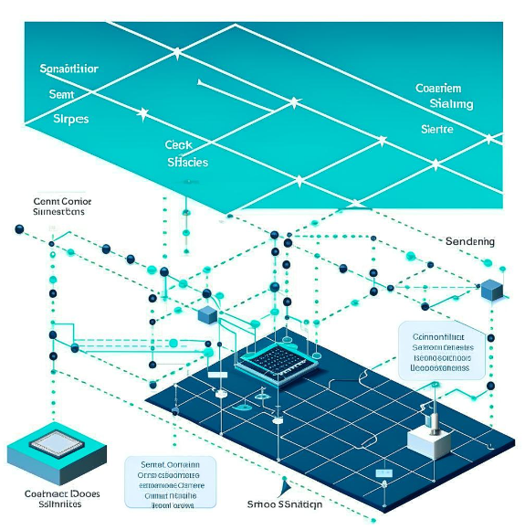
Projects similarities and differences
Notes:
In our article we describe the experience gained from working with two different systems. Externally they are looks quite different, but many internal processes are very similar. Both have certain sources of data streams that are collected on a common server and then somehow stored, processed and provided to the personnel. First system was used to test the quality of microchips, and the second to obtain medical data.
In this presentation, I will describe general issues of data storage, protection, and processing in such type of systems. And hope what this experience may be of interest to the other researchers.

Slide 3
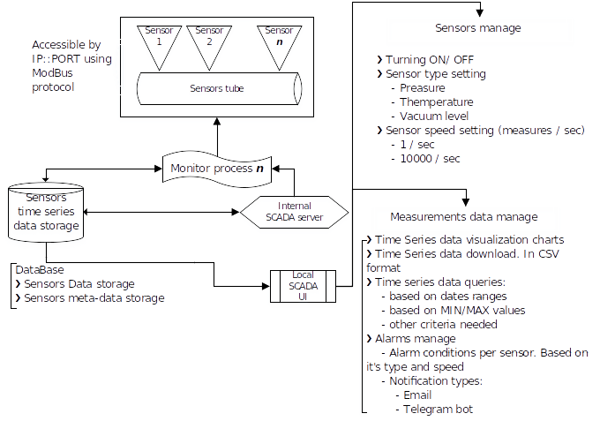
Collecting data from sensors
Data streams or chunks.
No requirement for real-time processing.
There can be a lot of data, but we are only interested in the aggregated resulting figures (of a relatively small volume).
Raw data received from sensors can be stored completely separately from the results of their analysis.
Notes:
When we have lot of the different sensors what used as the data sources, then initially we must think through several basic characteristics of data-processing sub-system.
For example, are data from the sensors received by the streams or the data-chunks? Depends on it we may use different processing approaches: real-time daemons, or just a scripts to process each new data piece.
Also the requirements to obtain data processing results can significantly change the overall system architecture. In current picture you may see architecture used by us for the real-time data processing.
If the processed data takes up significantly less space than the raw data received, then it is advisable to store it in a separate storage system.

Slide 4
Ensuring data access
It is advisable to store data from sensors in a place without access from outside. At the same time, access to the processed data most often must be provided using an administration panel accessible via the Internet.
Critical sensitive data should not be saved into database without encryption.
Access to the administration panel is protected by user authorization and authentication systems.
Access from mobile devices is especially in demand these days.
Notes:
To ensure security, it is important to store the data itself in a system that does not have direct access to the Internet. And all personal sensitive information should be encrypted and not stored in the data storage as it is.
It is also important to remember that staff are increasingly using mobile devices to access the administration panel. So, it should be adopted to the mobile devices screen sizes and touchscreens input specifics. For example , big tables should support responsible layout, and big charts also should works well on the small screen devices.

Slide 5
Data processing
Data can be processed in one or more stages.
Typically, programs written in scripting programming languages are used for processing.
Data processing can also be carried out in parallel.
To manage data processing processes, system utilities such as Supervisor or Watchdog are used.
To transfer data between servers, it is also convenient to use system utilities. Rsync is often used.
Notes:
Data can be processed in one or more stages. This gives us opportunities to parallelize this process. System threads can be used for the simple processing scripts, and micro-services approach for more complex processing logic.
In our projects we are use scripts to process the data received. But the state of them also must be monitored, and in case of any errors they must be automatically restarted. And Supervisor or Watchdog it’s great tools to do it.
To transfer data between nodes, the built-in capabilities of the operating system are most often sufficient. For example, Rsync is great.

Slide 6
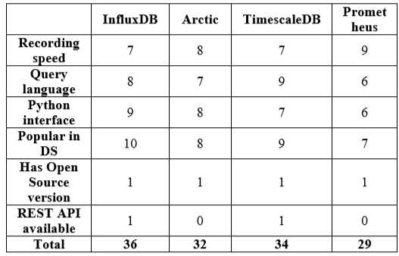
Data storage
To store raw data, it is advisable to use specialized storage.
Depending on the characteristics of the data, one or another software tool will be preferable. You need to create a table of the most important characteristics to choose the best data storage engine.
Notes:
When choosing a storage system, it is important to evaluate the available systems based on most important criteria. For example, in our case, we had following set of main characteristics,
%read them%
and InfluxDB became the best choice.

Slide 7
Performance optmiziations
It is important to pay special attention to the performance of scripts that process data. Very often, if one of the processing stages requires a lot of time, then you can find a way to significantly reduce it. For example, one of the analysis stages required about 4 hours to calculate a large number of standard deviations; as a result of a series of software optimizations, the same task was solved in approximately 365 milliseconds.
Notes:
When processing large amounts of data, a simple approach is often time consuming. As a proof of concept, this is enough to realize processing logic as simple as possible, but when the system goes into production mode, you need to try to reduce the data processing time. In our case, we managed to reduce the time of one step from 3.5 hours to 350 milliseconds! We achieved it by the implementing JIT compilation together with the using Cython data types.

Slide 8
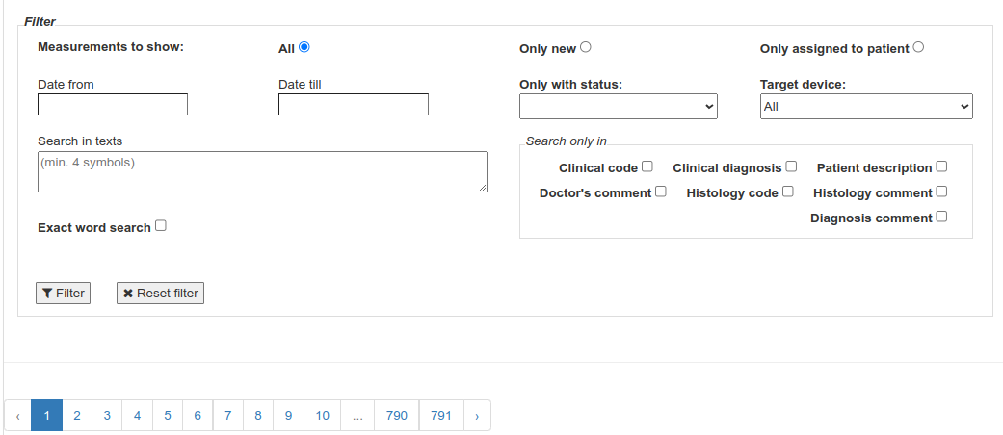
User Interface
It is important to pay attention to the search system using the received data. It is often one of the most important elements with which users interact a lot.
Notes:
Data can have many different characteristics, so it is important to implement a search system taking into account the possible interests of users. Flexible internal search system it’s very good tool what allow to be more efficient for the personnel.

Slide 9
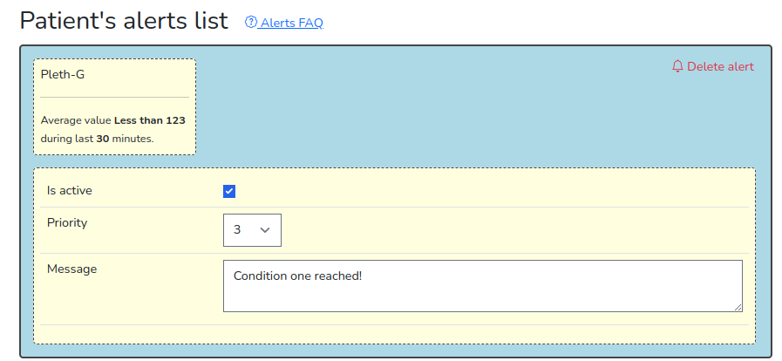
Notifications subsystem
In modern systems, there is more and more demand for notification of important events in real time. At the same time, there are quite complex and varied requirements for the logic of sending notifications.
Telegram bots are currently coping well with the process of notifications in real time.
And to create alert logic, it is convenient to provide users with a visual designer that allows them to create exactly the rules that they need in each specific case.
Notes:
Additionally, in complex systems, many different events occur, so it is important to have a warning system for them.
But often we cannot predict what a specific criteria for the alerts staff may need, so it may be a good idea to give them the ability to build alerts conditions itself, based on the criteria they want to receive notifications.

Slide 10
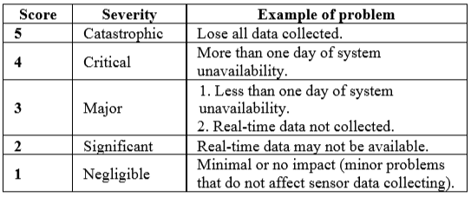
Preparing for Incidents
Sooner or later, problems may appear in every system. Already at the stage of its development, it is advisable to be prepared for this situation. Typically, problems can be sorted by the level of damage caused, and a set of activities can be prepared for each of them.
Notes:
The more important the data that is stored in the system, the greater the loss that its loss or damage can cause. Therefore, it is important to initially have a plan in place for different types of problems.
We divide them into five levels of significance. And for each we have set of the instructions + different ways of the notifications. As you may see, we have five levels of severity, and for each of them we are planned set of the actions and notifications.

Slide 11
This work has been supported by the following ERAF projects:
ERAF SmartAsistant CPAP F4596, Nr.1.1.1.1/21/A/082 - Machine learning-based clinical decision support system for the non-invasive ventilation devices in the treatment of COVID-19 patients.
ERAF Antibacterial resistance F4562, 1.1.1.1/21/A/034 - Rapid assessment system of antibacterial resistance for patients with secondary bacterial infections.

Slide 12
Thank you for attention!

