Slide 1


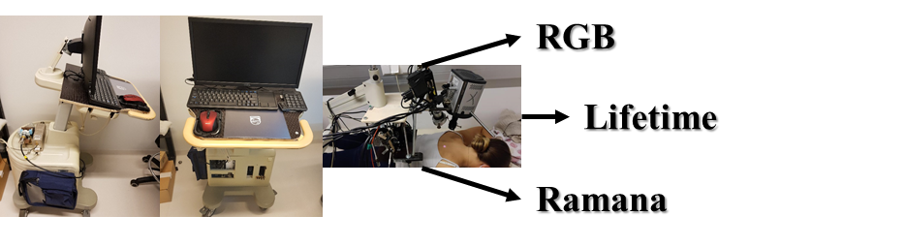
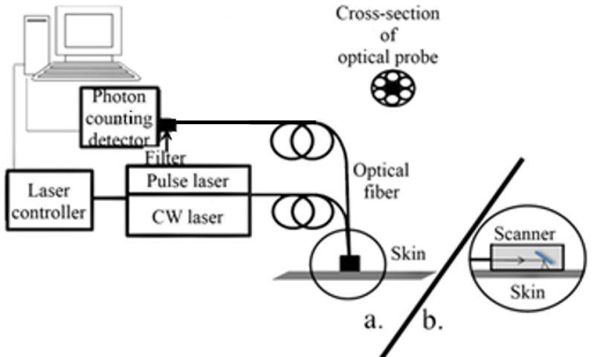
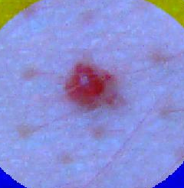
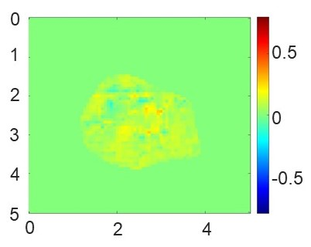
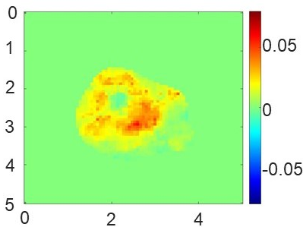
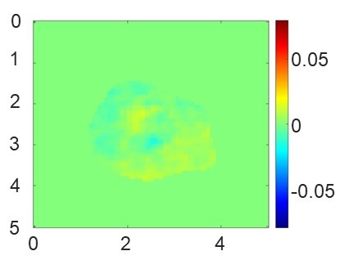
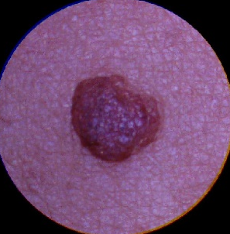
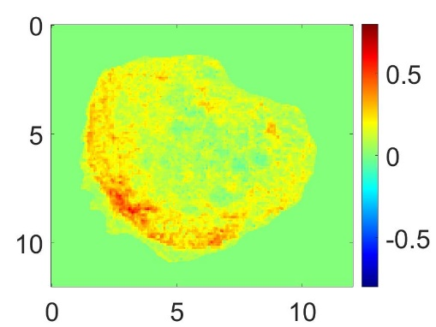
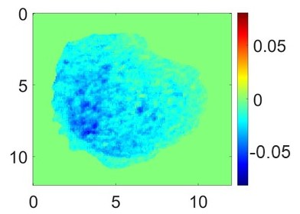
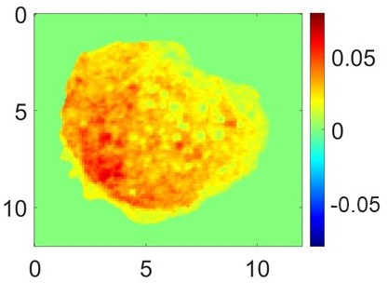
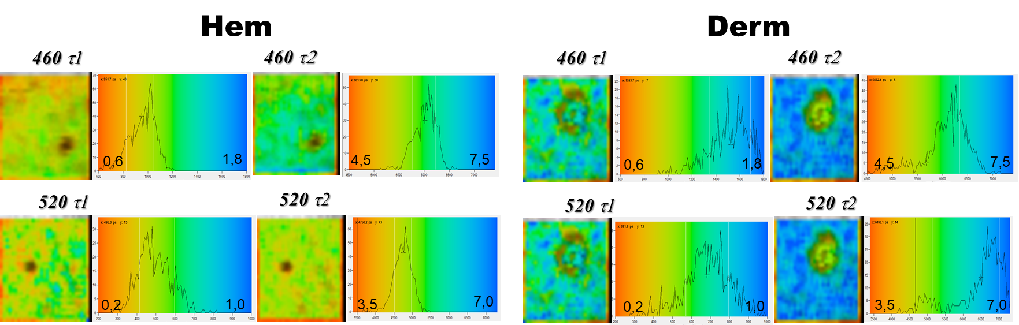
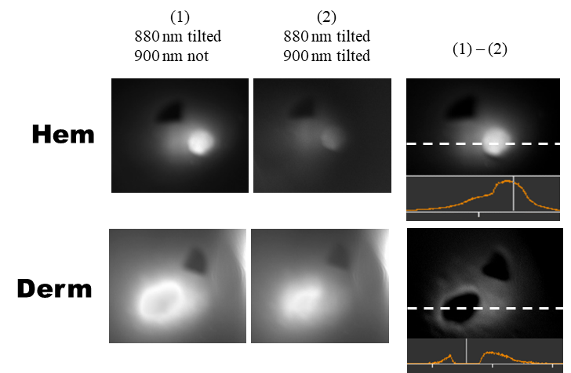
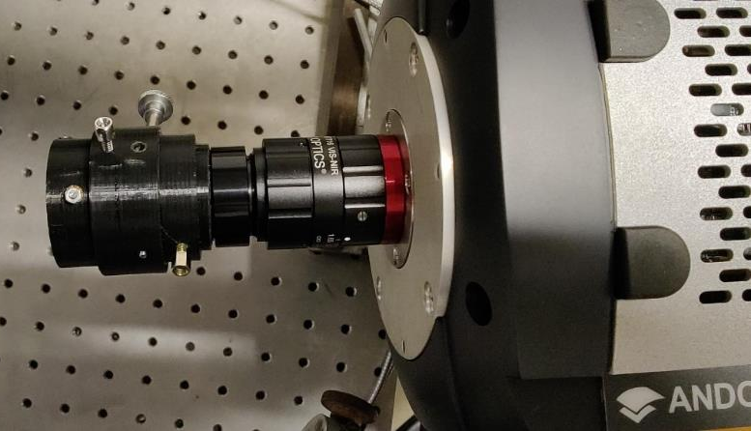
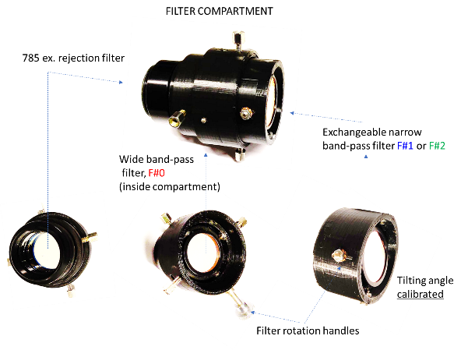
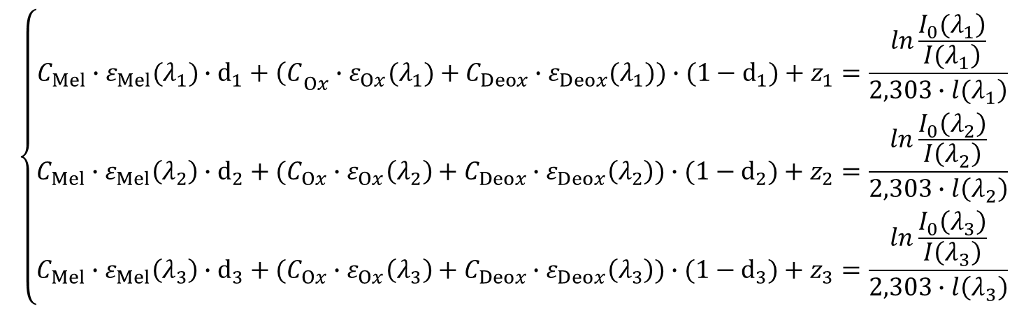
Fluorescence lifetime, RGB and Raman imaging
for skin diagnostics
Vanesa LUKINSONE¹, Mindaugas TAMOŠIŪNAS¹, Ilona KUZMINA¹, Maris KUZMINSKIS¹ Ilze OSHINA¹, Laura DAMBITE¹ and Janis SPIGULIS¹.
¹Biophotonics Laboratory, Institute of Atomic Physics and Spectroscopy, University of Latvia,
Raina Blvd19, Riga, LV-1050, Latvia
vanesa.lukinsone@lu.lv
The major goal is to improve skin diagnostics by using a combination of optical measures. Three imaging modalities were combined in this pilot study: fluorescence lifetime, RGB imaging, and Ramana spectroscopy imaging. Three measurements methods were used in succession to measure one neoplasm. In this study, the results of each method are presented separately.
RGB
Fluorescence lifetime
The chromophore maps were calculated from three RGB images captured by 1.3mpx RGB camera (Dino-Lite AM413T-FVW) under red (637nm), green (524nm) and blue (454nm) illumination of RGB laser (400–700nm, 500mW, Elite Optoelectronics Ltd.) RGB image of each neoplasm represents combined three images captured under red, green and blue illumination.
The maps of both neoplasms (Fig.1) show inhomogeneous distribution of the chromophores’ concentrations (C). The dermal nevus has the lower oxyhemoglobin concentrations (C_{Ox}) compared to the surrounding skin while the hemangioma (vascular neoplasm) has higher concentrations.
TCSPC – SPC 150
Detector - HPM-100-07 hybrid photon counting detector (Becker&Hickl, Germany).
Light sours – pulses laser 405 nm. (PDL-800-D, PicoQuant, Germany (Fianium, FWHM 59ps, 20 MHz)
Filters – 460 nm(Semrock, FF01-461/5-25) and 520 nm (Semrock, FF01-520/15-25)
RGB
Mel
C_{Mel},mM
Ox
C_{Ox},mM
Deox
The fluorescence were exited with 405 nm, and detected at 460 nm (NAD(P)H) and 520 nm (FAD). The data were approximated with two exponential approximation in SPCImage program (Fig.2.).
NADH and FAD fluorescence is excited by near ultraviolet radiation (350 nm–375 nm) NAD(P)H fluorescence is observed in the blue spectral range of 450 nm– 475 nm, while fluorescence from FAD is observed in the green spectral range of 530 nm – 550 nm [1 – 4].
C_{Deox},mM
Hem
C_{Mel},mM
C_{Ox},mM
C_{Deox},mM
Derm
Fig.1. RGB images and segmented chromophore maps of the melanin (Mel), oxyhemoglobin (Ox) and deoxyhemoglobin (Deox) for a hemangioma (Hem) and dermal nevus (Derm).
$$\left\{\begin{matrix}C_{Mel}∙ε_{Mel}(λ_{1})∙d_{1}+{\left(C\right.}_{Ox}∙ε_{Ox}(λ_{1})+C_{Deox}∙ε_{Deox}(λ_{1}))∙(1−d_{1})+z_{1}=\frac{ln\frac{\left.I_{0}(λ_{1}\right)}{\left.I(λ_{1}\right)}}{\left.2,303∙l(λ_{1}\right)} \\ C_{Mel}∙ε_{Mel}\left(λ_{2}\right)∙d_{2}+(C_{Ox}∙ε_{Ox}\left(λ_{2}\right)+C_{Deox}∙ε_{Deox}\left(λ_{2}\right))∙(1−d_{2})+z_{2}=\frac{ln\frac{I_{0}\left(λ_{2}\right)}{I\left(λ_{2}\right)}}{2,303∙l\left(λ_{2}\right)} \\ C_{Mel}∙ε_{Mel}\left(λ_{3}\right)∙d_{3}+(C_{Ox}∙ε_{Ox}\left(λ_{3}\right)+C_{Deox}∙ε_{Deox}\left(λ_{3}\right))∙(1−d_{3})+z_{3}=\frac{ln\frac{I_{0}\left(λ_{3}\right)}{I\left(λ_{3}\right)}}{2,303∙l\left(λ_{3}\right)}\end{matrix}\right.$$
Fig.2. Fluorescence life-time images of the dermal nevus:
τ₁ - 460nm, τ₂ - 460nm, τ₁ - 520nm, τ₂ - 520nm.
For questions about Beer-Lambert law and RGB, please, contact Ilze Oshina and Ilona Kuzmina: ilze.osina@lu.lv and ilona.kuzmina@lu.lv
Raman
High sensitivity EMCCD camera
(DU-888U3-CS0-BVF, Andor, Oxford Instruments, UK)
Single-band bandpass filters:
F_{900nm} (FF01-900/11-25, Semrock, USA);
F_{880nm} (FF01-880/11-25, Semrock, USA);
785 nm laser beam rejection filter.
For example, before rotating the filter F900, the first image (I#1) captures Raman+autofluorescence signal at 1460–1357 cm⁻¹ corresponding to 50% of the filters’ transmittance (1). After F900 rotation, the second image (I#2) captures Raman+autofluorescence signal transmitted at 1416–1377 cm⁻¹, (2). The final Raman map was computed by subtraction I#2 from I#1 ((1)-(2)).
The Raman spectral peak at 1437 cm⁻¹ is attributed to CH2 and CH3 deformations in proteins and lipids, mainly collagen, elastin, ceramide and triolein.
For questions about Raman spectroscopy, please, contact Mindaugas Tamošiūnas: mindaugas.tamosiunas@lu.lv
Acknowledgement for Raman part for the conference presentation: This research was funded by the Latvian Council of Science project LZP-2019/1-0254.
Conclusions: Each approach provides information about the state of tissues in its own way. These techniques work in tandem to provide extra information for tissue examination. The RGB, for example, provides an indication of the dominating chromophores in a given region, which aids in determining which fluorophores are calculated the fluorescence lifetime for. Raman spectroscopy is the same way.
Statistical results and a more extensive analysis are currently being generated and will be published soon.
[1] | K. Nakayama, T. Yamaguchi, T. Doi, Y. Usuki, M. Taniguchi, T. Tanaka, “Synergistic combination of direct plasma membrane damage and oxidative stress as a cause of antifungal activity of polyol macrolide antibiotic niphimycin,” J Biosci Bioeng., vol. 94(3), pp. 207-11, 2002.
[2] | B. Chance, H. Sies, A. Boveris, “Hydroperoxide metabolism in mammalian organs,” Physiol Rev, vol. Jul;59(3), pp. 527-605, 1979.
[3] | D. N. Romashko, E. Marban, B. O’Rourke, “Subcellular metabolic transients and mitochondrial redox waves in heart cells,” in Natl. Acad. Sci., USA., 1998.
[4] | H. Schneckenburger, K. Koenig, “Fluorescence decay kinetics and imaging of NAD(P)H and flavins as metabolic indicators,” Opt. Eng., vol. 31, p. 1447–1451, 1992.
Acknowledgments
This work was supported by the ERDF project #1.1.1.1/18/A/132 “Multimodal imaging technology for in-vivo diagnostics of skin malformations”. Expert advices of the Laserlab-Europe EU-H2020 project #871124 partners.

