Slide 1
PHD DEGREE IN LATVIA: INTERNAL NEED OR DEMAND FROM LABOUR MARKET?
ALEXANDER TARVID

Slide 2
Background

Slide 3
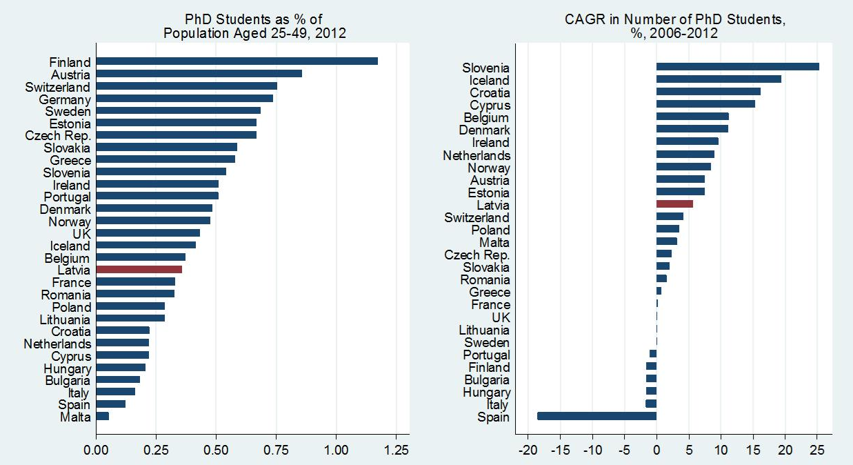
THE WORLD IS CHANGING…
2012: 13th lowest popularity of PhD studies in Europe
2006-12: 12th fastest annual growth in number of PhD students

Slide 4
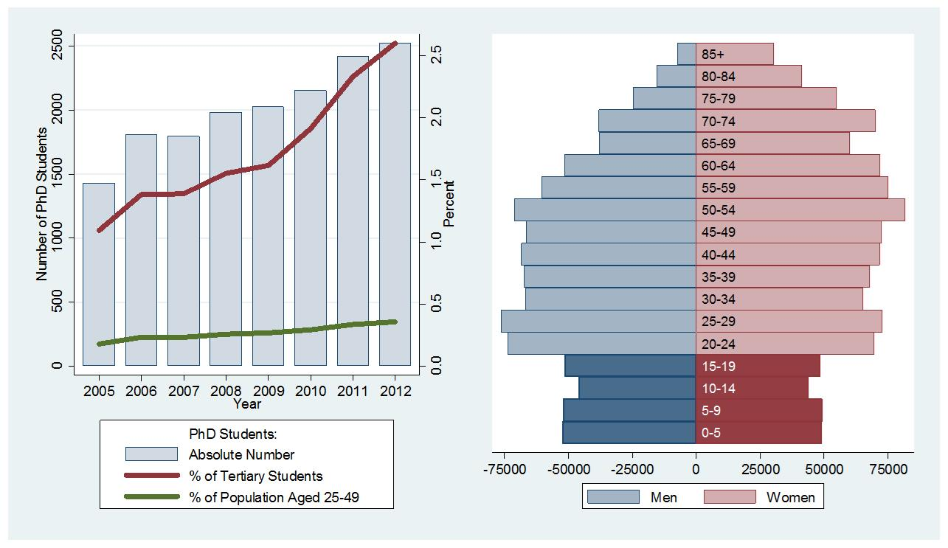
…EVEN IN LATVIA
2005-2012: number of students ↑77%, exceeded 2,500
Share of PhD students from all tertiary students ↑2.5 times
Demographic trough coming → tough competition in < 5 years

Slide 5
WHAT’S GOOD IN A PHD?
Driver of competitiveness
Key in EU innovation strategy
Necessary component of “Europe of Knowledge”
Major role in creating highly trained labour force
Produces professionals competent in extremely complex, knowledge-intensive environments
Key to economic success

Slide 6
WHY TO GO FOR PHD?
Thirst for knowledge
Higher-paid and more satisfying jobs
Successful careers
Prestige marker

Slide 7
PURPOSE
Analyse the motivation of graduates in Latvia to continue studies at doctoral level
Compare it across fields of study
Technical and related to natural science
IT, mechanics, biology, chemistry, physics, …
Non-technical fields
Economics, management, law, political science, …

Slide 8
WHERE TO STUDY FOR PHD?
Choose one of 21 HEIs in Latvia
More than 20 different fields of study
Management – the most widely available field
Exclusively provided fields
Choose one of foreign HEIs

Slide 9
FINANCING PHD STUDIES
State-funded places
Quite few
State scholarship possible ( €115 per month)
European Social Fund scholarship
Year 1 & 2 students: 1.5 x avg. wage
Year 3 students / candidates: 2.5 x avg. wage
Quite few
Tough competition
Grants by private companies
Scarce
Full tuition fees ( €1,700 – €9,100 per year, 3-4 years)

Slide 10
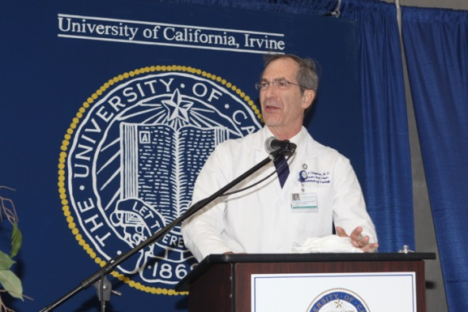
MARKETING PHD STUDIES
Internal marketing
Sources of information
University’s website
Contact person of the study programme
Potential doctoral thesis supervisor

Slide 11
Methodology

Slide 12
METHODOLOGY
Survey method: online survey
Distributed in: 14 largest uni’s in Latvia
Questionnaire: 33 questions
Current PhD studies
Goals respondents pursued
Factors affecting the choice of university
Previous studies
Last job and household income
Basic background (sex, age, family status)
Question types: closed & open-ended

Slide 13
Results & Analysis

Slide 14
BASIC INFO ABOUT SAMPLE
Number of responses
Overall 306
Fully completed 207
Study abroad 11
Composition by status
PhD students 78%
PhD candidates 22%

Slide 15
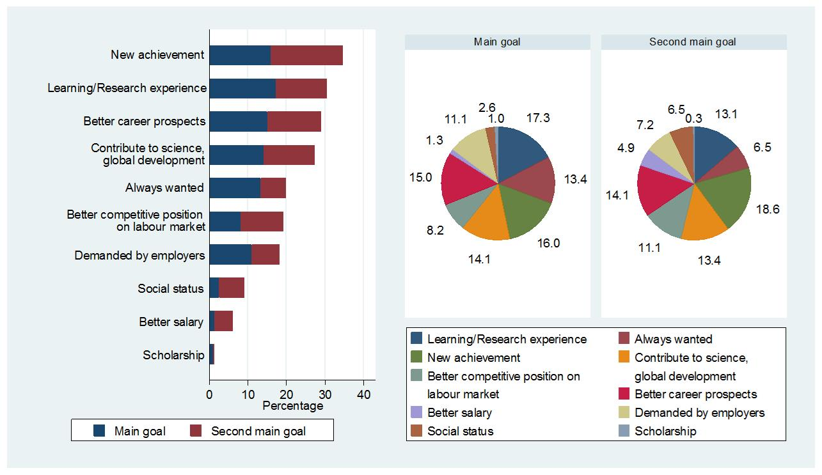
GOALS PURSUED WHEN GOING FOR PHD STUDIES
Most important goals: new achievement, learning/research experience, career, and contribution to science & global dev.

Slide 16
GROUPS OF GOALS
Experience
PERSONAL
Desire
Contribution
Status
Achievement
Competition
Career
Employers
Scholarship
LABOUR MARKET
Salary

Slide 17
OPEN-ENDED QUESTIONS ON GOALS
“Please provide a short description of an occurrence, observation etc. that made you believe that a PhD degree would help you in achieving your main goal”

Slide 18
COMMENTS ON LABOUR-MARKET GOALS
Work/desire to work where PhD is really required
Observation of success of a PhD graduate
Frequently invited as expert / Prestigious job
Not being fired when everyone else is
Desire to differentiate on labour market
High concentration of bachelors and masters
Desire for more weight of own opinion
PhD graduate has deeper knowledge on problems and knows how to solve them

Slide 19
COMMENTS ON PERSONAL GOALS
Family tradition
PhD studies open students to new social networks, knowledge, skills, experience
Perceived as possibility for new achievements
Positive “back to school” emotions
Desire to contribute to understudied areas of knowledge
Hobby, alternative to boredom in work/family life
Desire for recognition
Gold medal of education
Entrance ticket to the elite, the best, those having maximum available knowledge in the given field
A PhD is not just a way to be more respected. It is a way to be respected for a very good reason.

Slide 20
TYPES OF GOALS
SECOND MAIN GOAL
PERSONAL
LABOUR MARKET
MAIN
GOAL
PERSONAL
Mostly Personal
Primarily Personal
LABOUR MARKET
Primarily Labour Market
Mostly Labour Market

Slide 21
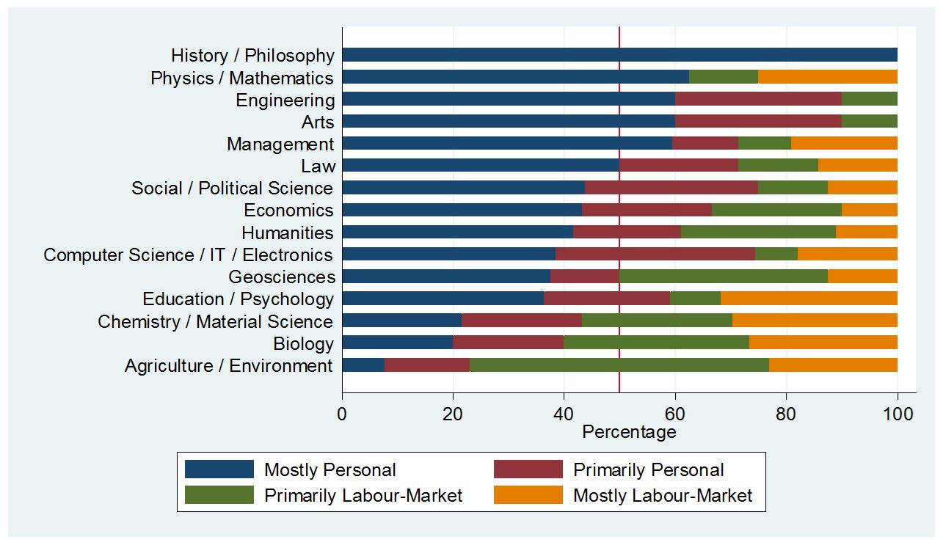
GOALS PURSUED WHEN GOING FOR PHD STUDIES
>60% have a personal goal as main goal (exc.: agric./bio/chem./geo)
This holds for both non-technical and technical fields
Mostly labour-market goals more popular in technical fields

Slide 22
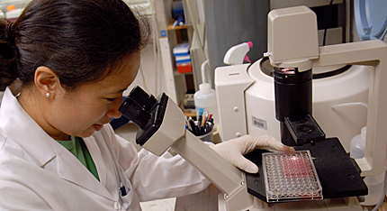
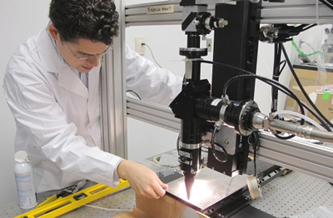
ECONOMETRIC ANALYSIS
Three groups of fields of study
Group 1—base group
Arts & humanities
Economics
Education & psychology
Group 2—stronger oriented at labour-market goals
Biology, agriculture, environment & geoscience
Physics, maths & chemistry
Law, social & political science
Management
Group 3—pursue primarily personal goals but keep a labour-market goal as a second-order goal
Computing & engineering

Slide 23
ECONOMETRIC ANALYSIS
Changing the field of study
Twice → pursue mostly personal goals
Labour-market experience shapes motivation
Started studies after 30 → pursue labour-market goals
Non-teaching professionals more likely to pursue mostly personal goals than managers
Family affects motivation
Family influenced decision / Married woman / Long desire → pursue mostly personal goals

Slide 24
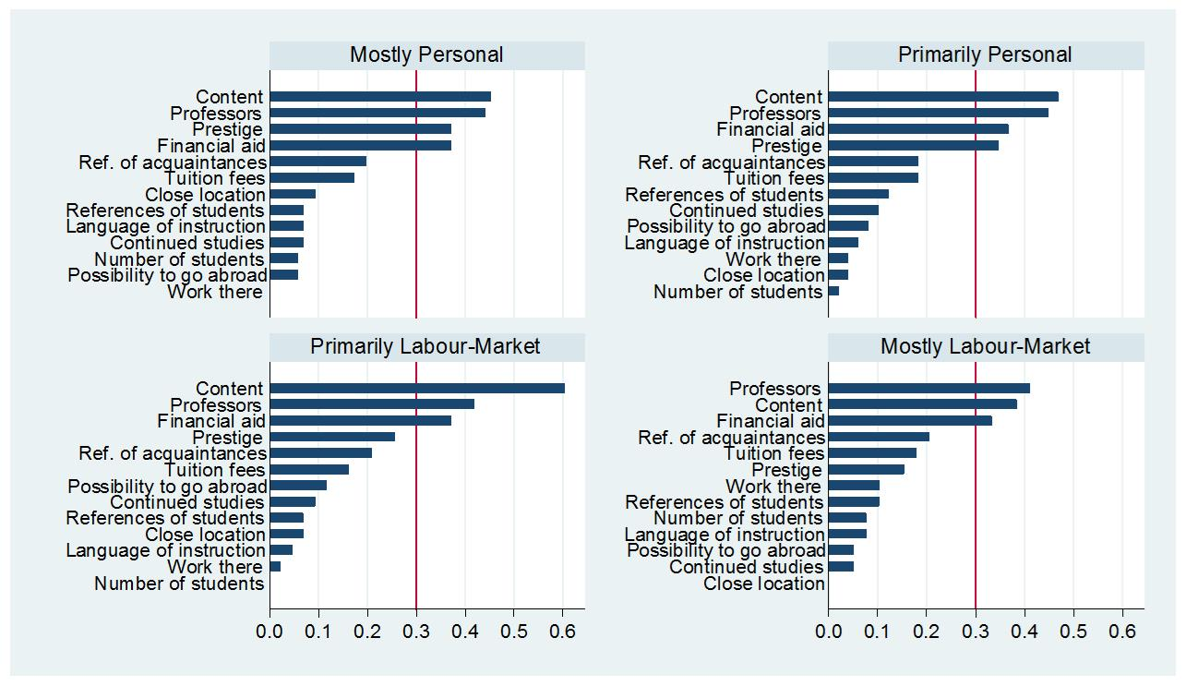
CHOOSING THE UNIVERSITY FOR PHD STUDIES
Irrespective of goal type, choice is based on content, quality of academic staff, and financial aid
Prestige is in Top 4 if pursue mostly/primarily personal goals

Slide 25
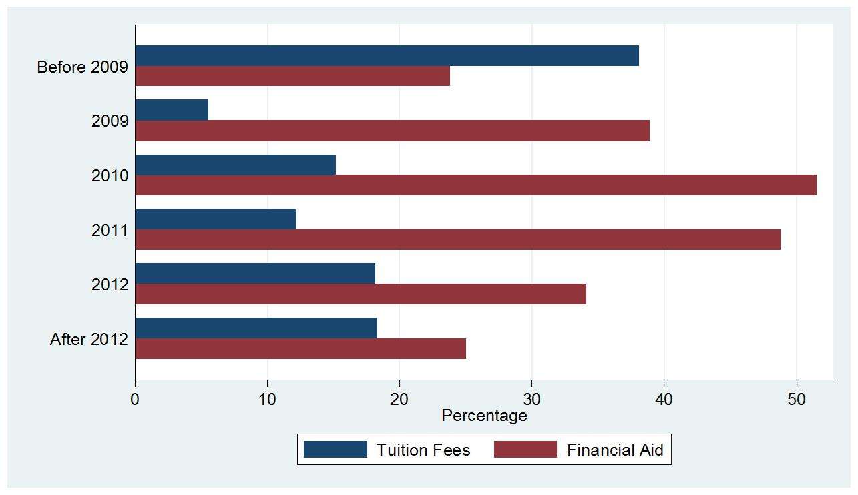
IS AID REALLY MORE IMPORTANT THAN FEES?
ESF scholarships available for first-year students → financial aid becomes >> important than tuition fees

Slide 26
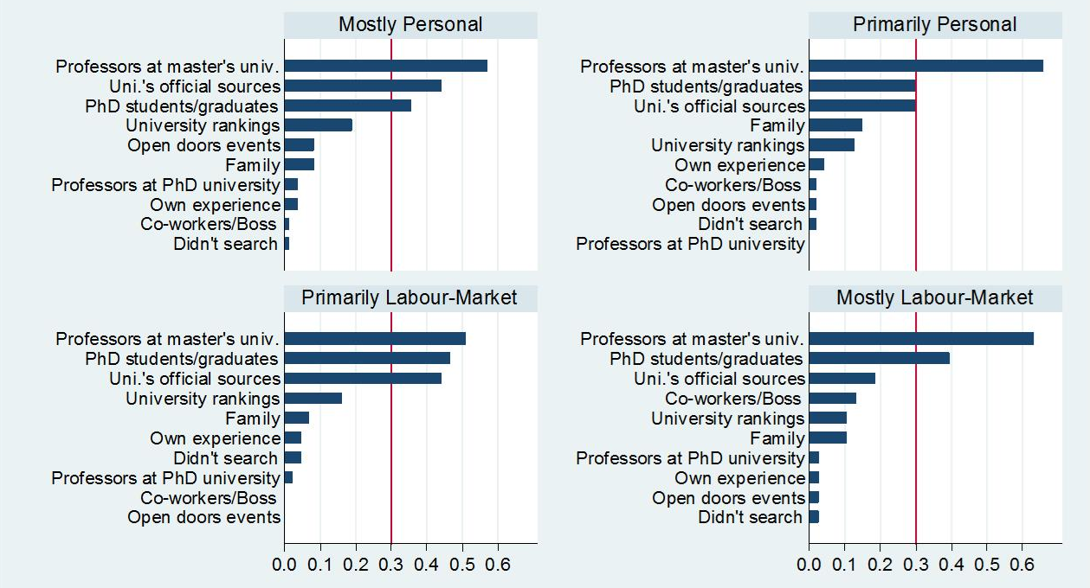
USEFUL INFORMATION SOURCES ON PHD STUDIES
Most important: professors at master’s uni, PhD students & graduates at target uni, target uni’s official info sources
Co-workers’/Boss’s opinion if pursuing mostly labour-market goals

Slide 27
Conclusions

Slide 28
WHY TO GO FOR A PHD?
Most important goals
Achieving something new
Continuing learning/research experience
Better career prospects
Contributing to science & global development
Three groups of fields of study – different types of goals
Changing field of study twice – pursue mostly personal goals
Older respondents – labour-market goals
Family-influenced and married women – personal goals

Slide 29
WHERE TO GO FOR A PHD?
Most important reasons of choosing university
Content of programme
Reputation of professors
Financial aid
Prestige – if pursue personal goals
Most important sources of information
Professors at master’s university
Target university’s students & graduates
University’s official online sources
Co-workers/Boss – if pursue labour-market goals

